Slide 1

Winning at Losing:
A Guide to Successful Weight Management

Slide 2
Outline
Background
Complications of excess weight
What causes weight gain?
Why is weight loss so challenging?
What lifestyle changes can help?

Slide 3

Obesity Trends* Among U.S. Adults BRFSS, 1990
(*BMI ≥30, or ~ 30 lbs. overweight for 5’ 4” person)
No Data <10% 10%–14%
Notes:
Note to presenter: after explaining what this slide shows, move quickly through slides 3-23 to show obesity trend over time.
Prevalence of obesity by state and year. In 1970s, prevalence of obesity was ~14%. (NHANES data)

Slide 4
Obesity Trends* Among U.S. Adults BRFSS, 1991
(*BMI ≥30, or ~ 30 lbs. overweight for 5’ 4” person)
No Data <10% 10%–14% 15%–19%

Slide 5
Obesity Trends* Among U.S. Adults BRFSS, 1992
(*BMI ≥30, or ~ 30 lbs. overweight for 5’ 4” person)
No Data <10% 10%–14% 15%–19%

Slide 6
Obesity Trends* Among U.S. Adults BRFSS, 1993
(*BMI ≥30, or ~ 30 lbs. overweight for 5’ 4” person)
No Data <10% 10%–14% 15%–19%

Slide 7
Obesity Trends* Among U.S. Adults BRFSS, 1994
(*BMI ≥30, or ~ 30 lbs. overweight for 5’ 4” person)
No Data <10% 10%–14% 15%–19%

Slide 8
Obesity Trends* Among U.S. Adults BRFSS, 1995
(*BMI ≥30, or ~ 30 lbs. overweight for 5’ 4” person)
No Data <10% 10%–14% 15%–19%

Slide 9
Obesity Trends* Among U.S. Adults BRFSS, 1996
(*BMI ≥30, or ~ 30 lbs. overweight for 5’ 4” person)
No Data <10% 10%–14% 15%–19%

Slide 10
Obesity Trends* Among U.S. Adults BRFSS, 1997
(*BMI ≥30, or ~ 30 lbs. overweight for 5’ 4” person)
No Data <10% 10%–14% 15%–19% ≥20%

Slide 11
Obesity Trends* Among U.S. Adults BRFSS, 1998
(*BMI ≥30, or ~ 30 lbs. overweight for 5’ 4” person)
No Data <10% 10%–14% 15%–19% ≥20%

Slide 12
Obesity Trends* Among U.S. Adults BRFSS, 1999
(*BMI ≥30, or ~ 30 lbs. overweight for 5’ 4” person)
No Data <10% 10%–14% 15%–19% ≥20%

Slide 13
Obesity Trends* Among U.S. Adults BRFSS, 2000
(*BMI ≥30, or ~ 30 lbs. overweight for 5’ 4” person)
No Data <10% 10%–14% 15%–19% ≥20%

Slide 14
Obesity Trends* Among U.S. Adults BRFSS, 2001
(*BMI ≥30, or ~ 30 lbs. overweight for 5’ 4” person)
No Data <10% 10%–14% 15%–19% 20%–24% ≥25%

Slide 15
Obesity Trends* Among U.S. Adults BRFSS, 2002
(*BMI ≥30, or ~ 30 lbs. overweight for 5’ 4” person)
No Data <10% 10%–14% 15%–19% 20%–24% ≥25%

Slide 16
Obesity Trends* Among U.S. Adults BRFSS, 2003
(*BMI ≥30, or ~ 30 lbs. overweight for 5’ 4” person)
No Data <10% 10%–14% 15%–19% 20%–24% ≥25%

Slide 17
Obesity Trends* Among U.S. Adults BRFSS, 2004
(*BMI ≥30, or ~ 30 lbs. overweight for 5’ 4” person)
No Data <10% 10%–14% 15%–19% 20%–24% ≥25%

Slide 18
Obesity Trends* Among U.S. Adults BRFSS, 2005
(*BMI ≥30, or ~ 30 lbs. overweight for 5’ 4” person)
No Data <10% 10%–14% 15%–19% 20%–24% 25%–29% ≥30%

Slide 19
Obesity Trends* Among U.S. Adults BRFSS, 2006
(*BMI ≥30, or ~ 30 lbs. overweight for 5’ 4” person)
No Data <10% 10%–14% 15%–19% 20%–24% 25%–29% ≥30%

Slide 20
Obesity Trends* Among U.S. Adults BRFSS, 2007
(*BMI ≥30, or ~ 30 lbs. overweight for 5’ 4” person)
No Data <10% 10%–14% 15%–19% 20%–24% 25%–29% ≥30%

Slide 21
Obesity Trends* Among U.S. Adults BRFSS, 2008
(*BMI ≥30, or ~ 30 lbs. overweight for 5’ 4” person)
No Data <10% 10%–14% 15%–19% 20%–24% 25%–29% ≥30%

Slide 22
Obesity Trends* Among U.S. Adults BRFSS, 2009
(*BMI ≥30, or ~ 30 lbs. overweight for 5’ 4” person)
No Data <10% 10%–14% 15%–19% 20%–24% 25%–29% ≥30%

Slide 23
Obesity Trends* Among U.S. Adults BRFSS, 2010
(*BMI ≥30, or ~ 30 lbs. overweight for 5’ 4” person)
No Data <10% 10%–14% 15%–19% 20%–24% 25%–29% ≥30%
Notes:
1/3 of American adults and 17% of children and teenagers are obese.

Slide 24
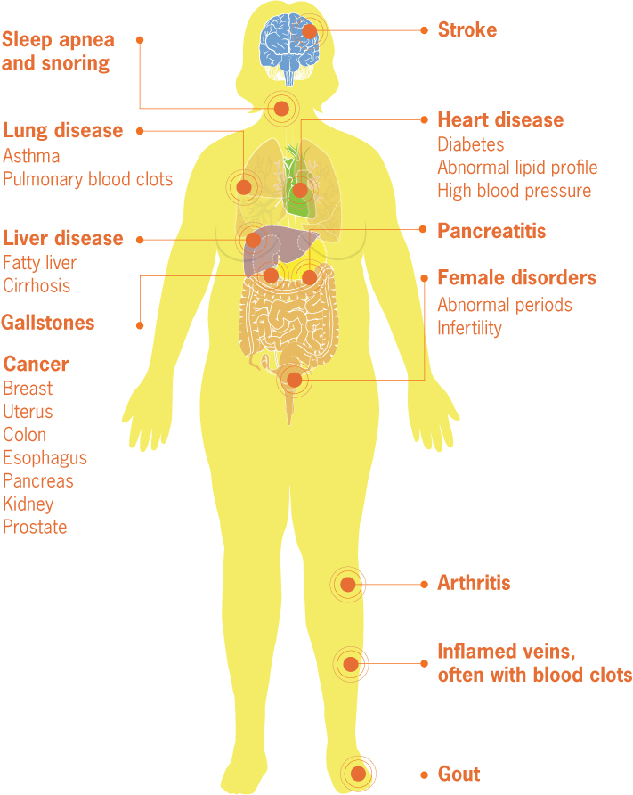
Complications of Excess Weight
Source: Adapted from Yale University Rudd Center for Food Policy and Obesity

Slide 25

What Causes Weight Gain?
Energy Balance = Energy Intake – Energy Expenditure
Notes:
At its most simplistic, when we eat more calories than we burn, we gain weight.

Slide 26

Why Do We Eat?
Notes:
Draw a circle on a board. Ask participants to give reasons why we eat. Write the answers on the board, with internal factors inside the circle and external factors outside the circle.
Internal Factors: Hunger* (stomach hunger), Cravings (mind or mouth hunger), Emotional triggers, Habits, Thoughts, beliefs, and self-talk
*Hunger is influenced by hormones (some made in the stomach & intestines), which are in turn influenced by time since the last meal, current weight (whether we’ve lost weight), how much sleep we get, meal composition
External Factors: People, Places, Events, Time cues, Sensory stimuli (like smells and visual cues like plate size, variety of food…)

Slide 27
Why Do We Eat?
Internal Factors
Notes:
Draw a circle on a board. Ask participants to give reasons why we eat. Write the answers on the board, with internal factors inside the circle and external factors outside the circle.
Internal Factors: Hunger* (stomach hunger), Cravings (mind or mouth hunger), Emotional triggers, Habits, Thoughts, beliefs, and self-talk
*Hunger is influenced by hormones (some made in the stomach & intestines), which are in turn influenced by time since the last meal, current weight (whether we’ve lost weight), how much sleep we get, meal composition
External Factors: People, Places, Events, Time cues, Sensory stimuli (like smells and visual cues like plate size, variety of food…)

Slide 28
Why Do We Eat?
Internal Factors
External Factors
Notes:
Draw a circle on a board. Ask participants to give reasons why we eat. Write the answers on the board, with internal factors inside the circle and external factors outside the circle.
Internal Factors: Hunger* (stomach hunger), Cravings (mind or mouth hunger), Emotional triggers, Habits, Thoughts, beliefs, and self-talk
*Hunger is influenced by hormones (some made in the stomach & intestines), which are in turn influenced by time since the last meal, current weight (whether we’ve lost weight), how much sleep we get, meal composition
External Factors: People, Places, Events, Time cues, Sensory stimuli (like smells and visual cues like plate size, variety of food…)

Slide 29
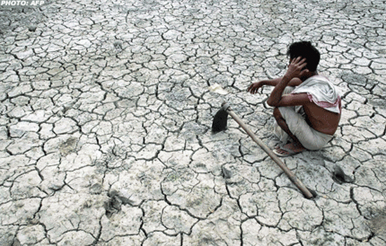
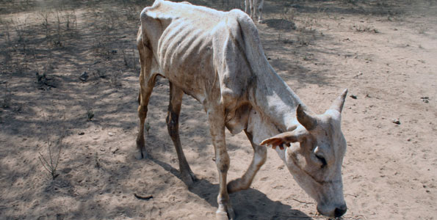
Evolution and Weight Control
Our weight control systems:
evolved to protect us against starvation
defend against weight loss by:
increasing hunger hormones
decreasing fullness hormones
reducing metabolism (calories burned)
permit weight gain
Notes:
To understand why we are gaining weight, we must understand the conditions in which we evolved. Up until recently, famine was a major environmental pressure on humans. As a result, our hypothalamus’ main weight management goal is to protect us from starvation and weight loss. Therefore, the defenses against weight loss are much stronger than those against weight gain. What this means is that the set point weight (the weight guarded by the hypothalamus) can be reset upwards over time (but not downwards).
That was fine 2000 years ago, when we all lived in this kind of environment, but it doesn’t work out so well when so many of us now live in a different kind of environment…

Slide 30
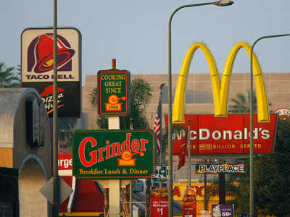
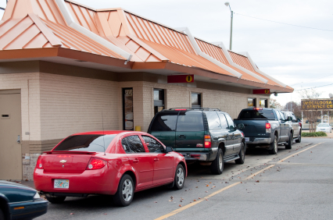
Why Are Americans Gaining Weight?
Then &
Now
Notes:
Change in Environment. Left – drought in India. Right – fast food restaurants in south LA. We’ll talk more about how the hypothalamus’s protection against starvation works against us when we talk about weight loss in a few minutes.

Slide 31

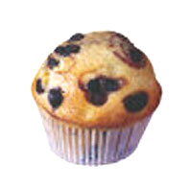
Change in Diet: Larger Portions
Then &
Now
210 calories
500 calories
Notes:
Blueberry muffin; 8 oz vs 16 oz coffee with whole milk; turkey sandwich; chicken caesar salad

Slide 32


Change in Diet: Larger Portions
Then &
Now
45 calories
350 calories

Slide 33
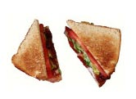
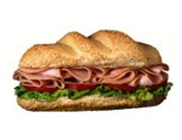
Change in Diet: Larger Portions
Then &
Now
320 calories
820 calories
Notes:
Blueberry muffin; 8 oz vs 16 oz coffee with whole milk; turkey sandwich; chicken caesar salad

Slide 34
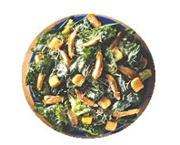
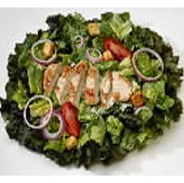
Change in Diet: Larger Portions
Then &
Now
390 calories
790 calories
Notes:
Blueberry muffin; 8 oz vs 16 oz coffee with whole milk; turkey sandwich; chicken caesar salad

Slide 35
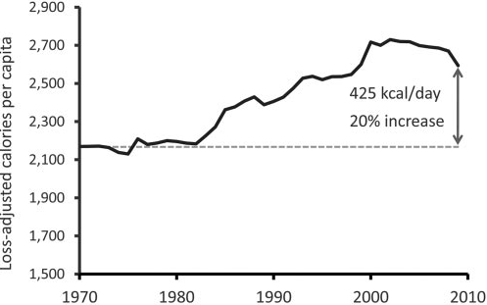
Why Are Americans Gaining Weight?
Energy intake has increased by ~ 20% since 1980.
Guyenet SJ and Schwartz MW, J Clin Endo Metab 2012.
Notes:
Per capita energy intake in the U.S. (USDA food disappearance data).

Slide 36


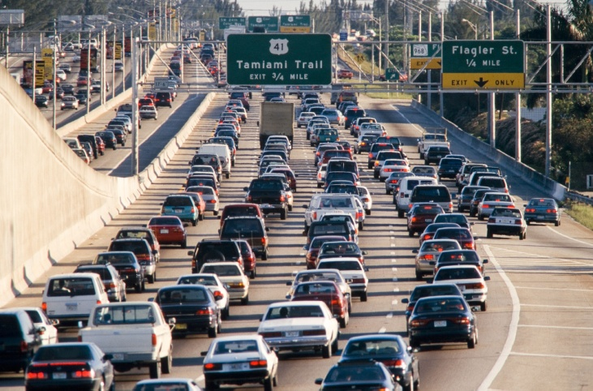
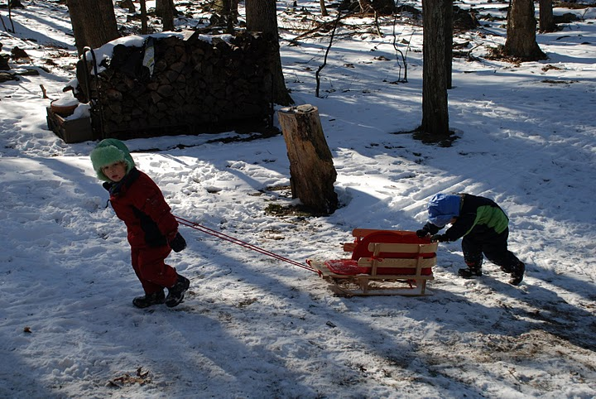
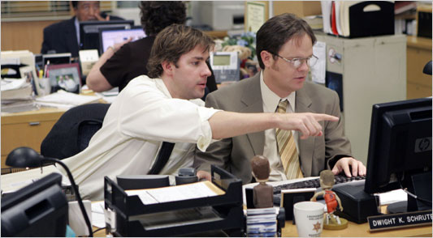
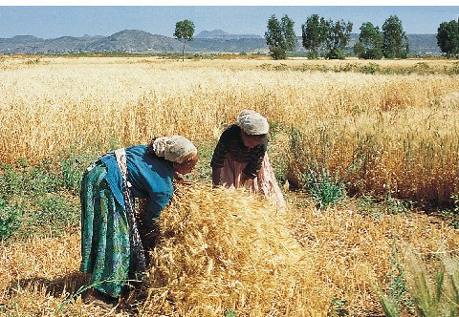
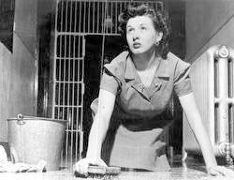
Change in Physical Activity
Then &
Now
Notes:
We used to be physically active all day, getting around, at work and at home, and at play. Now we sit in our cars and our offices and look at screens.

Slide 37
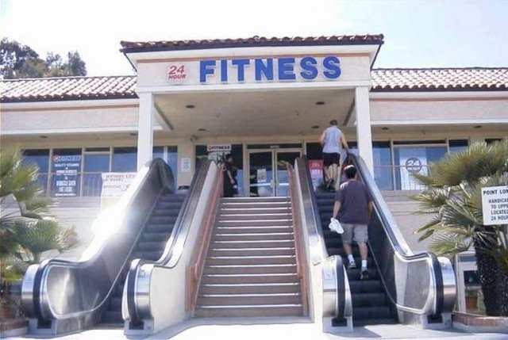
Notes:
Only in America.

Slide 38
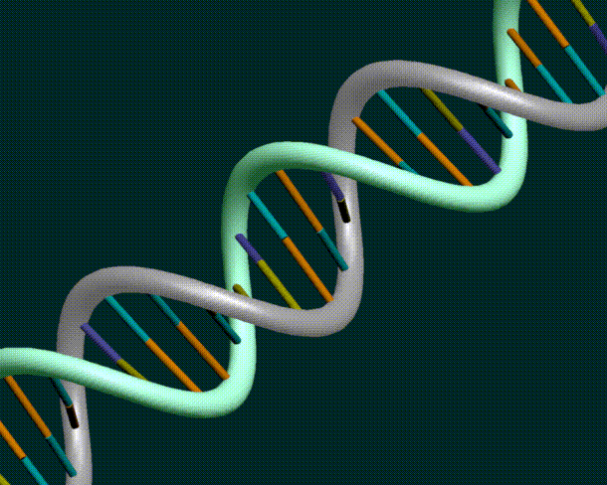
What About Our Genes?
40–70% of variation in weight is explained by genetic factors
Notes:
Although we’re all potentially at risk of obesity due to our current environment, there is significant variability in how much weight a person will gain when they consume more calories than they burn. Genes play a role. When we’re at risk for weight gain due to family history, we may need to be more careful to avoid excess calories.

Slide 39

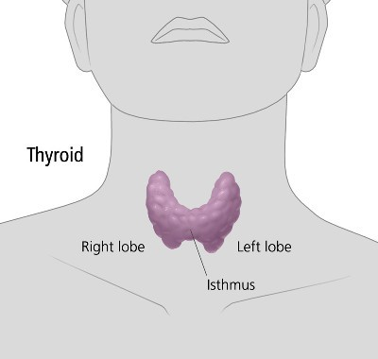
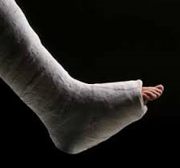


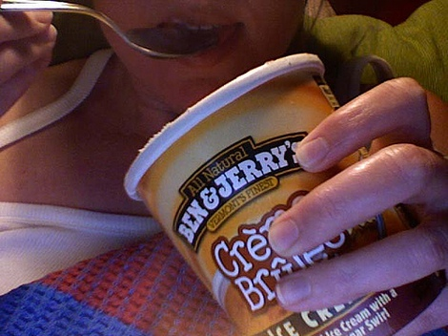


What Else Causes Weight Gain?
Notes:
Lots of other things can influence our weight. Over half of American women gain excessively during pregnancy and then have trouble losing the weight. Many people gain weight when they quit smoking (8-10 lb). Others gain weight because they eat more when they’re under stress. Some have medical issues, injuries, or medications that lead to weight gain. Evidence suggests that sleep deprivation may alter hunger and fullness hormones and promote weight gain. Also, babies whose mothers are overweight during pregnancy appear to be “programmed” to become overweight themselves.

Slide 40
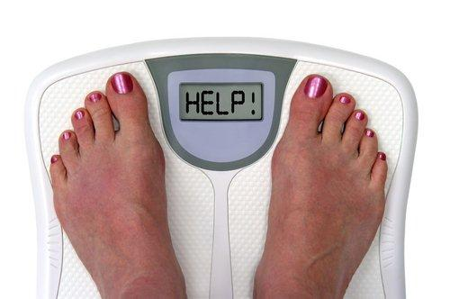
What Can Be Done?

Slide 41
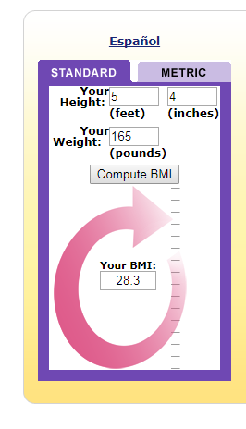
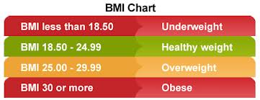
Assess Your Weight
For those over 18, we use BMI or Body Mass Index to assess weight. BMI =(weight in kg) /(height in cm)²

Slide 42
If You’re At a Healthy Weight
Prevent weight gain by:
Being active for 60 minutes every day
Limiting screen time
Surrounding yourself with healthy foods
Monitoring your weight regularly
Being vigilant during life events associated with weight gain:
College, grad school
Injuries that reduce activity
Pregnancy
Losses, depression
Sedentary or stressful jobs
Marriage
Notes:
Presenter: this is an optional slide, depending on your group

Slide 43
If You’ve Had Weight Gain: Graph It!
Mother’s illness and death
Notes:
Encourage participants to graph their own weight gain – can help identify their own triggers and targets for intervention.

Slide 44
If Your BMI is 25 or Higher, Modest Weight Loss Can Help
Typical weight loss with diet and exercise is 5-10%, which can:
Reduce risk of diabetes by 58%
Improve blood sugar control (if you already have diabetes)
Improve blood pressure
Improve cholesterol levels
Improve heartburn
Improve fat accumulation in the liver (“fatty liver”)
Reduce knee arthritis symptoms
And more…
Notes:
Reduce snoring

Slide 45
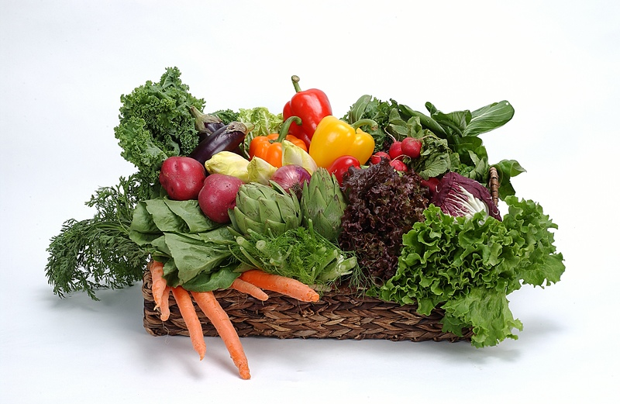
Lifestyle Modification for Weight Loss

Slide 46
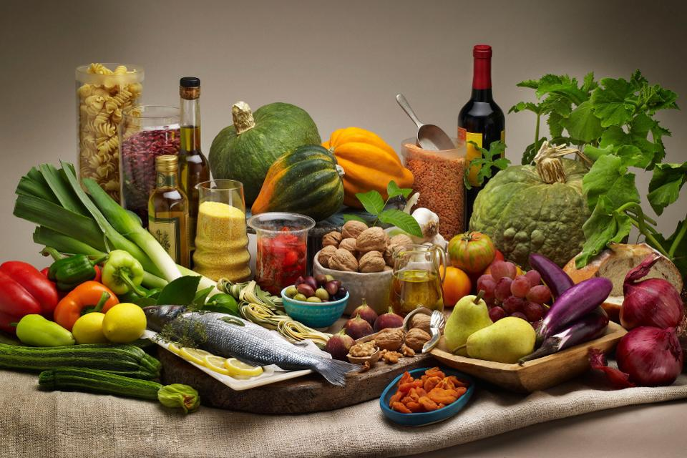
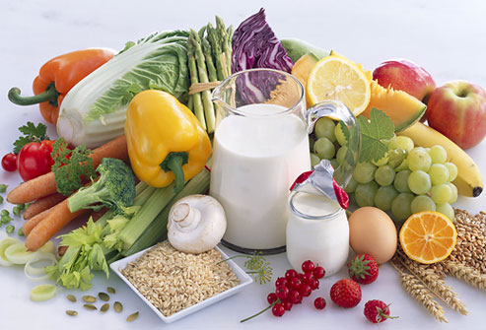

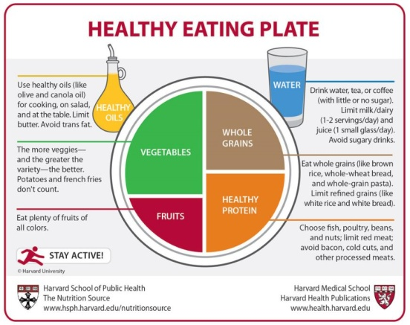
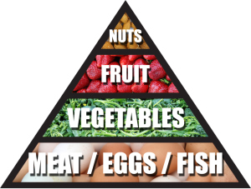
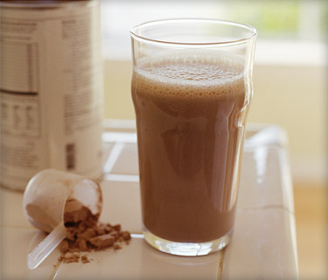
Is There an Optimal Weight Loss Diet?
Notes:
Presenter – the answer to the question is NO - There does not appear to be much difference among weight loss diets in terms of WEIGHT LOSS outcomes.

Slide 47
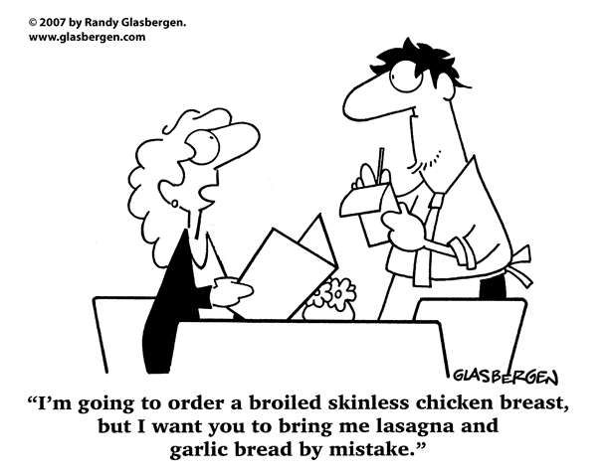
Studies show that the most important factor in determining weight loss on any dietary plan is:
ADHERENCE
Notes:
Presenter: for weight loss, the dietary pattern doesn’t seem to be important. Adherence is important.

Slide 48
Is There an Optimal Diet for Health?
Mediterranean Diet
DASH Diet
Notes:
Presenter: “Although any dietary pattern can produce weight loss, these two dietary patterns have been proven to be particularly good for health.” Briefly describe them (see below). Ask “how are the two dietary patterns alike?” answer – both are rich in fruit and vegetables and have limited red meat.
The DASH diet eating plan is a diet rich in fruits, vegetables, low fat or nonfat dairy. It also includes mostly whole grains; fish and poultry; nuts and beans. Red meat is limited.
The Mediterranean diet emphasizes fruits, veggies, whole grains, beans, nuts, legumes, and olive oil; fish and seafood at least a couple of times a week; and poultry, eggs, cheese and yogurt in moderation. Sweets and red meat are limited.

Slide 49
General Guidelines for a Healthy Weight-Loss Diet
Don’t drink your calories. Limit juice, smoothies, lattes, and sodas.
Don’t skip meals. Eat every 4-6 hours while awake. Eat 3 small meals and 0-2 snacks daily.
Don’t eat snacks out of a box or bag – put one serving on a plate.
Eat at least one serving of fruit and/or vegetables at each meal.
Choose whole-grain breads, cereals and pasta rather than more refined and processed foods.

Slide 50
General Guidelines for a Healthy Weight-Loss Diet
Have some protein at each meal. Choose leaner protein sources, such as fish, skinless chicken, beans, low-fat dairy products, soy products and leaner cuts of meat.
Eat out less.
Keep portions small.
Measure portions whenever possible.
Choose a dietary pattern that is maintainable long-term.
Notes:
Protein combined with fiber (eg from vegetables, fruits or whole grains) can increase satiety more than just protein alone.

Slide 51
The Plate Method

Slide 52
What About Exercise?
By itself, exercise is not very effective for weight loss.
BUT: Adding exercise to a reduced-calorie diet can improve weight loss a little.
AND: Exercisers maintain their weight loss over time better than sedentary people.

Slide 53


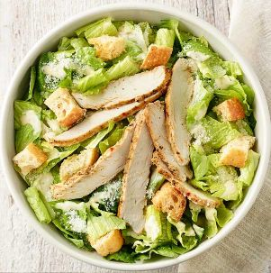
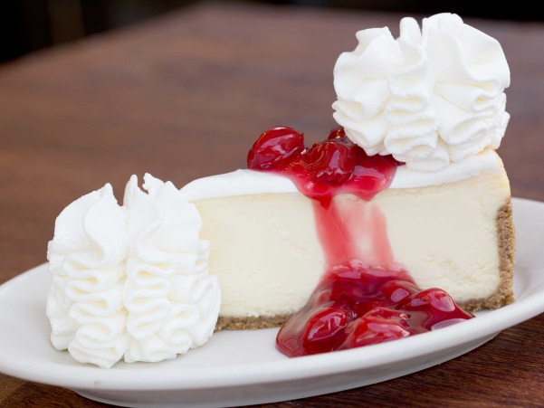
How Long It Could Take to Walk Off:
93 calories
23 minutes
340 calories
85 minutes
450 calories
112 minutes
1040 calories
260 minutes
Based on the estimated energy expenditure for someone who weighs 180 lbs
Notes:
Medium apple; medium fries from McDonalds, Panera chicken Caesar salad, Cheesecake factory cherry cheesecake slice

Slide 54
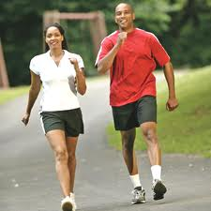
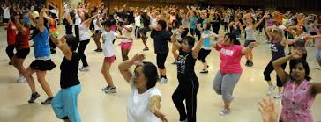
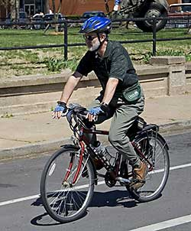

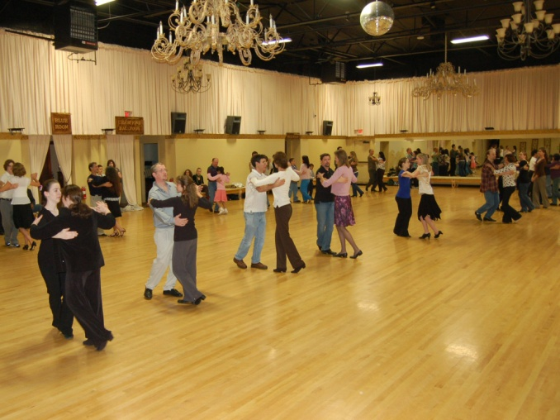
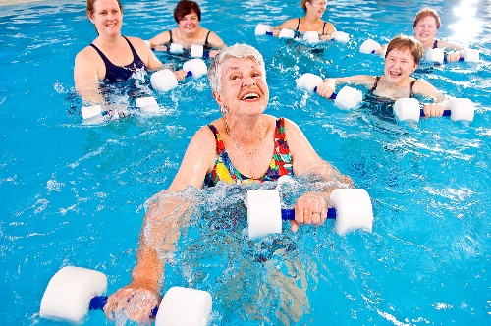
What Kinds of Exercise are Best?
The best exercise is the one you’ll do!
Notes:
The best exercise is the one you’ll do. If you like dancing, go dancing. If group classes motivate you, try water aerobics or a Zumba class. If you like walking, get a walking buddy.

Slide 55


What Kinds of Exercise are Best?
Wear a pedometer or activity monitor to keep track of your physical activity.
The ultimate goal is at least 10,000 steps/day.
Take long cuts. Take the stairs, walk at lunch, get off the bus a stop early, walk to the store or park farther away from the store, exercise during commercials, etc.
Notes:
If you don’t love exercise, try to increase your steps through walking and everyday movement. This is a strategy called “long cuts.”

Slide 56
Other Things To Do
Keep a food diary (eg MyFitnessPal or LoseIt).
Plan your meals:
Try pre-tracking your meals one day in advance.
Make a grocery list.
Stock up on healthy foods and get rid of the foods you want to avoid.
Plan your exercise, and put it on your calendar.
Notes:
Pre-tracking = log your intended meals and snacks in Myfitnesspal or on a paper food diary, then try to stick to the plan.

Slide 57
Other Things To Do
Weigh yourself at least once a week.
Get enough sleep.
If you are an emotional eater:
Identify your triggers
Write out an action plan that helps you de-stress without food. You might call a friend, go for a walk, knit or take a bath. Post the action plan in your kitchen or carry it with you.

Slide 58
Summary
2/3 of American adults are overweight or obese.
Prevention of weight gain is an important strategy to improve future health.
Lifestyle changes can help people lose 5-10% of initial weight.
Even small weight losses can be very powerful in improving health.
The best diet and exercise regimens are the ones you can see yourself doing in 5 or 10 years.
Weight loss takes planning and persistence, but it’s worth the effort!

