Slide 1

State of
Anastassios G. Pittas, MD, MS
On behalf of the Research Group
Notes:
Look at saved emails

Slide 2
Data as of June 30, 2017 | mean follow-up 23.1 months

Slide 3
How is doing?

Slide 4

Notes:
Starting with Recruitment

Slide 5
Cumulative randomization
N=2423
102% of goal
Notes:
…. The next slide – No X – the final randomization number, which is 2,423, which is 2% above the goal….

Slide 6
Recruitment via Electronic Health Records
More like this
Not really…

Slide 7
“I am glad I am joining after the study has been going on for 2 years. Most studies never get this far”
– D2d participant at the Tufts site

Slide 8
Study Conduct
Patty
Paul
Olivia
Cindy
Danielle
Ellen
DSMB
Myrlene
Saul

Slide 9

Retention
Over a mean follow-up of 23.1 months
Off study includes: withdrawn (n=40), deaths (n=3), lost to follow-up (n=1), administrative withdrawals (n=2)
Notes:
In terms of retention, to provide more meaningful information, we show not only that that withdrew consent by any participant who is "off study" for any reason. 1.9% of participants have withdrawn after a mean follow-up of 23.1 months. All participants withdrew due to personal choice, none due to a safety concern. This rate is essentially unhanged from the prior DSBM report.
3.2% of the cohort is termed “inactive,” defined as having missed at least 2 consecutive visits. Even if we assume that these participants eventually withdraw, the overall retention rate remains excellent at about 95%.
How does that compare to other recent D trials? –
(Jin et al JAMA 2016): 2-year trial (n=413); completed trial 82.3%; stopped pills 7%
Witham JAMA IM 2013: 1 year (n=159); completed; stopped pills:

Slide 10
D2d site hopping
A fun way for participants to stay in D2d
Maine to Florida (Shared)
Baltimore to Tufts, to Denver (Transfer)
Tufts to Atlanta (Transfer)
Northwestern to Baylor (Transfer)
Notes:
Kept calling, writing letter, I wrote hand-written letter, etc. Finally, he called …
Denver is rapidly expanding just like the rest of Denver.
> This participant was the only inactive participant at Tufts, so he was making our stats look bad…A good trick to improve your metrics, send part to Denver.

Slide 11
Adherence to study pills, overall
Includes 1.9% of cohort that is “off study”
Notes:
In terms of adherence, ~6.4% are off study medication. Please note that this number includes about 2% of participants who are ”off study.”
NOTE TO SELF: the default in the analyses is that participants are ”on study pills.” That includes inactive participants who may or may not be taking the pills.

Slide 12
Out-of-study use of vitamin D, IU/day
2.5% (n=60) of all D2d participants vs. 35% US population
Maximum allowed (1000 IU/day)
Notes:
While participants should be taking the study pill, they should not be taking exogenous D
Next slide, shows mean Out-of-study vitamin D intake, which at ~350 units/day remains well below what D2d allows and has not changed over time.
At each visit, a small fraction of participants has exceeded the maximum allowed. The mean intake for these individuals is ~2,500 IU/day. Overall, 2.5% participants have reported personal vitamin D use higher than 1000 units at any point in the study. This compares very favorably to the general population in the US, where 1/3 of Americans over the age of 60 report vitamin D supplement use over 1000 IU/day or more (JAMA 2017)
Intake of supplements in D2d, compare with JAMA letter

Slide 13
Baseline Characteristics
Patty
Notes:
Moving on to Study conduct and baseline characteristics ..

Slide 14
Age, Gender, Race, Ethnicity
Age, mean, years | 59
Female sex, % | 45
Race, %
American-Indian / Alaska Native | 0.5
Asian | 5.4
Native Hawaiian or Other Pacific Islander | 0.2
Black or African American | 25.4
White | 66.7
Other | 1.8
Ethnicity, % Hispanic or Latino | 9.3
Notes:
The next 3 slides show baseline characteristics
-Slide19 shows demographics. ~half of the cohort is women, ~33% non-White, 9% of participants are Hispanics
// Percentages for Non-Whites and Hispanics are a bit lower not because we are recruiting fewer but because the two busiest D2d sites (Kaiser and HP) are recruiting a predominantly white population and sites with predominantly Hispanic populations (Baylor and LA) have been relatively quiet.

Slide 15
Clinical Characteristics [mean]
Body mass index, kg/m² | 32.0
Waist circumference, cm | 105.0
Fasting plasma glucose, mg/dL | 107.9
2h plasma glucose, mg/dL | 137.2
A1c, % | 5.91
Notes:
Slide 20 shows physical measurements and glycemic characteristics. Mean values, including for the glycemic variables, are essentially unchanged.
Another way to look at the glycemic profile is shown in slide 22 -- SKIP NEXT SLIDE.
//Of interest, - CLICK - out-of-study vitamin D intake from supplements is still only about 300 units/day. This low number reflects (1) current controversy in the vitamin D world about the importance of vitamin D supplementation and (2) emphasis of D2d on diabetes prevention, not vitamin D. Importantly, this low intake of vitamin D makes us confident that we will see an appropriate differentiation in blood vitamin D level between the placebo and vitamin D groups, thereby, increasing the likelihood of seeing an effect in the active group.
// We did emphasize to sites recruitment of people that are closer to diabetes but these means are difficult to move. //

Slide 16
At-Risk-For-Diabetes Population at baseline
IA1C
IFG
IA1c, impaired Hemoglobin A1c (5.7 to 6.4%)
1188
315
IFG, impaired fasting glucose (100 to 125 mg/dL)
516
IGT, impaired glucose tolerance (2h glucose 140 to 199 mg/d
IGT
848
NGT, normal glucose tolerance (FGP, A1c, 2hPG all normal)
242
145
35
NGT, 153
Notes:
Glycemic breakdown is in the form of a Venn diagram, which shows the overlap of the 3 glycemic categories, IFG, IGT, IA1c. D2d falls in the dark. People in the lighter areas are those who were excluded because they met 1 criterion only.
The advantages of the D2d population can be summarized as follows:
1. About 1/3 met all 3 criteria.
2. 8 out of 10 met both FPG and A1c criteria
Love to bring back...
// Beyond the underlying hypothesis, D2d is also interesting because it is perhaps the only study of its size that has used the 3 ADA criteria as eligibility criteria and reflects the modern population at risk for diabetes. We think this is interesting given the uncertainty about what to do with pre-diabetes.
Not qualified, still a great population we can tap to study the natural history of pre-diabetes among those with only a single criterion. // IA1c not qualified would be the most interesting category.
------ Let me pause here and see if there any questions or comments from the DSMB members

Slide 17
Safety
Serious Adverse Events (SAE) as expected for population
Few cases of nephrolithiasis and even fewer cases of abnormal labs
Notes:
In summary – shown in slide xx --SAE and kidney stones as expected for the population. Rare cases of abnormal labs.

Slide 18
Diabetes Outcomes
Notes:
Moving on to Safety and Outcomes. The SOS has reviewed all AE and SAE and did not identify any worrisome safety signals.

Slide 19
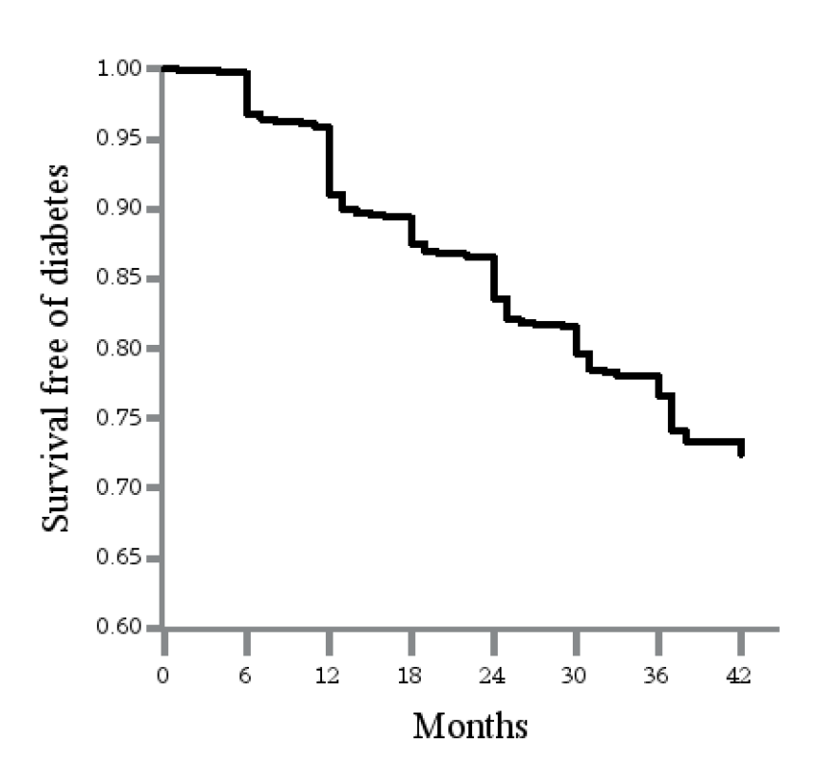
Diabetes-free Survival (Kaplan-Meier curve)
Limited duration of exposure to the intervention prior to development of diabetes
Event rate: 9.2%
Notes:
The figure on the left shows accumulated events over time: the blue line on top shows total events, the red below it, shows events diagnosed by the central laboratory and the green line shows adjudicated events. Please ignore the purple line for now, I will come back to it.
What this figure shows is that as D2d accumulates more events over time, nearly all of them are coming from the central laboratory and we have been able to minimize the occurrence of adjudicated events.
The purple line shows the projection we made about 1 year ago.
The curve on the right shows K-M curve for survival free of diabetes. K-M curves are nice because it shows that something is happening but to me. Although single curves may seem to always look about the same, I would like to point out that there seem to be proportionately more events at M06 and M12 compared to the rest of the visits. This may have implications when interpreting the interim analyses results. Namely, if the interim analyses detect a smaller than expected effect on outcomes, this could be due to limited duration of exposure.
------ Let me pause here and see if there any questions or comments…

Slide 20

What will the future bring for ?
Predicting the future is tricky
Notes:
I don’t know. We will answer the primary question and, despite many challenges we faced, we may do so on time!

Slide 21
Is D2d still important and relevant?
DSMB
Notes:
It’s too late to be asking this…
DSMB and NIDDK think – show photo of committee and NIDDK deliberating
Who am I to argue with the DSMB and the funding agency?

Slide 22
Beyond the primary question
To fully assess the balance of benefits and risks of long-term vitamin D supplementation
Notes:
Beyond the primary outcome, there are additional variables that we are measuring to fully assess...
When designing the study, the planning committee decided to have participants continue the study pill after they met the primary outcome, which allows D2d to test for effect of the intervention on non-diabetes outcomes.

Slide 23
Subgroup & Secondary Analyses
Subgroup
Secondary
25OHD concentration (IOM categories)
Race (White, non-White, Other)
Glycemic risk (2 vs. 3 criteria)
BMI (healthy, overweight, obese)
Ethnicity
Waist circumference
Age
Geographic location
Calcium intake
Change in
  HbA1c, FPG and 2hPG
  Insulin resistance and beta-cell function
  25OHD
  Blood pressure
  Cholesterol profile, CRP, UAE
  ASCVD risk score
  Quality of life (month 24)
OTHER
Genetics (blood for DNA extraction is available)
Notes:
The variables shown in blue are the most relevant and data will be provided in the closed report.
Another area that we have not touched on is genetics. D2d has whole blood saved for DNA extraction and the plan is to conduct genetic analyses in the future.

Slide 24
Establish the long-term safety of the 4000 IU/day of vitamin D
Per 2010 Institute of Medicine (IOM) report, the Tolerable Upper Limit (UL) for vitamin D is 4000 units per day. However, that dose has never been tested in a long-term trial.
D2d is the only one of the large, long-term, ongoing vitamin D trials to test the UL dose.
Safety data on UL will be critical for the IOM and other scientific bodies to confirm/reconsider the UL dose.
Notes:
The first area of interest is to establish...

Slide 25
Assess effect of vitamin D (4000 IU/d) on incident cardiovascular events in people with prediabetes.
Assess effect of vitamin D (4000 IU/d) on incident cancer and pre-cancerous lesions in people with prediabetes
Notes:
D2d also is assessing the effect of ...
We don't think we have the power to detect small effects but we have decided to do this because it is of interest and the incremental burden to sites and the CC is very small.
We met with NCI…

Slide 26
Outcomes Study (D2dOS)?

Slide 27
Examine “legacy” effects of the 4000 IU/day of vitamin D
Whether vitamin D supplementation provided for ~3 years in people at risk for diabetes has enduring benefits that persist beyond the period of the intervention.
Notes:
The first area of interest is to establish...

Slide 29
Closing Statements
Anastassios G. Pittas, MD, MS

Slide 30
D2d publications
Pittas et al. Rationale and Design of the Vitamin D and Type 2 Diabetes (D2d) Study; A Diabetes Prevention Trial. Diabetes Care 2015
Aroda et al. Optimizing use of the electronic health record (EHR) to identify persons at high risk of diabetes in the D2d study. ADA 2016 (poster). Manuscript in preparation
Vogel et al …Facebook as a recruitment tool for clinical trials: The D2d Study experience NIH student conference (poster)
Lewis et al. Management of Hemoglobin Variants Detected Incidentally in HbA1c Testing: A Common Ethical Problem currently Lacking a Standard Approach. Provisionally accepted to Diabetes Care
DeSouza et al. Baseline characteristics that predict pre-diabetes eligibility in the D2d study. In preparation
Brodsky et al. Reclassification of patients with prediabetes upon repeated testing. In preparation

Slide 31


Ups and Downs
Notes:
We knew that recruitment has its ups/down and may often may feel like this, but over the course of D2d, recruitment looks a bit more like this.

Slide 32
The key to D2d life is resilience.
We will always be knocked down
It’s the getting up that counts
Government shutdown
EDC development
Recruitment
Glycemic discrepancy
Metformin use
Retention
Just wait
Change vendors
More sites, EMR
Algorithms
Education
Not a D2d problem
Notes:
Challenges

Slide 33
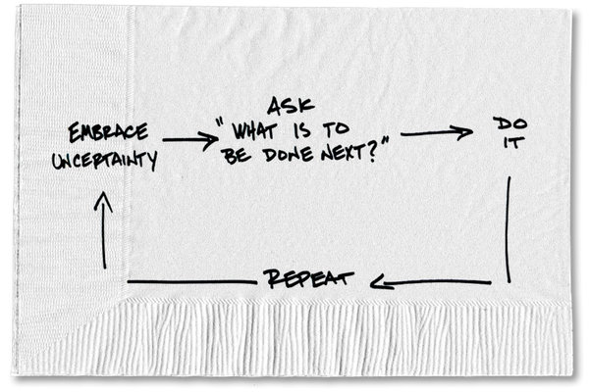
What is the secret to ?

Slide 34
Cc applause everybody else

Slide 35
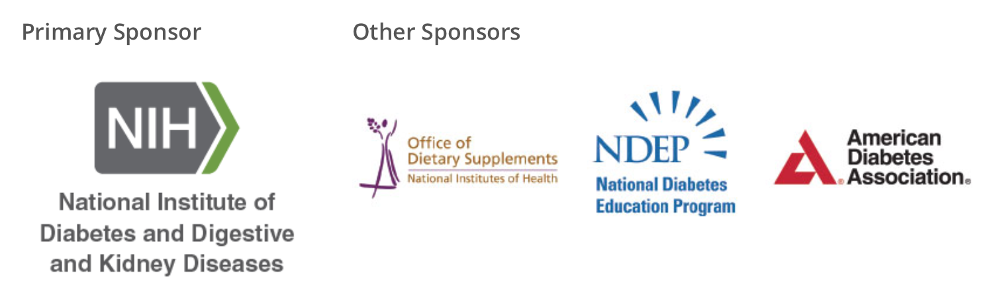

Slide 36

Exec Committee (aka D2d support group)
Taso Pittas, MD MS
Principal Investigator
Co-Investigator
Cliff Rosen, MD
Co-investigator
Bess Dawson-Hughes, MD
Project Manager
Dave Reboussin, PhD
Patty Sheehan, RN, MPH, MS
Lead Statistician
Myrlene Staten, MD
Saul Malozowski, MD
NIDDK Program Official
NIDDK Project Scientist
David Robbins, MD
Co-Investigator

Slide 37




The
Patty Sheehan, RN, MPH, MS
Project Manager
Paul Fuss
Research Associate
Dave Reboussin, PhD
Lead Statistician
Olivia Lovegreen
Research Administrator
Danielle Riggs,
Manager, Research Administrator
Ellen Vickery, MS
Data Manager
Cindy Haviet, MS
Research Assistant
Jason Nelson, MS
Statistician/Analyst
Myrlene Staten, MD
Project Scientist
Saul Malozowski, MD
Program Officer
Notes:
Start with credits.
First, team
DSMB and the new chair, Jill, for graciously agreeing to assume the Chair position.

Slide 38
3.4.3 Randomized by site, % of target
✓
N randomized
✓
✓
✓
✓
✓
✓ Exceeded 100% of goal
Notes:
…Randomizations by site and also as a percent of the site's target. 6 sites exceeded their target and these sites continued to recruit to make up for underperforming sites, ..
// As an example of the dynamic and appropriate way we are managing the budget, funds are diverted from underperforming sites (shown by an asterisk) to well performing sites. //

Slide 39
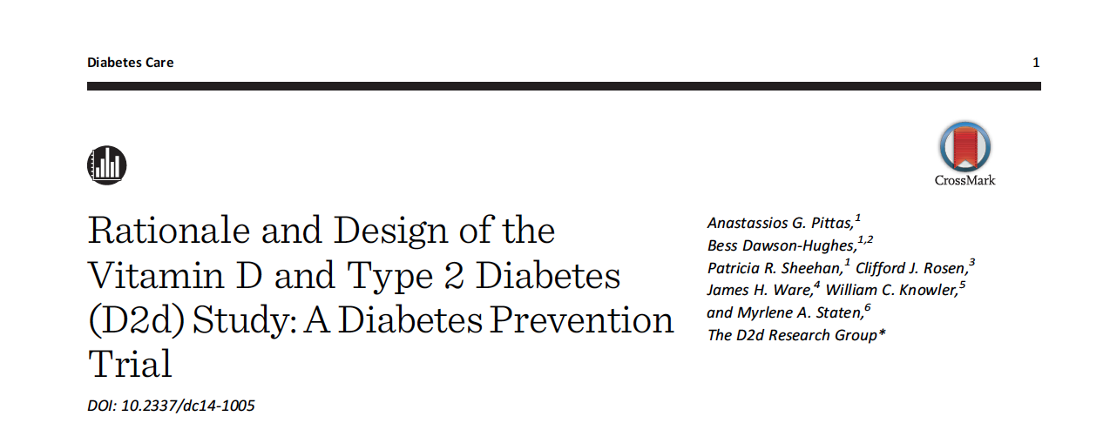
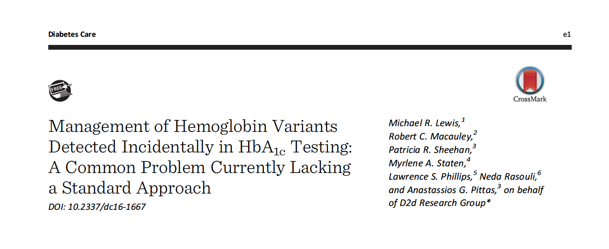
D2d publications
published
Submitted or in preparation
Devchand et al. Assessment of a National Diabetes Education Program (NDEP) diabetes prevention toolkit: the Vitamin D and type 2 diabetes (D2d) study experience (under review).
Lovegreen et al. Management of NIH research budget in the modern fiscal environment (under review).
Aroda et al. Optimizing use of the electronic health record (EHR) to identify persons at high risk of diabetes in the D2d study (in preparation)
Chadha et al. Reproducibility of prediabetes classification upon repeat testing. ADA 2017 (poster)
Hsia et al. The hemoglobin glycation index influences glycemic classification: the vitamin D and type 2 diabetes (D2d) study. ADA 2017 (poster)
Notes:
In terms of publications, ….

Slide 40
Projections
Data as of 9-25-2017
Data as of 8-30-2017
5-year grant ends | May 2018
 | When 508 events will be reached [Last Participant In]
Earliest, Diabetes event rate going forward = 9.1% (=to-date) | May 2018 [October 2018]
Latest, Diabetes event rate going forward = ~7% (=last 2 months) | September 2018 [February 2019]
Notes:
------ Let me pause here and see if there any questions or comments…

Slide 41

Central Laboratory

Slide 42
Collaborating Clinical Sites
The Dream Team
Maine
Duke
Tufts Medical Ctr
MUSC
Florida Hospital
Atlanta VA
Northwestern
Tennessee
Pennington
HealthPartners
Kansas
Baylor
Nebraska
UTSW
USC Keck
Stanford
Medstar-Hyattsville
Cleveland
Kaiser
Medstar-Baltimore
Lenox (NYC)
Denver
Notes:
The sites, I call this the dream team, because this really where the action happens. Without the sites, there would be no participants and no study. One of the reason that participants come back is because of the staff. Also, I am impressed by the willingness and ability of the sites to learn from each other and to adopt successful recruitment and retention methods and implement changes to the protocol in a timely fashion. No site is perfect, they all have strengths and weaknesses but all share

Slide 43
