Slide 1
Investigator Breakout Session

Slide 2


Edition

Slide 3
Session Goals
Make ancillary studies presentations to the D2d "sharks" who then choose whether to “invest.”
Provide an overview of existing papers/proposals.
Discuss 3 specific publication proposals.

Slide 4
Role of Glycated Albumin in the diagnosis of prediabetes
Cyrus Desouza

Slide 5
Background
A1C commonly used to diagnose prediabetes
A1C has known limitations including race differences and relationship to actual glycemia
A1C , FPG and 2hPG likely identify overlapping but different subsets of people for prediabetes
It is unknown what combination of glycemic tests better predict progression to diabetes
Glycated Albumin (GA) is a measure of integrated glycemic that does not have share the limitations of A1C

Slide 6
Background/rationale
Selvin et al ARIC study (Lancet diabetes 2014)- GA independent predictor of diabetes risk beyond baseline A1C
Nathan et al DCCT (Diabetes 2014)- GA independent predictor of diabetes complications. Combination of GA and A1C was a superior prognostic indicator than A1c alone for future diabetes complications.
Sacks et al (Diabetes Care. 2016) - ability of A1C to diagnose prediabetes in African Americans –sensitivity-50%. Combining GA and A1C increased the sensitivity to 80%
Bergenstal et al. (Ann Intern Med. 2017) –- A1C overestimates mean blood glucose in African Americans. GA does not.

Slide 7
Hypothesis:
GA alone and in combination with HbA1c will be more sensitive for the diagnosis of diabetes and prediabetes and a better predictor of future risk of diabetes when compared to the standard 75gm OGTT. You mean the 2hPG?
Specific Aims:
Aim 1 - To determine if GA alone and in combination with HbA1c is more sensitive for the diagnosis of prediabetes
Aim 2- To determine if GA alone and in combination with HbA1c is more sensitive for the diagnosis of diabetes
Aim 3- To determine if GA alone and in combination with HbA1c better predicts future risk of diabetes.
Aim 4- To determine racial differences in GA and HbA1c measurements for detection of prediabetes and diabetes,
Aim 5- To determine the relationship between the glycation gap (calculated by HGI and GA) and time to onset of diabetes
Notes:
When you compare two tests, what is the gold standard? I think we may get confused.

Slide 8
Other considerations
Subject /site burden – NONE- only stored samples to be used
GA assays will be done using the Lucica®GA-L (Asahi Kasei Pharma) provided free of cost by Asahi
Add scientific value to D2d. GA results may be used in other hypotheses (e.g. effect of vitamin D on GA)

Slide 9
Proposal 2
Lisa ceglia

Slide 10
Evaluating bone, muscle, and fat in D2d

Slide 11
Vitamin D₃
Aim 1
Change in bone turnover markers
• P1NP, OC
• CTX
• Sclerostin
Aim 2
Change in muscle biomarkers
• IGF-1
• myostatin
• skeletal muscle troponin T
Aim 3
Final body composition
• bone mineral density
• lean tissue mass
central and total fat mass
Exploratory Aim

Slide 12
Questions to D2d group
BIOMARKERS
Subset of D2d cohort
Suggestions on biomarkers selected for bone and muscle?
Circulating microRNAs?
Should we include inflammatory markers?
Longitudinal analysis (how many time points?)

Slide 13
Questions to D2d group
BODY COMPOSITION
Can a DXA be added at this point in the study?
Cross-sectional analysis at end of study (year 3 or year 4?)

Slide 14
Proposal 3
Daniel Hsia

Slide 15
The Relationship of Baseline Glycemic Patterns to the Development of Diabetes: the D2d Study
Daniel S. Hsia, M.D.
D2d Study Annual Meeting
10/23/17

Slide 16
Background
Screening and diagnosis of prediabetes and diabetes
  FPG
  2 hour glucose from OGTT
  HbA1c
Participants had to meet 2 out of 3 criteria for prediabetes for inclusion into D2d
Secondary analysis of baseline and future data
  Does glycemic profile at baseline correlate to earlier diabetes diagnosis or a specific diagnostic criterion for diabetes
  Do baseline characteristics correlate to glycemic parameters at entry?

Slide 17
Specific Aims
Primary Aims
1. Determine how diabetes was diagnosed in those who developed diabetes and correlate to the combination of glycemic parameters at baseline that permitted inclusion into the study (FPG+2h OGTT, FPG+HbA1c, 2h OGTT+HbA1c)
2. Determine which combination of glycemic parameters at baseline was associated with the shortest time to conversion to diabetes
Secondary Aims
1. Correlate non-glycemic variables such as race, sex, BMI, etc. to each combination ofbaseline glycemic parameters
2. If follow up of screen failures is approved, we may determine which glycemic parameter diagnoses diabetes in those with only one value in the prediabetes range

Slide 18
Significance
Guidance on screening for prediabetes and diabetes
  Who could benefit from an OGTT?
  Who would it less likely to benefit?
For example, if FPG and HbA1c are both in the prediabetes range, how often does an OGTT diagnosis diabetes
  Are these people more likely to be diagnosed with diabetes by an OGTT in the future?
Is there a combination of glycemic parameters which may be more likely to convert to diabetes over a shorter period of time thus requiring more frequent or closer monitoring of certain patients?

Slide 19
Publication Update
Bess Dawson-Hughes

Slide 20
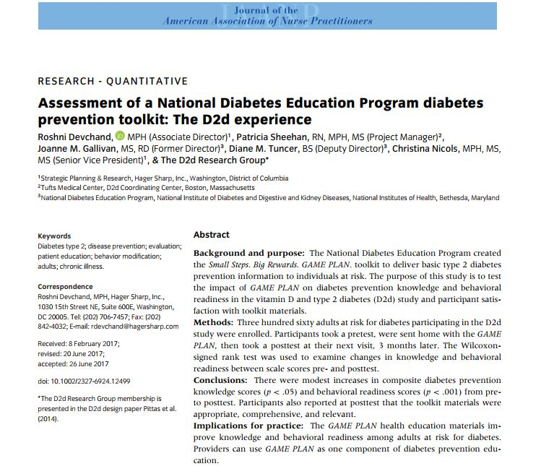
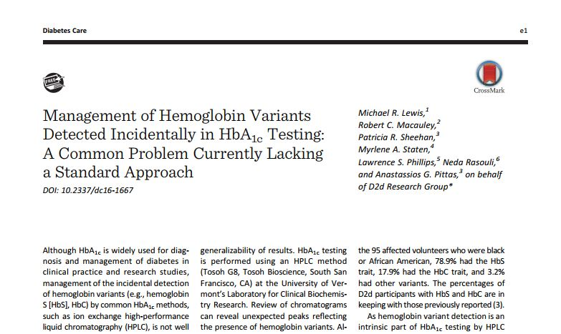
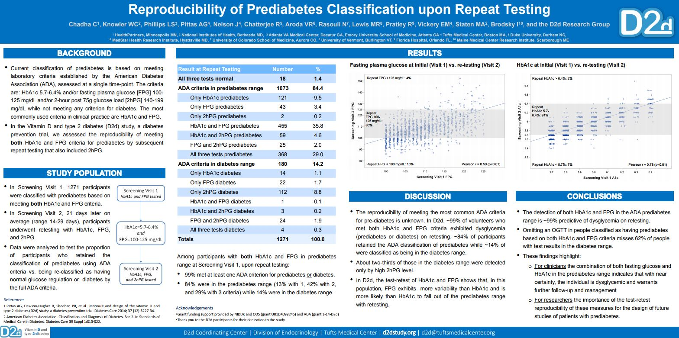
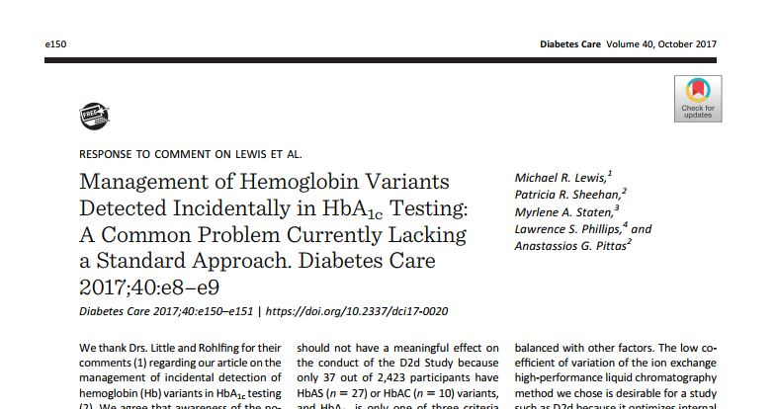
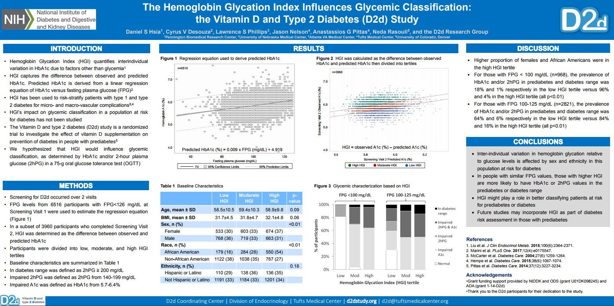
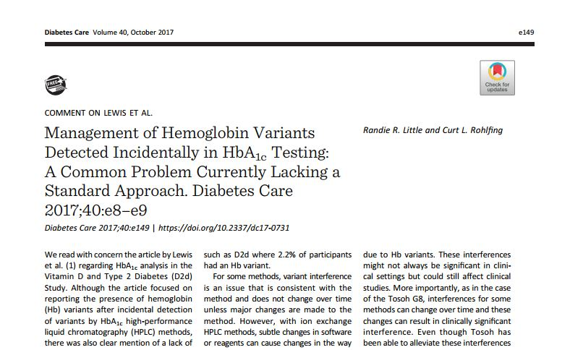
Published/Presented
Chadha C, Knowler WC, Phillips LS, Pittas AG, Nelson J, Chatterjee R, Aroda VR, Rasouli N, Lewis MR, Pratley R, Vickery EM, Staten MA, Brodsky I, and the D2d research group. Reproducibility of Prediabetes Classification upon Repeat Testing. Poster presented at ADA 2017. Proceedings of the 77th Scientific Session of the American Diabetes Association. 2017 Jun 9-13; San Diego, California.
Hsia DS, Desouza CV, Phillips LS, Nelson J, Pittas AG, Rasouli N, and the D2d research group. The Hemoglobin Glycation Index Influences Glycemic Classification: the Vitamin D and Type 2 Diabetes (D2d) Study. Poster presented at ADA 2017. Proceedings of the 77th Scientific Session of the American Diabetes Association. 2017 Jun 9-13; San Diego, California.
Lewis MR, Macauley RC, Sheehan PR, Staten MA, Phillips LS, Rasouli N, Pittas AG and the D2d Research Group. Management of hemoglobin variants detected incidentally in HbA1c testing: a common problem currently lacking a standard approach. Diabetes Care Nov 2016, dc161667; doi: 10.2337/dc16-1667.
Little RR, Rohfling CL. Comment on Lewis et al. Management of Hemoglobin Variants Detected Incidentally in HbA1c Testing: A Common Problem Currently Lacking a Standard Approach. Diabetes Care 2017 Oct; 40(10): e149-e149. doi: 10.2337/dc17-0731
Lewis MR, Sheehan PR, Staten MA, Phillips LS, Pittas AG. Response to Comment on Lewis et al. Management of Hemoglobin Variants Detected Incidentally in HbA1cTesting: A Common Problem Currently Lacking a Standard Approach. Diabetes Care 2017 Oct; 40(10): e150-e151. doi: 10.2337/dci17-0020.
Devchand R, Sheehan PR, Gallivan JM, Tuncer DM, Nicols C, and the D2d Research Group. Assessment of a National Diabetes Education Program diabetes prevention toolkit: The D2d experience. Journal of the American Association of Nurse Practitioners 2017 Aug; 29: 514–520. doi: 10.1002/2327-6924.12499.

Slide 21
In Process
Lovegreen et al. Management of large multi-center trials in a challenging funding milieu – under review
Aroda et al. Optimizing use of the electronic health record (EHR) to identify persons at high risk of diabetes in the D2d Study – rejected from Annals. Considering next journal.
Brodsky et al. Reproducibility of prediabetes classification upon repeat testing – in development
Desouza et al. Baseline characteristics that predict prediabetes eligibility in the D2d study – in development

Slide 22
ADA Abstract Submission Timeline
Regular Submission
Late-Breaking Submission
**ADA deadline 1/8/18**
Proposal due to CC: 11/8/17
Abstract due to CC: 12/13/17
**ADA deadline 3/12/18**
Proposal due to CC: 1/18/18
Abstract due to CC: 2/14/18

Slide 23
Publication Roundtables
Racial and ethnic differences and patterns of A1c vs. glucose levels at study entry and at the diagnosis of diabetes
The effect of vitamin D supplementation on risk of cancer
Effect of vitamin D supplementation on insulin resistance (including a cross-sectional review at baseline)

