Slide 1
GCP based source documentation
How to spruce up your source
and
your compliance

Slide 2
What is “GCP”?
Developed by the International Council for Harmonisation of Technical Requirements for Pharmaceuticals for Human Use (ICH) founded in 1990
Industry and regulatory experts
Develop quality, safety, efficacy and multidisciplinary guidelines for clinical research
Guidelines have been adopted by the FDA
GCP - Good Clinical Practice
Ethical and scientific quality standards for designing, conducting, recording, and reporting trials that involve the participation of human subjects to ensure they are protected
As of September 16, 2016, GCP compliance is required in all NIH funded trials

Slide 3

Source documents should tell the complete story of a person’s participation on a clinical trial
This Photo by Unknown Author is licensed under CC BY-SA

Slide 4
ALCOAC
Attributable
Legible
Contemporaneous
Original
Accurate
Complete

Slide 5
Examples of source
Original records
May be electronic or paper
Forms created by the site to collect data; correlate to EDC
Medical records from various encounters including lab, pharmacy and others
Progress notes from an encounter or phone call
Telephone scripts with responses
X-rays
Print off’s from electronic devices
Notes:
Can you stress progress notes from phone calls (even logging your attempts at phone calls). Emails sent or from participants/letters sent to from participants that are study related.

Slide 6
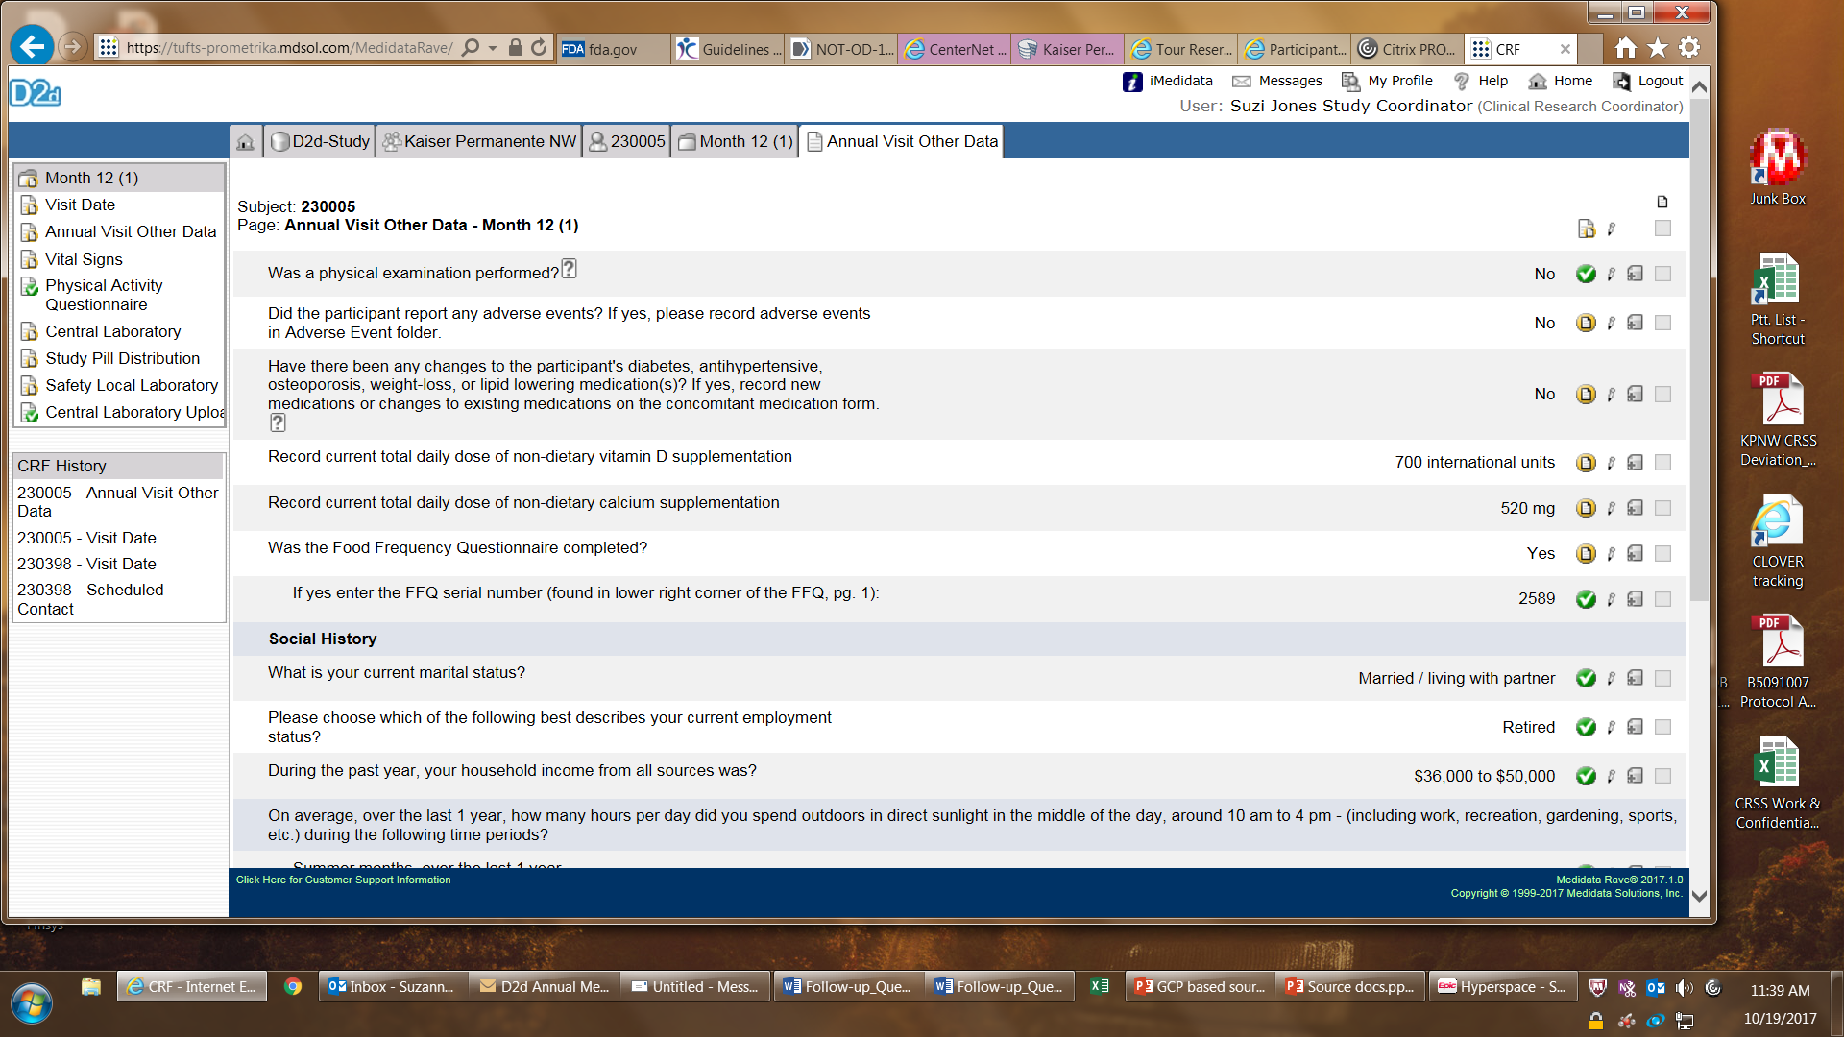
Start with the data points required by study

Slide 7
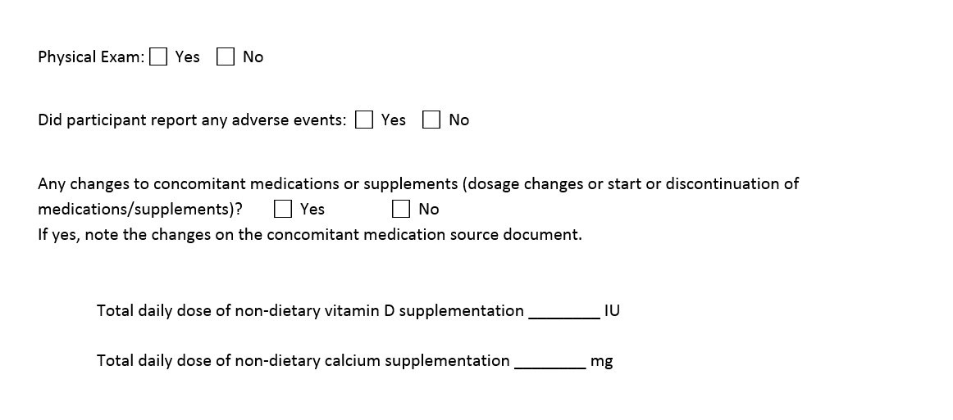
Create a basic checklist; compare it to the protocol
Notes:
This is the basics. Other information of relevance reported by a participant should be included. E.g. – “participant moving on mm/dd/yy- use cell phone until she provides new best land line #”
Husband – major surgery next week. Plan- Call mm/dd/yyyy to check on her and him.

Slide 8
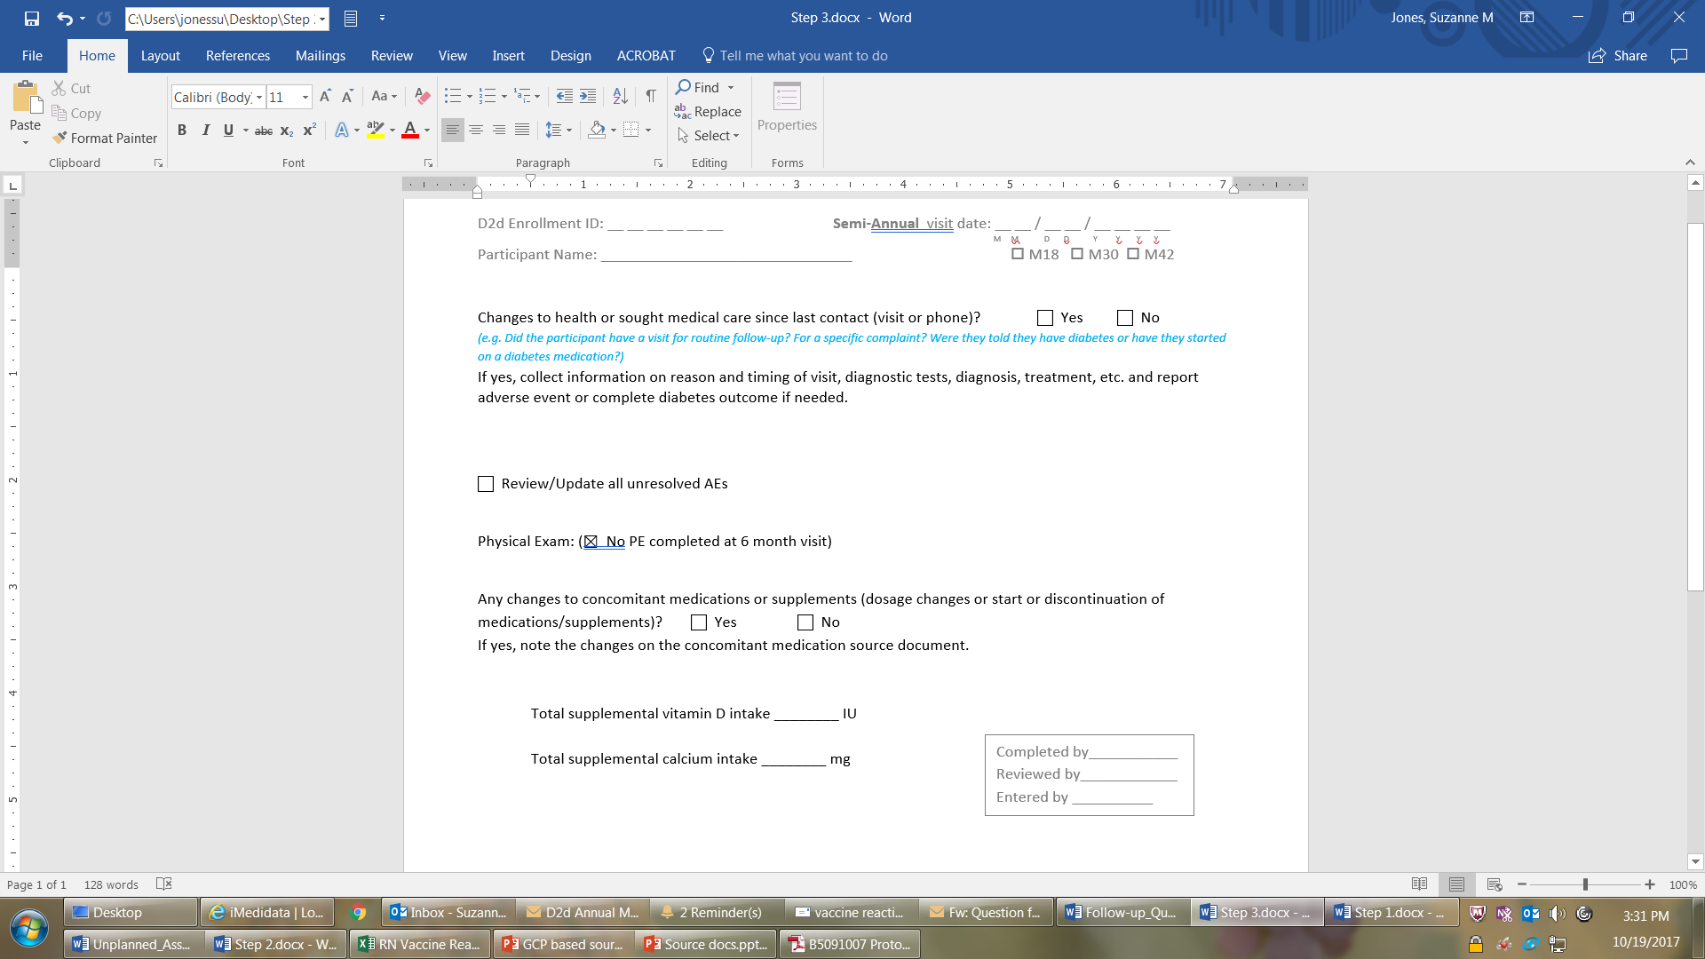
Add in ALCOAC elements and workflow edits

Slide 9
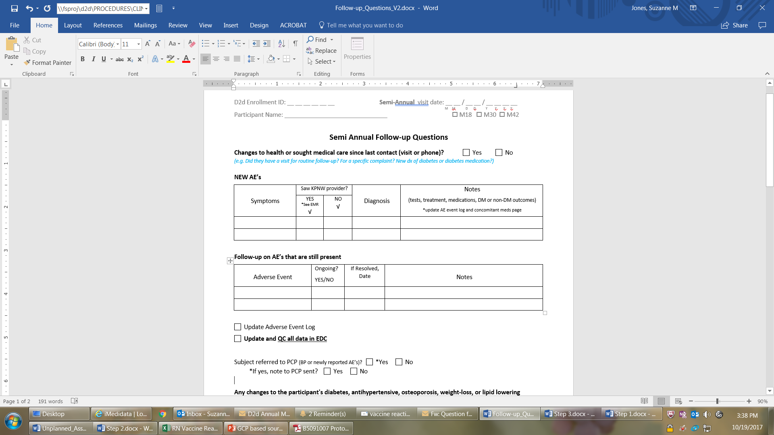
Fluff it up to tell the story
Notes:
This is great

Slide 10
Common findings in FDA audits
Eligibility criteria could not be confirmed
Certified copies? Specifically reference source you are using
Clinical significance not clearly documented
Generation of data comes responsibility
What happened then?
Multiple documents conflict on the same data point
Clearly ID the source you are using
Numerous AE’s not reported
Visit to the doctor? = new diagnosis = AE
New prescription? = new diagnosis = AE
CS data? = new diagnosis = AE
Comprehensive medical history is essential
CS or NCS signed promptly by PI
verify participant reported data when possible

Slide 11
Good source documentation is the key
To running an efficient trial, collecting accurate data and keeping participants safe

Slide 12
references
ACRP 2017 Meeting & Expo workshop in Seattle
  John Rowell, RN, MSN, CCRC
  Christina Ledbetter, PhD
  Jill Petro, BS, CCRA, CCRC
    Good documentation practice in clinical research
      Perspectives in Clinical Research 2011 Apr-Jun; 2(2): 59-63

