Slide 1
Research Coordinator Breakout Session

Slide 2
End of Study Process Recap
Procedures will begin prior to 508 events being reached
Data cleaning and UNCOs
Completion of EOS visits and UNCOs (as needed)
-2 months
*
+3 months
+5 months
…
?
Announcement to start EOS procedures
508 events reached
(estimated)
Complete EOS visits
Data lock
Result letter

Slide 3

End of Study – Other Examples
Example: Commissioner Gordon
Inactive since M24
Last ditch effort – express in phone message and letters that this is the last study visit
If unable to contact, will be marked as “Lost to follow-up”

Slide 4
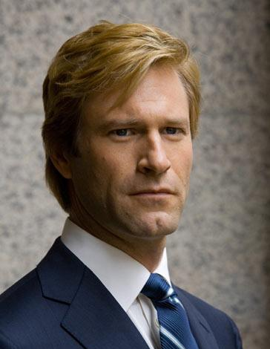
End of Study – Other Examples
Example: Harvey Dent
Phone-only contact since M18
Inform participant this is the end of study and encourage to come back in
  If willing to come in, complete next scheduled encounter
  If not willing to complete OGTT, complete fasting glycemia labs only
      => Complete non-visit contact data collection just in case
  If not willing to come in at all, complete non-visit contact

Slide 5

End of Study – Other Examples
Example: Edward Nigma
Refused to sign extension consent
Original consent provides for visits through M48 plus an EOS visit
Once the end of study is announced, these participants can be contacted for the EOS visit ASAP
Note: study procedures in this consent provide only for a semi-annual type visit

Slide 6
End of Study – Other Examples?

Slide 7
Procedures Moving Forward
End of Study Source Documents
  Released at end of study announcement
Planning for post-study participant contact
  Treatment group, participant glycemia results, and study results
Goal: For very little to need to be done at data cut off
  FFQ request every other month
  Covers must be completed correctly and in their entirety
  Review before shipment – problem booklets will be returned to the site to be fixed
Data cleaning frequency
  May see out-of-norm queries on past visits start popping up

Slide 8
GCP based source documentation
How to spruce up your source
and
your compliance

Slide 9
What is “GCP”?
Developed by the International Council for Harmonisation of Technical Requirements for Pharmaceuticals for Human Use (ICH) founded in 1990
Industry and regulatory experts
Develop quality, safety, efficacy and multidisciplinary guidelines for clinical research
Guidelines have been adopted by the FDA
GCP - Good Clinical Practice
Ethical and scientific quality standards for designing, conducting, recording, and reporting trials that involve the participation of human subjects to ensure they are protected
As of September 16, 2016, GCP compliance is required in all NIH funded trials

Slide 10

Source documents should tell the complete story of a person’s participation on a clinical trial
This Photo by Unknown Author is licensed under CC BY-SA

Slide 11
ALCOAC
Attributable
Legible
Contemporaneous
Original
Accurate
Complete

Slide 12
Examples of source
Original records
May be electronic or paper
Forms created by the site to collect data; correlate to EDC
Medical records from various encounters including lab, pharmacy and others
Progress notes from an encounter or phone call
Telephone scripts with responses
X-rays
Print off’s from electronic devices
Notes:
Can you stress progress notes from phone calls (even logging your attempts at phone calls). Emails sent or from participants/letters sent to from participants that are study related.

Slide 13
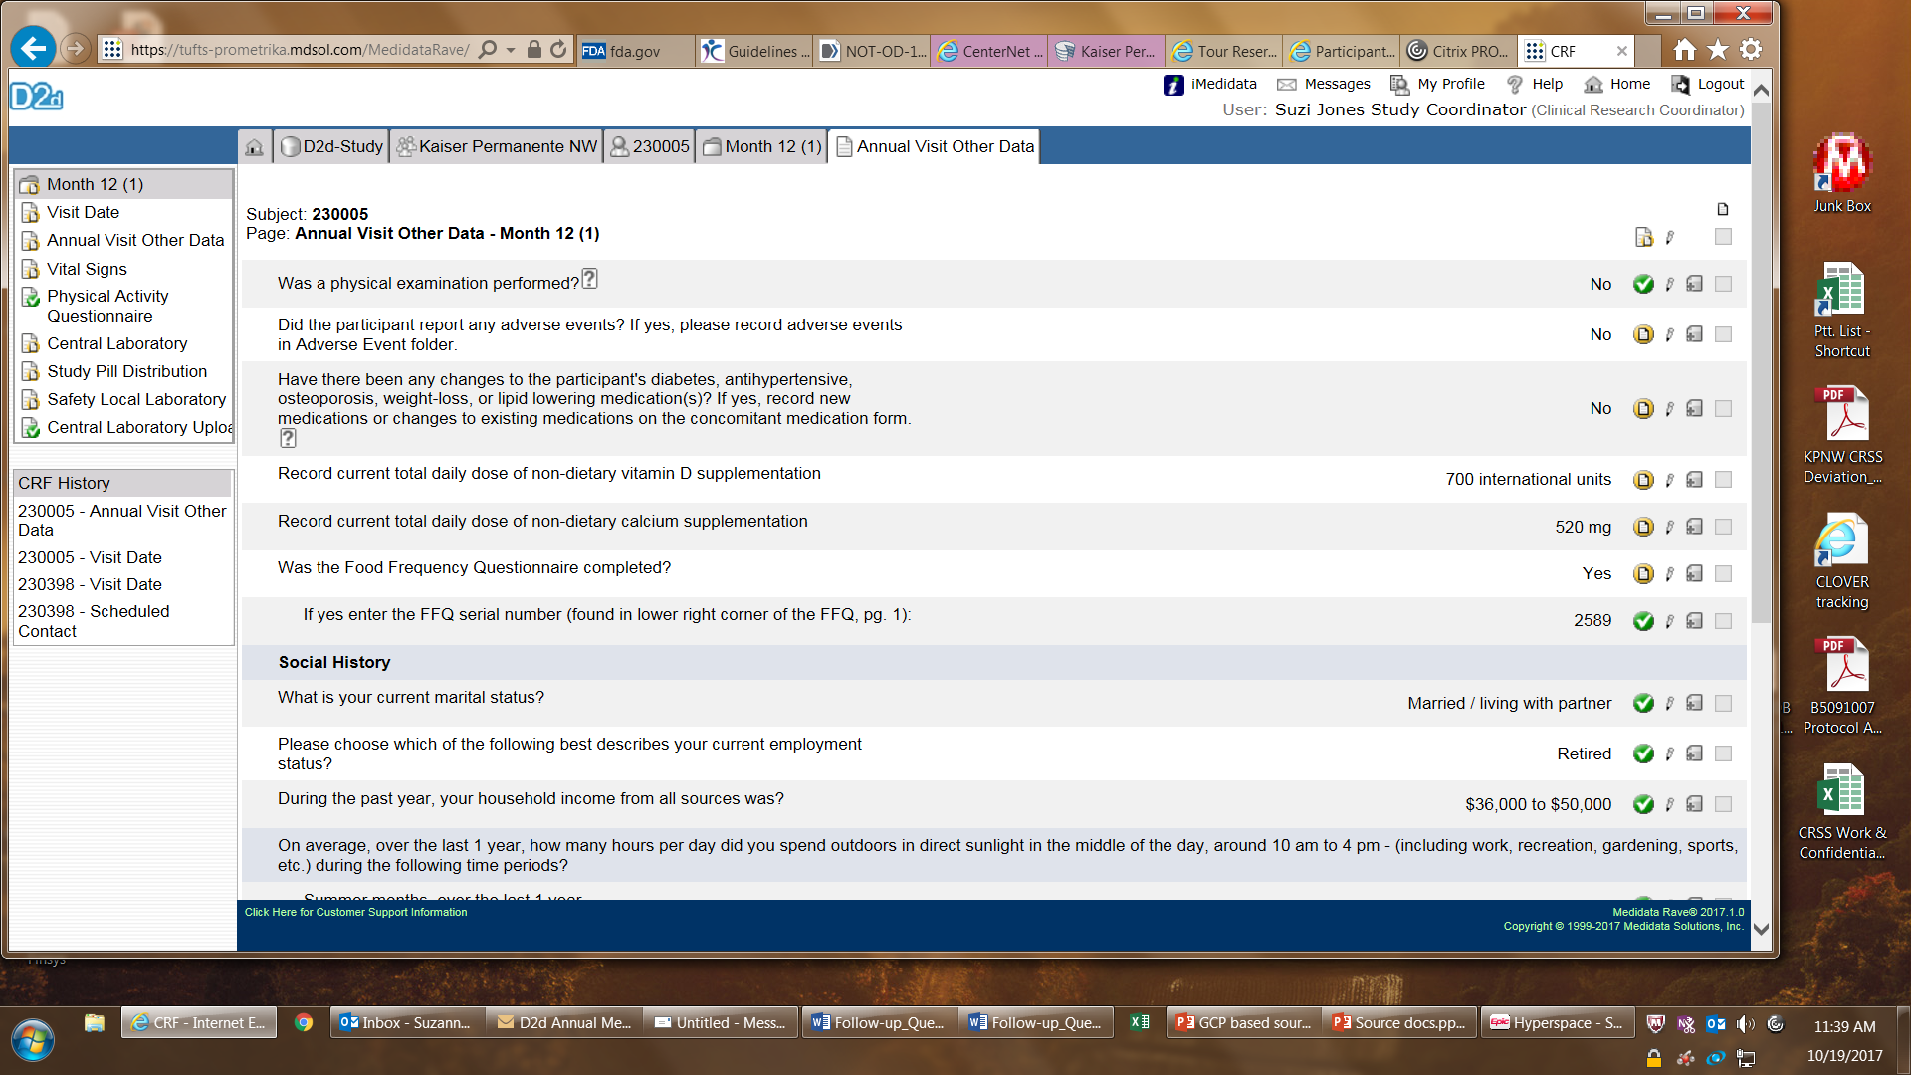
Start with the data points required by study

Slide 14
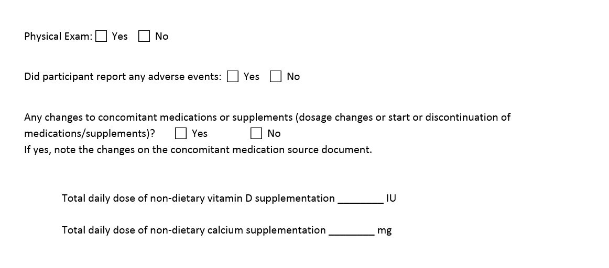
Create a basic checklist; compare it to the protocol
Notes:
This is the basics. Other information of relevance reported by a participant should be included. E.g. – “participant moving on mm/dd/yy- use cell phone until she provides new best land line #”
Husband – major surgery next week. Plan- Call mm/dd/yyyy to check on her and him.

Slide 15
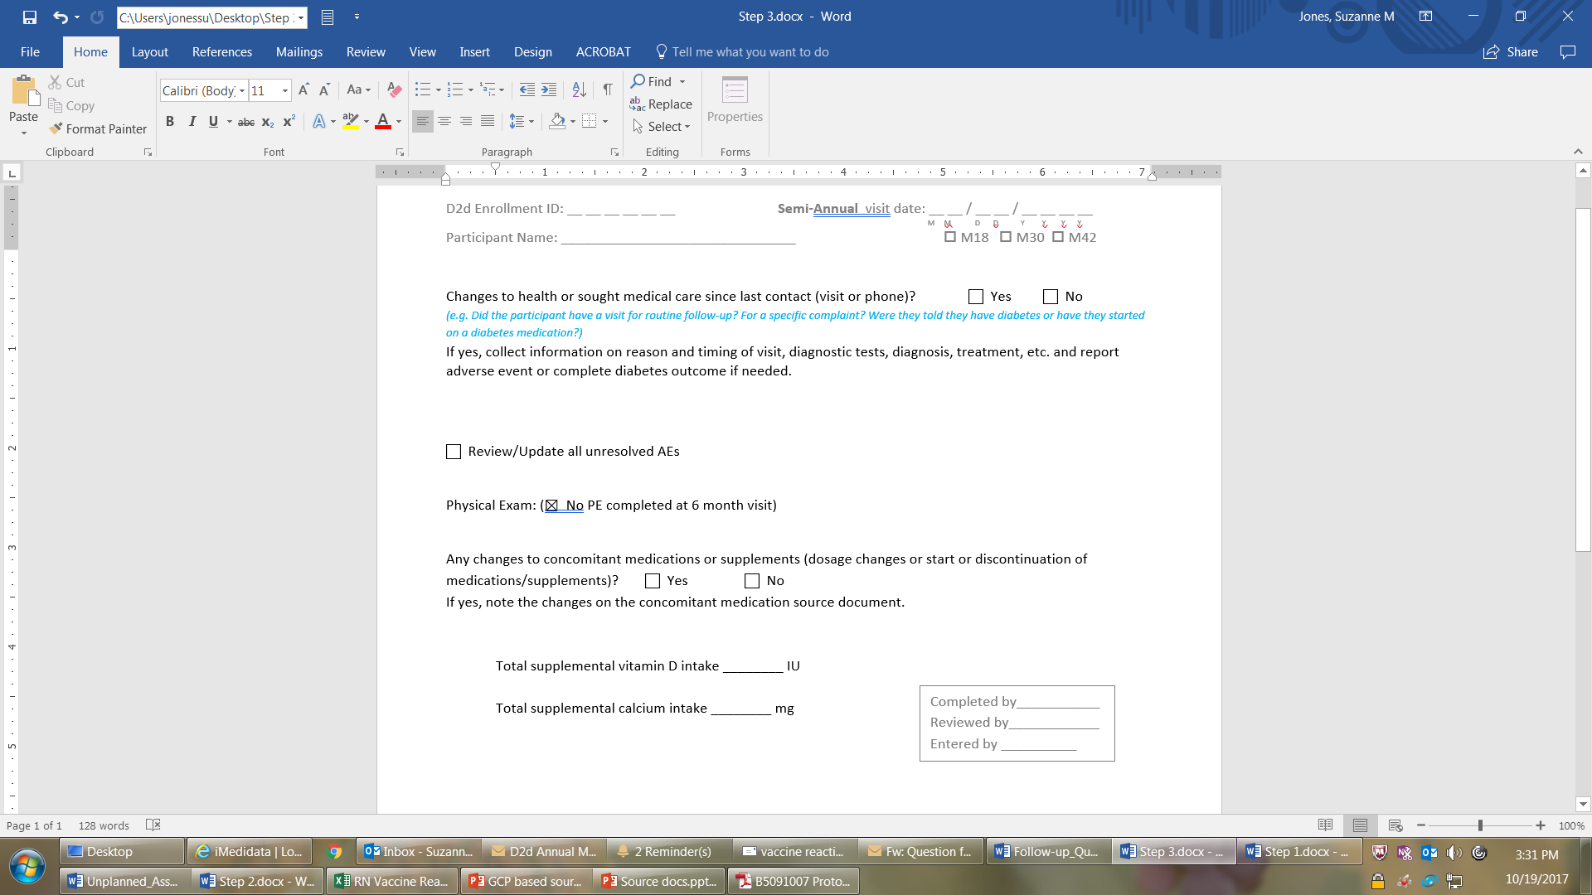
Add in ALCOAC elements and workflow edits

Slide 16
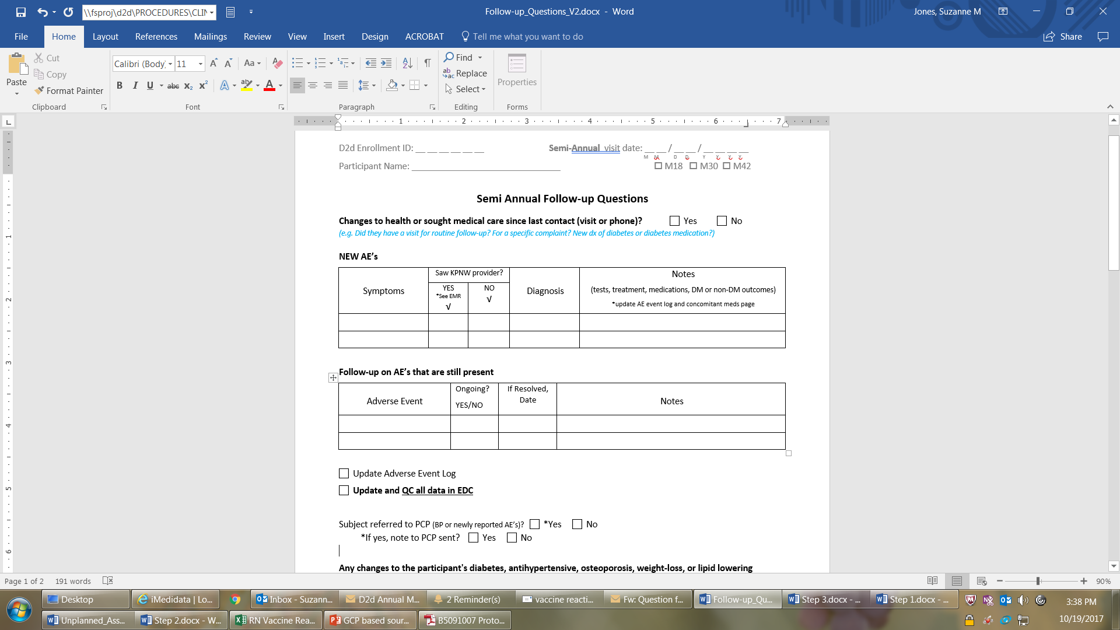
Fluff it up to tell the story
Notes:
This is great

Slide 17
Common findings in FDA audits
Eligibility criteria could not be confirmed
Certified copies? Specifically reference source you are using
Clinical significance not clearly documented
Generation of data comes responsibility
What happened then?
Multiple documents conflict on the same data point
Clearly ID the source you are using
Numerous AE’s not reported
Visit to the doctor? = new diagnosis = AE
New prescription? = new diagnosis = AE
CS data? = new diagnosis = AE
Comprehensive medical history is essential
CS or NCS signed promptly by PI
verify participant reported data when possible

Slide 18
Good source documentation is the key
To running an efficient trial, collecting accurate data and keeping participants safe

Slide 19
references
ACRP 2017 Meeting & Expo workshop in Seattle
  John Rowell, RN, MSN, CCRC
  Christina Ledbetter, PhD
  Jill Petro, BS, CCRA, CCRC
    Good documentation practice in clinical research
      Perspectives in Clinical Research 2011 Apr-Jun; 2(2): 59-63

Slide 20
Non-Diabetes Outcomes
Tips (Revisited)
If all the questions from the data collection form were answered “no”, then the eCRF does not need to be completed (and no records need to be submitted)
If a skin biopsy was done but it was not cancer, it does not need to be submitted
All colonoscopies should be submitted, even if normal
If a cancer diagnosis is reported, it also needs to be entered as an AE
Diagnostic or screening procedures by themselves are not AEs
Notes:
Initial and subsequent forms with cancer questions are in MOP 13. For each “yes” response, collect relevant records and submit to CC.

Slide 21
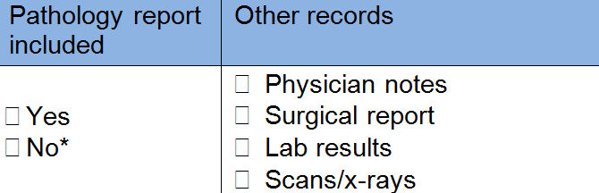
Non-Diabetes Outcomes
Records to collect:
Coversheet is found in MOP 21 Appendix 2a (“CA Checklist”)
Notes:
For other types of cancer, there may or may not be a pathology report (e.g. if diagnosis was based on imaging instead).

Slide 22
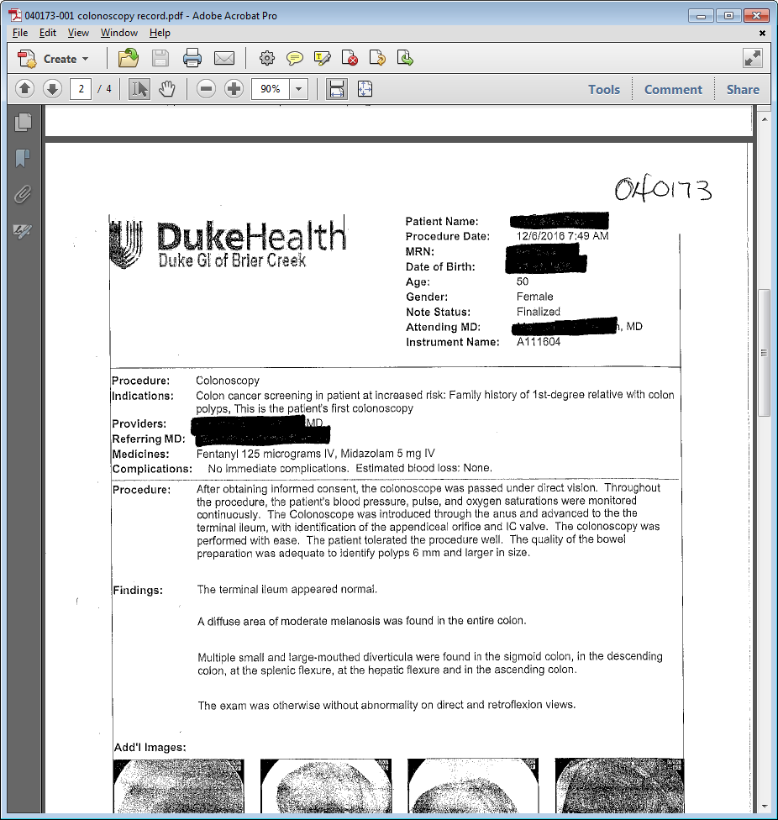
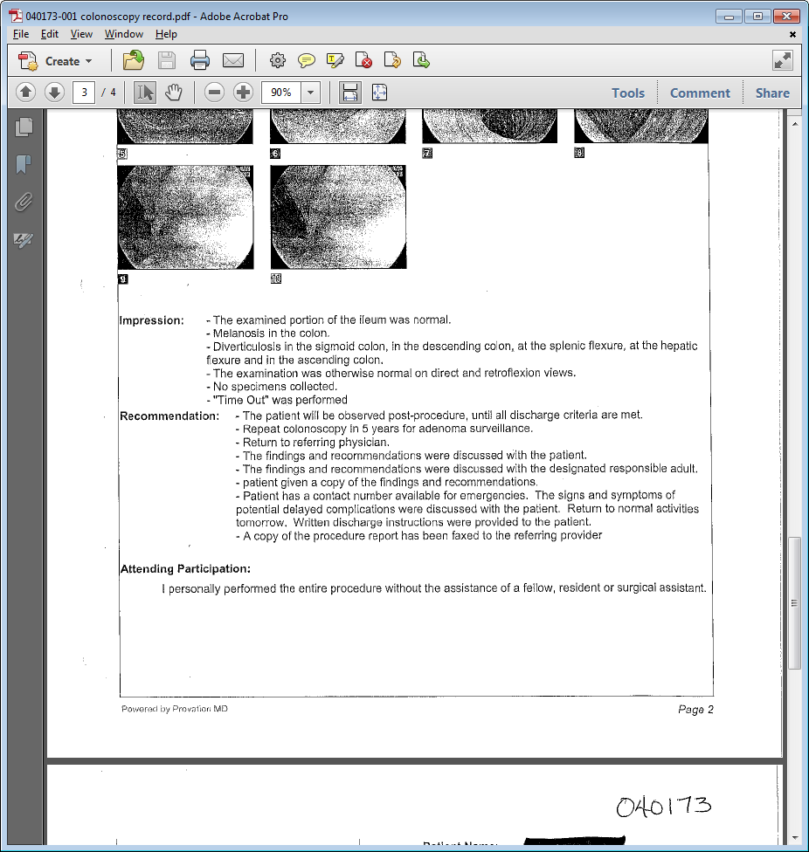
Non-Diabetes Outcomes
Notes:
If a colonoscopy is normal and it says “no specimens collected”, there will not be a pathology report – on the coversheet, check “no,” and in the comments section, write “normal, no pathology done.”

Slide 23
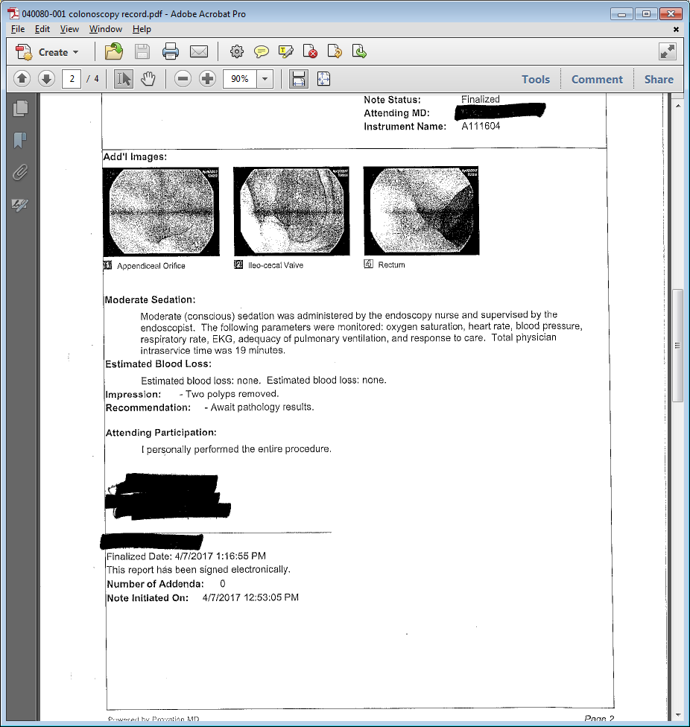
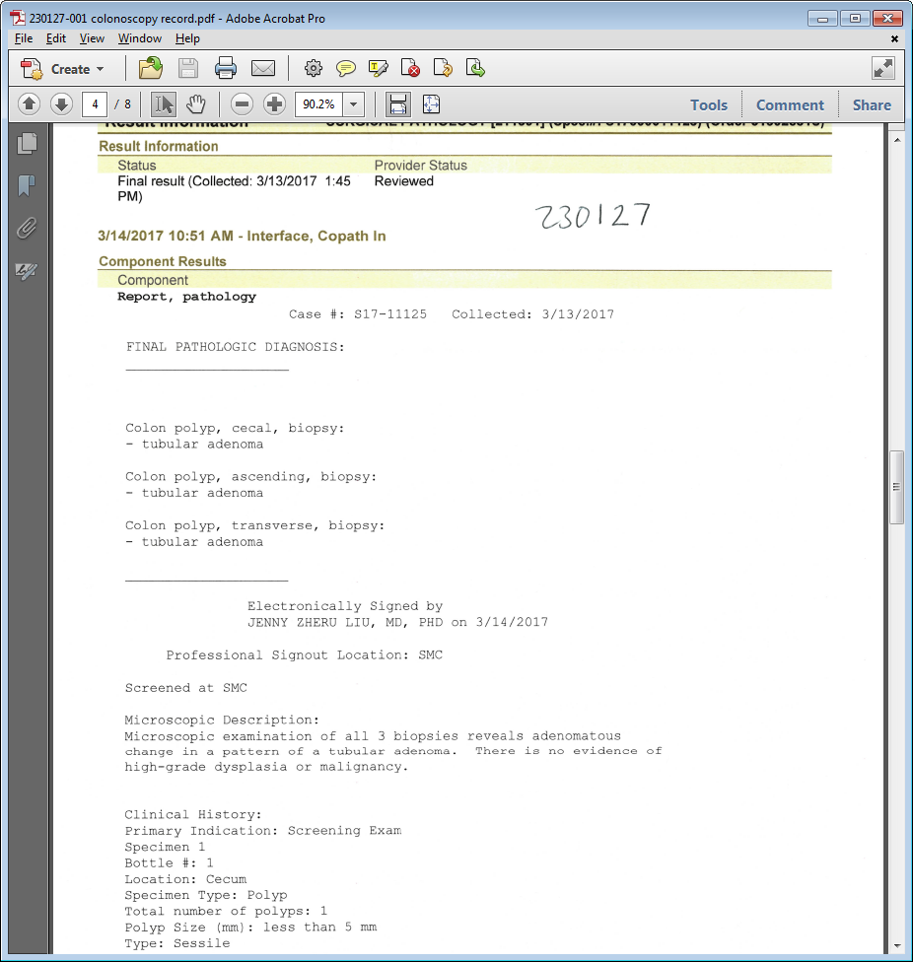
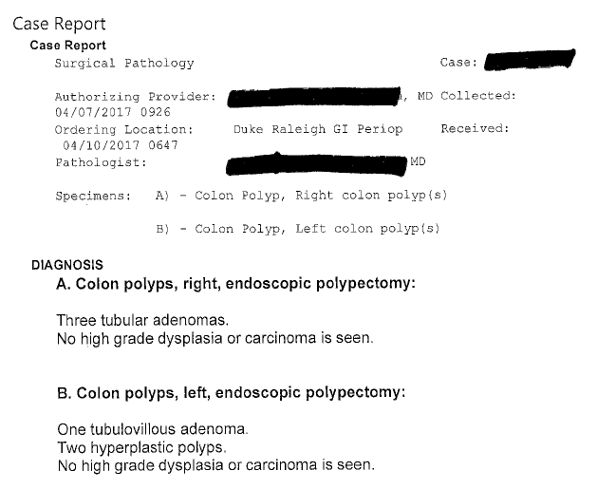
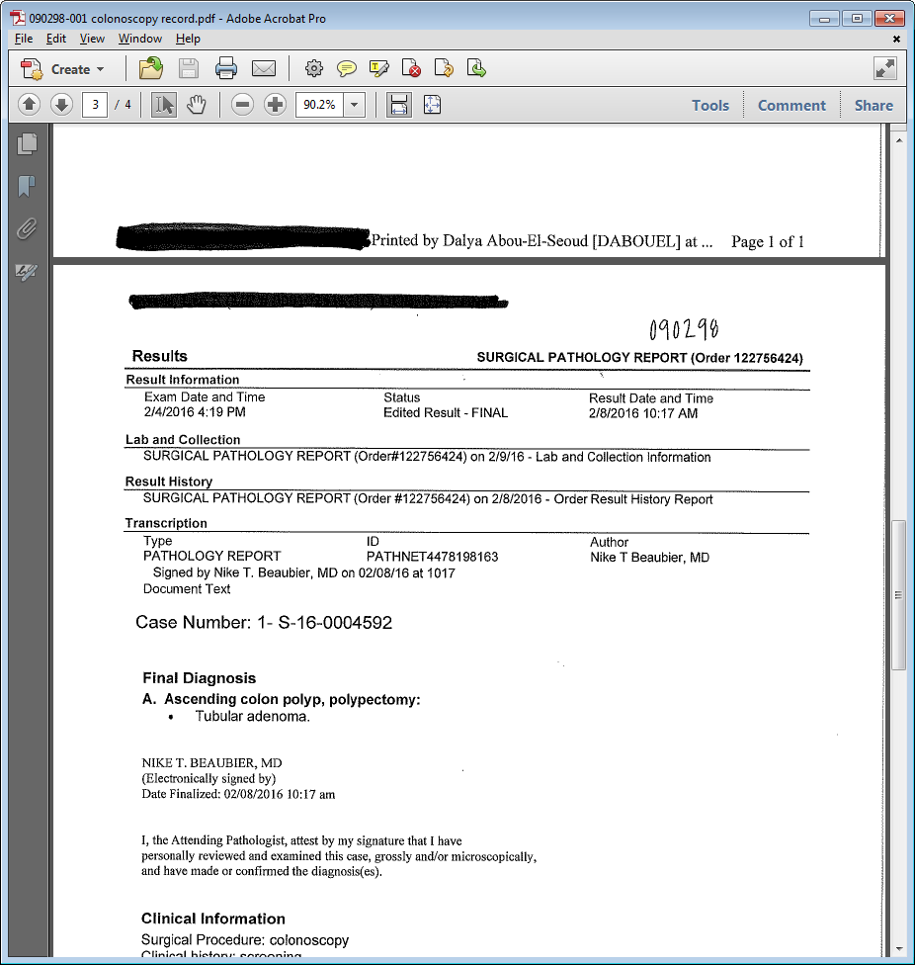
Non-Diabetes Outcomes
Identifying the pathology report in the medical record:
Notes:
If a polyp was removed or a biopsy taken, look for the pathology report. Medical record systems all have unique formats and appearances.

Slide 24
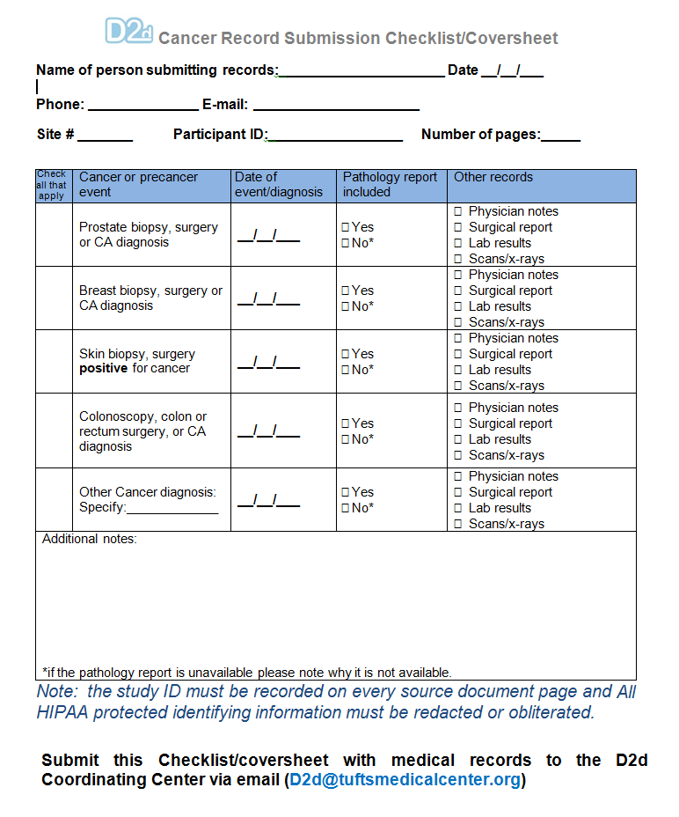
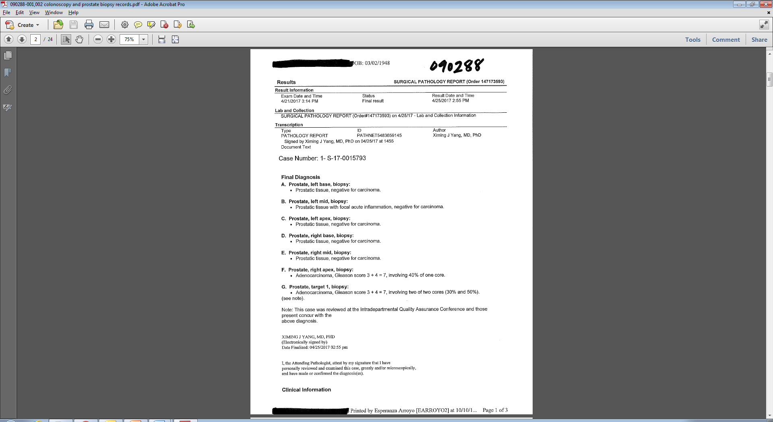
Non-Diabetes Outcomes
Submitting to CC:
ID#
Send to:
d2d@tuftsmedicalcenter.org
Include in subject line:
“Non-DM Enrollment ID#”
Coversheet De-identified records with participant ID

Slide 25
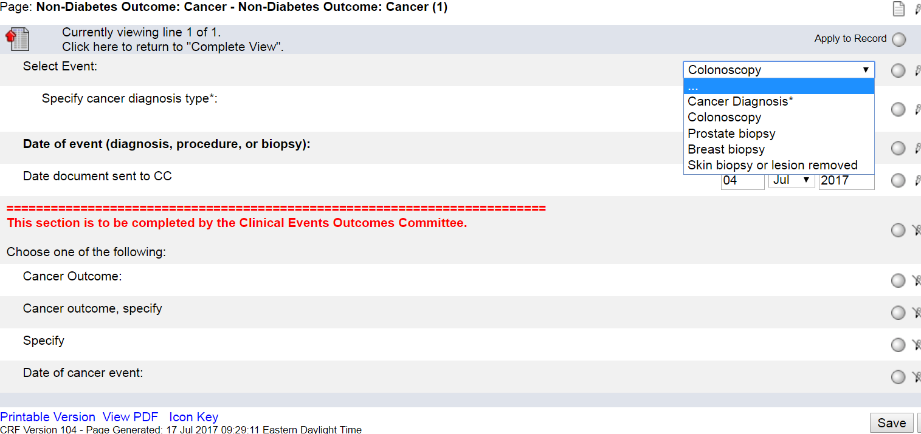
Non-Diabetes Outcomes
Notes:
eCRF is found in the Add Events drop down menu. Only the top fields above the red line need to be completed: Event, diagnosis type (if relevant), date of event, and date document sent to CC.
This is a log form so you can add a new log line if a participant has multiple events.

