Slide 1
Participant Appreciation and Education Program
Plan for the Future

Slide 2
Participant Appreciation and Education Program
Components:
  Participant Events – twice per year
  Handouts – at each visit
Goal: Enhance retention
Question: How are handouts currently being used?
Notes:
Optional: circulate handout for participants to use as a worksheet

Slide 3

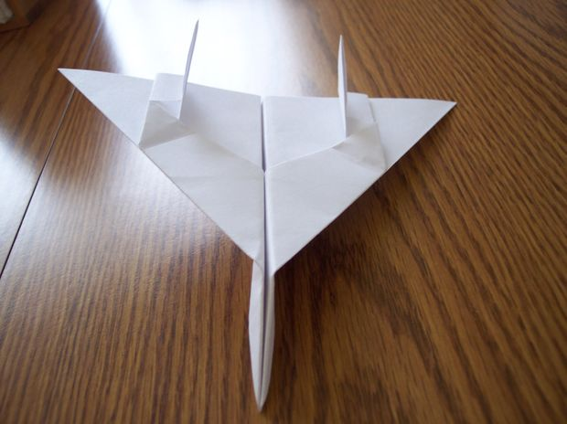
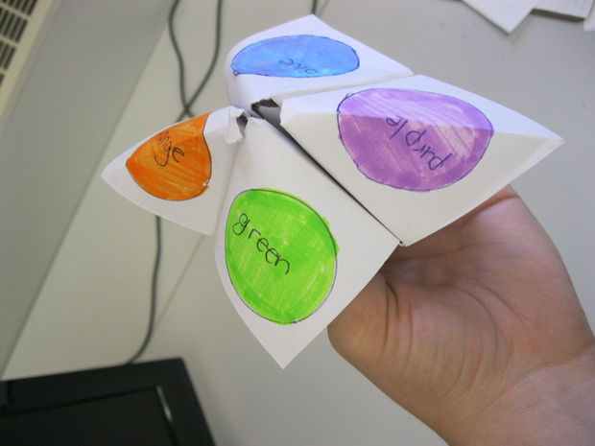
From instructables.com

Slide 4
Handouts
Ranking by sites – how are handouts most commonly provided?

Slide 5
What Kinds of Questions do Participants Ask?
None
Updates on vitamin D efficacy
Ask for more individualized information about diet or diabetes prevention
More specific information about what is covered in the handout

Slide 6
Proposed Future Directions
Additional resources or training for site staff re: handouts or presentations (optional/as needed)
Spring presentation: Winning at Losing: A Guide to Successful Weight Loss
Your ideas for handouts and presentations?
Notes:
Is there anything more we can do to enhance participants’ experience in the study, and thereby also retention, without veering too much into intervention territory?

