Slide 1

Retention Retention
Retention
October 23, 2017

Slide 2
Recruitment and Retention
Subcommittee Membership
Members | Site
Irwin Brodsky (Chair) | Maine Medical Center Research Institute
Vanita Aroda (former Chair) | Medstar
Myrlene Staten | NIDDK
Chhavi Chadha | HealthPartners Research Foundation
Shelly Cook | HealthPartners Research Foundation
Kim Vo | Tufts Medical Center
Sarah Serafin-Dokhan | Los Angeles Royal Comprehensive Health Center
Taso Pittas | Coordinating Center
Patty Sheehan | Coordinating Center
Cindy Haviet (CC Liaison) | Coordinating Center
Notes:
Like all Commmittees our leadership has had some retention issues. We would like to thank Vanita Aroda and Miranda Ouellette who made significant contributions to the RRS committee and have moved on.

Slide 3
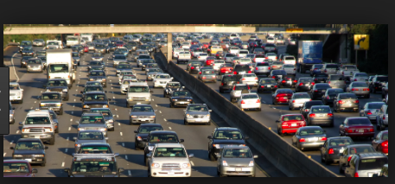

Scenario 1
LA Transportation
Starring:
Marina Perez, Sara Serafin-Dokhan
Notes:
Presenters Introduction: Mrs Perez is real 45 year old D2d participant with school age children and transportation challenges. Please watch the following role play presented by Sara Serafin-Dokhan and Marina Perez from the University of Southern California to see how they have dealt with these challenges

Slide 4
Scenario 1- (slide will be removed or hidden this is to describe what will have)
Presenter Lead: Mrs Perez is real 45 year old D2d particpant with school age children and transportation challenges. Please watch the following role play presented by Sara Serafin-Dokhan and Marina Perez from the University of Southern California to see how they have dealth with these challenges
Staff: Good Morning, Mrs. Perez how are you?
Mrs. Perez: I'm good thank you how are you guys doing, am I do for a visit already !
Staff: Yes your due for your annual 24 mo. visit
Mrs. Perez ooooh ! Is this the long visit
Staff: Yes
Mrs. Perez Well, I'm very busy with the kids and I don’t have a ride, what time is my appt
Staff: Your appt. will in the morning, because you have to be fasting and remember you will be here for about 3 hours
Mrs. Perez (sigh) I don’t think I will make it in that early because I have to walk the kids to school and then I have to
pick one of them up at 11:30
Staff: Ok its not problem perhaps we can schedule you on a Saturday?
Mrs. Perez mmmm I don’t have a babysitter and my husband is working and also take care of my sisters
kids.
Staff: Ok so how about we do this, if you like to come on a Saturday you can bring the kid and we can put in a few movies, we also have coloring books, or if you rather come in during the week we can send you an Uber. (do you know what that is ?)
Mrs. Perez Yes I heard about it.
Staff: Its very safe and you will not have to pay for anything, you just tell me when you drop off the kids, I will send the car to pick you up, and when your done with the visit we can have Uber drop you off at either your house or at the school.
Mrs. Perez: oooh really that would be great, mmm then lets do Tuesday at 8:30,
Staff: Great we will give you a call the day before to remind you about your appt. and in the morning around 8:15 with the Uber instructions
Mrs. Perez: are you sure I don’t have to pay for anything,
Staff: No absolutely nothing we will take care of it, we just want you to relax and not worry.
Mrs. Perez That sounds great
Notes:
Role play – Sara RC , Marina participant.

Slide 5
Scenario 1 Follow-up
Identified the retention challenge.
Did not ignore or minimize it.
Recognized the challenge not just as this “Participant has a transportation problem”
  but as
  What can we do to ensure this participant comes to study visits
Sought out participant centered solutions
Examples of transportation challenges and solutions.
Notes:
The presenter will encourage discussion here, and Sara and Marina can answer questions regarding the process.
We can seek out other challenges and solutions from audience. What this site did was (review bullet by bullet). Click for each bullet to appear.

Slide 6
Scenario 1 Follow-up
Uber versus Taxi in LA
 | Yellow Cab | Uber
Cost from Clinic to USC (5.5 miles at 11:00AM) | $17-20 | $10.74
Wait time | ~ 15-30 minute | < 10 minutes
Advantages to participant | - Familiarity | See driver ratings and reviews Reliability Payment is behind the scenes
Notes:
The LA site can add the following information regarding UBER

Slide 7
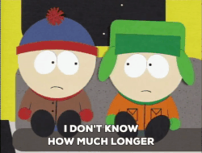
Scenario 3
Starring
Theresa Young and Omar Khalid
from MedStar
Notes:
Theresa and Omar and from the Medstar will present a retention challenge that may or may not be becoming more familiar. This first scene starts with the RC speaking with a participant at Month 42 visit..

Slide 8
Scenario 3- this slide will be removed or hidden it is just here to give idea of scene
Eg "how long did you say this study was going on for?"
"Possibly 1 more years"
"I thought it would be done by one more year. I think I'm done with this study”

Slide 9
Scenario 3- this slide will be removed or hidden it is just here to give idea of scene
"Can we talk about that and why you are hoping for it to be done?"
"I don't want to take pills. I'm trying to avoid pills."
"Yes, we are looking to prevent diabetes with a vitamin, to help prevent people having to take medications. To understand the effect, we need to see a certain number of outcomes to know for certain. Everything is going on pace, and we anticipate learning the results, together, in about 1 to 2 years."
"Never mind, you said what I needed to hear - PREVENTION. This is why I signed up for the study - I want to prevent having to take medications. Ok were good, just keep reminding me of that, ok?"
Notes:
Role play-
I think I am done w study ( seek permission- before trying to educate or convince)

Slide 10
Scenario 2- Follow-up
Site identified the retention challenge.
Sought permission to discuss what bothered the participant.
"Can we talk about that and why you are hoping for the study to be done?"
Focused on the participants issue: not wanting to take pills
Did not focus on the investigators issue: wanting the participant to continue past month 48
Notes:
One thing that struck me was how the investigator asked the participant for permission to discuss what the issue was…. It invited participant to share what the biggest issue.

Slide 11
Scenario 3
An Education Opportunity
Starring:
Denver VA/ University of Colorado, Denver team
Neda Rasouli
Abtin Kiany
Amy Harrison
Notes:
Mrs. Y was an active participant in the study until she had a kidney stone around that required the pills to be discontinued.
Participant was then inactive for almost a year! Site made many attempts to reach and connect with participant without success.
Recently the participant was seen by a resident in Dr. Rasouli’s Endocinology clinic. This is what happened.

Slide 12
Scenario 3 this slide will be deleted/hidden - just provides background
Neda (to Amy): I’m Dr. Rasouli. Nice to see you today. How are you feeling?
Amy: good, thank you.
Abtin (to Neda): Ms. Harrison’s A1c is elevated, but her PCP did not want to start metformin. I think she is or was in the D2d study. There are notes in her chart about it.
Amy: I was in the study, but I had to stop taking the study pill. I had a kidney stone or something. There was no point for me to go to visits since I wasn’t taking the mediation.
Neda (to Abtin): Do you know about the D2d study?
Abtin: No
Neda (to Abtin): Neda tells Abtin about the D2d study, goals, and importance of results and how drop could affect the results
Amy: looks interested the whole time.
Neda (to Amy): Your continued participation is extremely important even if you cannot take the study medication. Can you come in for a visit with the D2d coordinator?
Amy: Do I have to start taking the study pill again?
Neda: No.
Amy: I suppose I can fit it into my schedule.
Neda: Great! The study coordinator will call you today to find a time that works best for your schedule.
Notes:
Denver will role play this case.

Slide 13
Scenario 3 Follow-up
Was it just good luck that the Denver team got the participant re-engaged with the study?
What do you think was the pivotal thing that led to this participant re-engaging in the study?
“The study coordinator will call you today to find a time that works best for your schedule.”

Slide 14

Case Presentation 1
Is it you or is it us?
Presented by Faith McNeil of the Maine Medical Center team
Coordinating Center at Tufts Medical Center
www.d2dstudy.org | d2d@tuftsmedicalcenter.org
Notes:
In this scenario ______ will present an interesting retention challenge from the my site.

Slide 15
Case Presentation 2
75 Y.O. female with a PMH significant for coronary heart disease, Barrett’s esophagus. Had a baseline visit in 12/16. Randomization visit was conducted via a home visit because of recent URI, cold weather.
At the reminder call for the 3 month visit participant said:
“Hi, Faith.
It was so nice of Lori to come out to my house to randomize me into the study. She said I would be the last one entered into the study. That is interesting. I’m not sure I can come to my 3 month appointment. A lot is going on. I have had some bursitis of my right shoulder and had a really bad cold and a urinary infection. Of course, you know I had to stop your pills, because I had stomach pain that they said was gastritis. Stopping the pills didn’t help my stomach but I better stay off of them, because when I started taking them for 3 days, it made my stomach pain worse. So, I’m not sure what I should do about my appointment with you.“
Notes:
Move to end- a we are stuck. Case presentation, described.

Slide 16
Case Presentation 2
M03: “My UTI and cold are much better, but I’m having bladder spasms. I’m in pain so I don’t think I can make it in.” “I can’t come in because I have a bad cold. Doctor put me on antibiotics.” “Because of the antibiotics, I now have a yeast infection. I’m so sorry, Faith, I’m not trying to be difficult.” Completed a non-visit contact.
M06: “I was at the ER yesterday with chest pain and lightheadedness and just not up to meeting you.” “My sciatica flared up and I sprained a ligament in my left knee. They put me on a 10-day taper of Prednisone and am wearing a boot. I cannot go up and down my stairs.” “I’ve got a periodontist appointment tomorrow and have to take a dose of antibiotics. When I do that, I end up with diarrhea for a week due to my gastrointestinal issues, so I’m not going anywhere!” Completed a non-contact visit.
M12: TBD
Site agreed to meet participant at a location close to her home.
Site also agreed to meet participant on a Saturday.
Notes:
Arranged to meet the patient in a location for blood drawing that was nearer to her home, because she had diarrhea and did not think she could hold her feces for the entire drive to our office. The patient did not come, because her diarrhea that day was too severe to make to the alternate location.
Another recent attempt to bring the participant in was thwarted by an injury to a knee ligament and an intraarticular steroid injection.
The very most recent attempt was thwarted by the patient’s requiring periodontal work and antibiotics and expected that the antibiotics would cause her to have … you guessed it… diarrhea.

Slide 17

Case Presentation 1
What do you think is going on here?
Ideas for next steps?

Slide 18

Discussion Point
Failure is the path of least
persistence.
Persistence
When is too much?
Notes:
We thought we would discuss how much persistence is perfect and how to customize it for a participant?
Does anyone have a good example of where persistence paid off?
Does anyone have an example where you backed off and it worked?

Slide 19
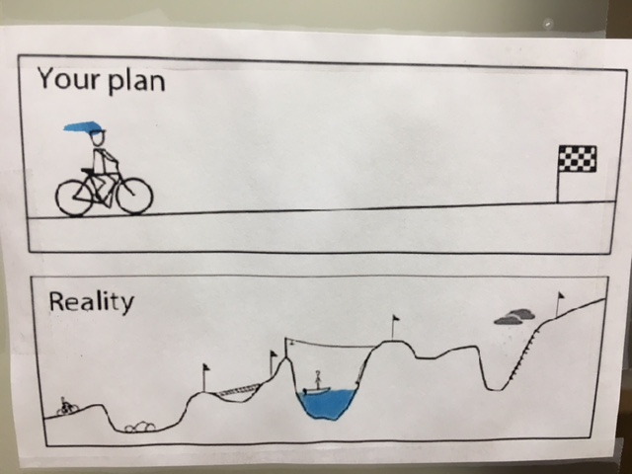
Participant’s
̂
Notes:
This slide illustrates that participants don’t join D2d expecting life to get in the way, but it does.
We need to work with our participants deal with the hurdles, highs and lows.

