Slide 1
Protocol Fidelity
Focus on performance metrics
Notes:
Present each component separately. How do you use it?

Slide 2
Retention of Participants
> Minimize “inactives” and missed visits
Notes:
To apply the protocol, you need participants and visits

Slide 3
Retention
Inactive Participants
Off study includes: withdrawn (n=40), deaths (n=3), lost to follow-up (n=1), administrative withdrawals (n=2)
Notes:
Overall, D2d is doing well.
Emphasize that there is no such thing as drop-out, until the end of the study

Slide 4
Retention
Missed Visits

Slide 5
Site-specific data

Slide 6
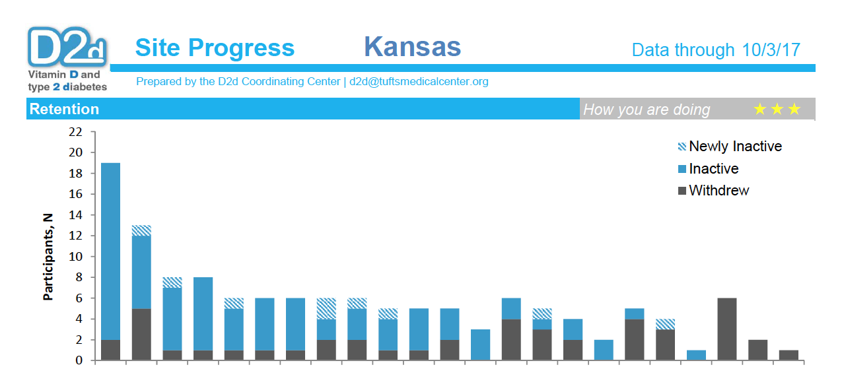

Slide 7
Principles of behavioral economics:
Relative social ranking and group competitiveness
A participant from X site is as good as a participant from any other site
Notes:
Point 1: N to emphasize the all participants are equal. For example, this site may be HP with 12 participants, very good proportionately speaking but…the site still contributes the most. Sites with larger numbers contribute the most data but also the least data if particippnts are missing
Point 2: Report developed based on principles of behavioral economics: People are influenced to change behavior by how they compare to their peers.
However, use of “social ranking” and “group competitiveness” approaches may produce unintended behaviors, including potential for demotivation.
Therefore, goals will be set not be too far removed from where the patient currently is, so that they are seen as attainable. Sites are given grades for their progress (stars), not for how they rank.

Slide 8
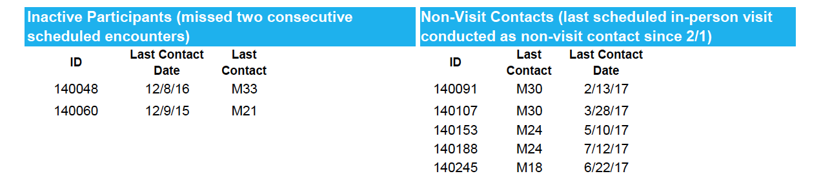
Notes:
In addition to emphasis on “norms” etc.… provides actionable information.

Slide 9
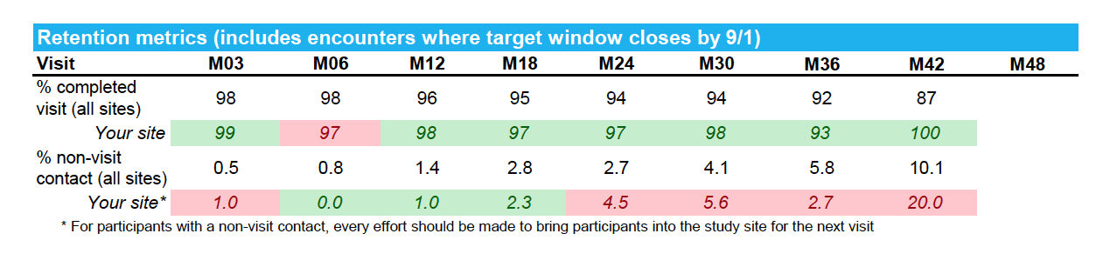
Notes:
In addition to emphasis on “norms” etc.… provides actionable information.

Slide 10
Adherence to study pills
Notes:
To apply the protocol, you need participants and visits

Slide 11
Adherence to study pills, overall
Includes 1.9% of cohort that is “off study”
Notes:
In terms of adherence, ~6.4% are off study medication. Please note that this number includes about 2% of participants who are ”off study.”
NOTE TO SELF: the default in the analyses is that participants are ”on study pills.” That includes inactive participants who may or may not be taking the pills.

Slide 12
Reasons for being off study pills
Participants can re-start study pills (unless stopped for DSMP safety reason)
Notes:
Among participants who are off study pills, about a quarter stopped pills per a safety reason per protocol, e.g. kidney stones….About 3/5, stopped pills either because of an AE unspecified in the protocol or due to personal choice. The last 5th is participants who withdrew consent.
Need to minimize PINK reasons.
NOTE TO SELF: Any other reason.
N=4 Other
N=1 , participant with elevated urine calcium creatinine ratio at BAS visit; study pills stopped within 48 hours of randomization.
N=2, administratively withdrawn at the discontinued Tulane site.
N=1, lost to follow-up after site activities transferred from one location to another at the New York site.
N=3 deaths are under “Other AE” – two were stopped prior to death, one was stopped as a result of death

Slide 13
Adherence to study pills, by visit
*
Average adherence among participants who had in-person visit and returned pill bottles
% did not return pill bottles
1.8%
2.1%
1.6%
2.6%
1.4%
2.8%
Notes:
Average study pill adherence rate among participants who had in-person visit and returned pill bottles, remains high, at about 93%.
-- [CLICK] At each visit, a small number of participants did not return their study pills, shown below. (These have been excluded from the analyses above). Importantly, for all visits, this metric has improved, meaning that fewer participants forget to bring their pill bottles at their visits.

Slide 14
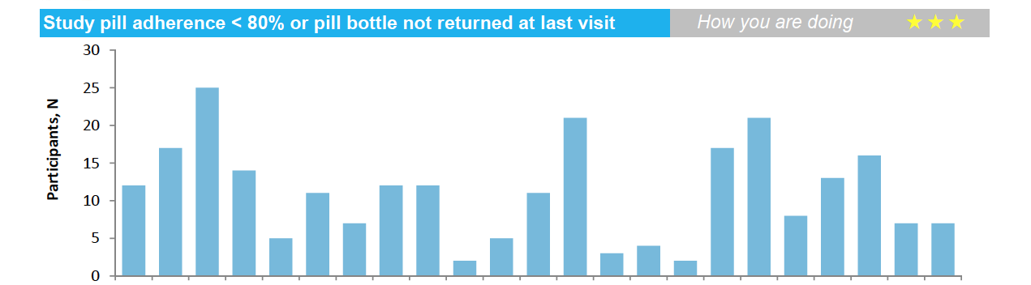
A participant from X site is as good as a participant from any other site
Notes:
In addition to emphasis on “norms” etc.… provides actionable information.

Slide 15
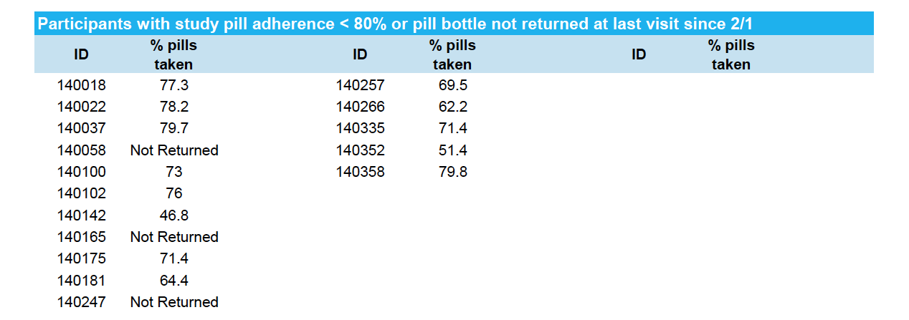
Remind them when confirming the visit
Give them self-addressed envelope to return
Participants can re-start study pills (unless stopped for DSMP safety reason)
Notes:
In addition to emphasis on “norms” etc.… provides actionable information.

Slide 16
Adherence to study procedures
> Minimize use of metformin (other diabetes meds)
Notes:
To apply the protocol, you need participants and visits

Slide 17
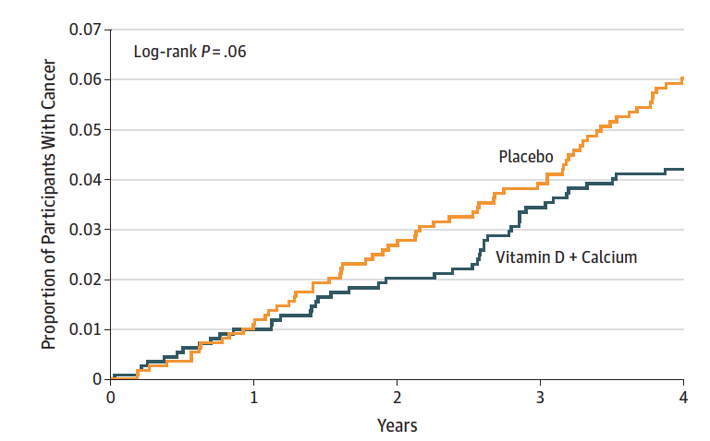
Is protocol fidelity important?
YES: it is our obligation to the ~2,423 participants
YES: To maximize the power. Statistical significance may be missed

Slide 18
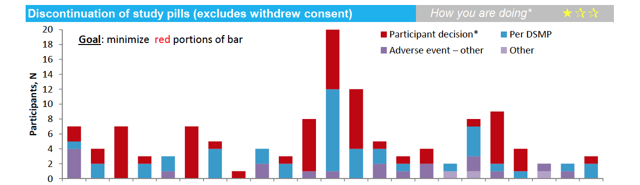
Notes:
In addition to emphasis on “norms” etc.… provides actionable information.

