Slide 1
Non-diabetes Outcomes
Cardiovascular
Cyrus Desouza, MD
October 22, 2017

Slide 2
Why?
1A. Evaluate the effect of vitamin D supplementation on incident CVD in people with pre-diabetes.
1B. Establish CVD risk in people with pre-diabetes, defined by the modern ADA criteria.

Slide 3
Vitamin D supplementation and CVD
Observational data suggests low 25[OH]D level is associated with CVD risk¹
It is unknown whether vitamin D supplementation reduces CVD risk.
A recent trial from Australia showed no effect of monthly Vit D supplementation on CVD outcomes²
High monthly doses were used (not physiologic)
Outcomes were based on ICD codes, not adjudication.
Authors recommended additional research be conducted, specifically with daily doses of vitamin D.
Zhang R, Li B, Gao X, Tian R, Pan Y, Jiang Y, Gu H, Wang Y, Wang Y, Liu G. Serum 25-hydroxyvitamin D and the risk of cardiovascular disease: dose-response meta-analysis of prospective studies. Am J Clin Nutr. 2017 Apr;105(4):810-819. Epub 2017 Mar 1.
2. Scragg R, Stewart AW, Waayer D, Lawes CM, Toop L, Sluyter J, Murphy J, Khaw KT, Camargo CA, Jr. Effect of Monthly High-Dose Vitamin D Supplementation on Cardiovascular Disease in the Vitamin D Assessment Study : A Randomized Clinical Trial. JAMA Cardiol. 2017
Notes:
Observational data suggests a low 25-hydroxyvitamin D (25[OH]D level is associated with CVD risk . This is summarized in a recent Meta Analysis by Huang
as summarized recently in a meta-analysis (23).

Slide 4
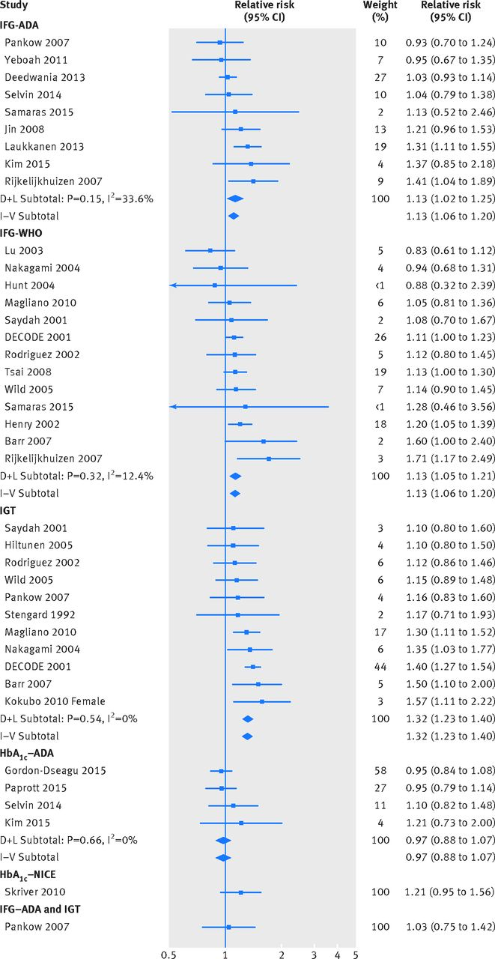
Establish CVD risk in people with prediabetes
Several studies indicated an increased risk of CVD in patients with prediabetes¹
1. Huang Y, Cai X, Mai W, Li M Hu Y Association between prediabetes and risk of cardiovascular disease and all cause mortality: systematic review and meta-analysis. BMJ. 2016 Nov 23;355:i5953. doi: 10.1136/bmj.i5953.

Slide 5
Advantages to Evaluating CVD in D2d
Collection of data at no additional burden to participants and nearly zero additional burden to sites (all CVD are hospitalizations, which are adjudicated anyway).
Largest randomized, placebo-controlled Vit D supplementation trial in people with prediabetes, using the modern ADA criteria
D2d also prospectively assesses glucose tolerance annually by OGTT.
D2d will define CVD risk in a modern cohort of pre-diabetes – as defined by the ADA criteria - which will be informative to future studies and health policy makers.

Slide 6
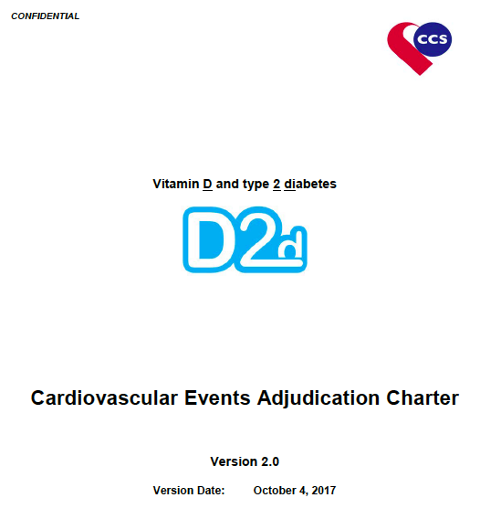
What CVD Outcomes?
As defined in the D2d CVD-Clinical Events Adjudication Charter

Slide 7
Events to be Adjudicated
Acute Myocardial Infarction
Sudden Cardiac Death
Heart Failure
Stroke
  Ischemic
  Hemorrhagic
  Undetermined
CV Procedures (e.g. cath, CABG, pacemaker)
CV Hemorrhage
Other CV (PE, PAD)
Mortality:
Cardiovascular death due to
The definition of these endpoints is standardized.
Acute Myocardial Infarction
Unstable Angina
Stroke
  Ischemic
  Hemorrhagic
  Undetermined
TIA
CV Hemorrhage
Other CV (PE, PAD)
  Elective CV Procedures (e.g. cath, CABG) are being adjudicated but not considered MACE
Cardiovascular Hospitalization
Hicks KA, Tcheng JE, Bozkurt B, Chaitman BR, Cutlip DE, Farb A, Fonarow GC, Jacobs JP, Jaff MR, Lichtman JH, Limacher MC, Mahaffey KW, Mehran R, Nissen SE, Smith EE, Targum SL. 2014 ACC/AHA Key Data Elements and Definitions for Cardiovascular Endpoint Events in Clinical Trials: A Report of the American College of Cardiology/American Heart Association Task Force on Clinical Data Standards (Writing Committee to Develop Cardiovascular Endpoints Data Standards). J Am Coll Cardiol. 2015 Jul 28;66(4):403-69.

Slide 8
CVD Data Collection
Continue to assess for Adverse Events at each encounter.
    All CVD of interest meet the definition of serious adverse event (SAE).
SAE records are compiled at the site and sent to the Coordinating Center. Review MOP for list of essential records.
SAE records are sent to the CVD Clinical Events Committee for adjudication.
CEC outcome is entered into EDC by CC staff.

Slide 9
CVD Data Analysis Plan
A composite MACE for D2d is defined as
  Cardiovascular death (due to acute myocardial infarction, sudden cardiac death, heart failure or stroke) or
  Hospitalization due to non-fatal acute myocardial infarction, unstable angina, stroke or TIA.
The primary outcome is first occurrence during D2d (i.e., since randomization) of the composite MACE as defined above and each participant with a MACE is counted only once.
Subgroups analyses identical to those completed for the diabetes outcome (by baseline 25[OH]D level etc.) will be conducted for the primary CVD outcome (composite MACE).
Secondary analyses will be conducted for each individual CVD event that defines MACE.

Slide 10
Sample Size Calculations
As of 8/3/2017, 29 SAEs likely meeting the MACE definition (over a total participant follow-up of 4658 person-years)
Observed yearly MACE incidence of 0.63% (in both vitamin D and placebo groups)
Cohort of N=2,423 and follow-up of 3 years
  Power of 77% to detect a relative risk reduction of 50% if yearly incidence in PLA is 1.25% and vitamin D is 0.625%.
  56% to detect a relative risk reduction of 40% if yearly incidence in PLA is 1.25% and vitamin D is 0.75%.
Power estimates assume a 2-sided type 1 error probability (alpha) of 0.05.

Slide 11
  ?

