Slide 1

D2d Study Supplement:
Non-diabetes Outcomes
Cancer
D2d Annual Meeting
Ranee Chatterjee
October 22, 2017

Slide 2
Vitamin D and Other Health Outcomes
Bone health
Cardiovascular disease
Blood pressure
Body weight/obesity
Cancer
Respiratory tract infections/asthma
Depression
Falls

Slide 3
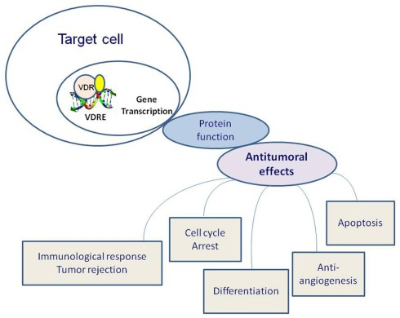
Effects of vitamin D receptor (VDR) activation on tumorigenesis.
Vuolo L et al. Vitamin D and Cancer. Frontiers in Endocrinology, 2012

Slide 4
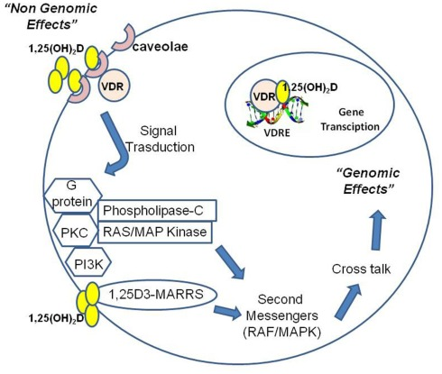
1,25(OH)2D operates through nuclear receptor-mediated and plasma membrane-initiated mechanisms
Vuolo L et al. Vitamin D and Cancer. Frontiers in Endocrinology, 2012

Slide 5
Non-diabetes Outcomes: Cancer
Background
Potential biologic mechanisms for vitamin D impact on cancer risk:
  promotion of apoptosis or autophagy of cells
  promotion of cellular differentiation
  regulation of cellular proliferation
  inhibition of angiogenesis
  prevention of invasion of malignant cells
  modulation of immune responses/inflammation

Slide 6
Epidemiologic Studies of Vitamin D and Cancer
Colon and rectal cancer:
  4 meta-analyses with consistent inverse associations
  Per 25-nmol/L increase in vit D: RR 0.85 (0.79, 0.91)
Breast cancer:
  Many meta-analyses with inconsistent results
Prostate cancer:
  1 meta-analysis with positive association
  Highest vs lowest quantile: RR 1.17 (1.05, 1.30)
Bladder cancer:
  2 meta-analyses with consistent inverse association
  Vit D>75 vs. <25 nmol/L: RR 0.68 (0.49, 0.86)
Lung cancer:
  2 meta-analyses with consistent inverse association
  Highest vs. lowest quantile: RR 0.83 (0.77, 0.90)
Notes:
Prostate cancer- Does this mean D increases Prostate cancer risk?

Slide 7
Trials with Vit D Supplementation and Cancers as Secondary Outcomes
Cochrane review (Bjelakovic et al) of 18 trials:
  Vit D dose was 300 IU to 3333 IU (mean 1146 IU) /day
  Weighted mean follow-up was 6 years
  Most participants were post-menopausal women
  RR incident cancer = 1.00, 95% CI: 0.94, 1.06
  No sig effect on an single type of cancer
  RR cancer mortality = 0.88, 95% CI: 0.78, 0.98
  RR all-cause mortality = 0.93, 95% CI: 0.88, 0.98

Slide 8
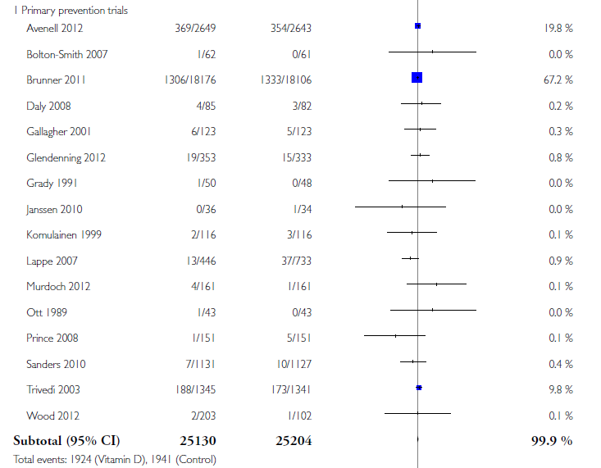

Slide 9
Trials with Vit D Supplementation and Cancer/Precancers as Primary Outcome
Vitamin D and Colon Polyp study: calcium carbonate 1200 mg/d +/- D₃ 1000 IU/d
  2259 participants who had adenomas removed
  Follow-up colonoscopy performed 3-5 yrs later
  Adj RR of recurrent polyps 0.99 (95% CI, 0.89, 1.09)
Lappe J et al JAMA 2017: vitamin D₃ 2000 IU/d and calcium 1500 mg/d or placebos
  2,303 women (mean age 65) from Nebraska
  Followed for 4 years for incident cancer
  Unadj. HR 0.70 (95% CI, 0.47 to 1.02)

Slide 10
Invasive and In Situ Cancer Incidence Among Healthy Older Women Receiving Vitamin D and Calcium vs Placebo (Lappe J et al 2017)
Lappe J et al JAMA. 2017;317(12):1234-1243

Slide 11
VITAL Trial (ongoing)
Vitamin D₃ (cholecalciferol; 2000 IU/d) and/or marine omega-3 fatty acids (1g/day) (2X2 factorial)
  N= 25,874 U.S. adults:
    12,793 men aged ≥50 and 13,081 women aged ≥55
    5,107 African Americans
  Self-reported outcomes: Cancer and CVD to be assessed after mean treatment period of 5 yrs
    To be verified by medical record review
  Allowed to take up to vitamin D 800 IU/day
  Lots of ancillary studies being planned

Slide 12
What Can D2d Add?
 | Lappe et al, N=2303 | D2d, N=2432
Population | White women | All races, men and women
Risk | Healthy, Post-menopausal | At risk for diabetes (=higher cancer risk)
Mean age | 65 | 59
Intervention | D₃, 2,000 IU/day | D₃, 4000 IU/day
Mean follow-up | 3 years | 3 years (expected)
Out-of-study vit D allowance | < 800 IU/day | ≤ 1000 IU/day
Out-of-study vit D supplement intake (baseline) | 734 IU/day, vitamin D 700 IU/dau, placebo | ~300 IU/day (vitamin D and placebo combined)
Out-of-study vitamin D supplement intake | 740 IU/day, vitamin D 869 IU/day, placebo | ~300 IU/day (vitamin D and placebo combined)
Baseline 25OHD | 33 ng/mL | 27 ng/mL (first 1023 participants)
Achieved 25OHD at month 24 | 44 in vitamin D 32 in placebo | Not available yet, but expected to be higher given higher dose.
Outcome Assessment | 2 times/year | 4 times/year (In-person twice a year; phone twice a year)
Withdrew | 236 (106; no information; 130 partial information) | 161 (46 withdrew + 81 “inactive”) over 23-month mean follow-up
Discontinued intervention | N=484 | N=114 (23-month mean follow-up)
Total events | 109 (4 year mean follow-up) | 155 (23-month mean follow-up)

Slide 13
D2d Cancer Outcome Determination
Cancer events are identified at D2d scheduled encounters
Records including pathology are sent to CC
Oncologist reviews records and adjudicates cancers and pre-cancers
  Events to be adjudicated:
    Prostate (biopsy or surgery)
    Breast (biopsy or surgery)
    Skin (biopsy or lesion removed)
    Colon or rectum (colonoscopy or surgery)
    Other Cancer (biopsy or surgery)

Slide 14
Analytical Plan: Primary outcome
Primary outcome = first diagnosis of any type of cancer* post D2d randomization.
Each participant is counted once
  the entire cohort and
  one analysis will be within each sex as cancers may differ among sexes
  * excluding non-melanoma skin cancers

Slide 15
Secondary Analyses
Subgroups analyses identical to those completed for the diabetes outcome (by baseline 25[OH]D level etc.) for the primary cancer outcome.
Secondary analyses for specific types of cancer including: prostate, breast, colon/rectum (including pre-cancerous lesions), lung, melanoma, hematologic cancers, gynecologic, pancreas and other.

Slide 16
Outcomes to Date/Power Calculation
As of June 30, 2017, observed yearly cancer incidence of 1.5% (both groups).
For N=2,423 and follow-up of 3 years
  Power of 76% to detect a relative risk reduction of 40% if yearly incidence in PLA is 2% and vitamin D is 1.2%.
  If follow-up is extended to 4 years, power improves to 86%.
The final power will be determined by the duration of the parent D2d study.

Slide 17
D2d Cancer Adverse Events Reported as of 6/30/2017
Acute lymphoid leukemia | 1
Bladder cancer | 3
Breast cancer | 11
Chronic lymphocytic leukemia | 1
Colon cancer | 1
Colon polyp(s) | 11
Endometrial cancer | 4
Gastric cancer | 1
Intraductal papillary mucinous neoplasm | 1
Liver cancer | 1
Lung cancer | 3
Lymphoma | 1
Malignant lesion, vulva | 2
Meningioma | 1
Oropharyngeal squamous cell carcinoma | 1
Pancreatic cancer | 2
Prostate cancer | 10
Renal Cell Carcinoma | 3
Skin cancer (non-melanoma) | 44
Skin cancer (melanoma) | 5
Thyroid cancer | 1
Tubulovillous/tubular adenoma | 4
Notes:
Note these are include all cancers events reported as AE.

Slide 18
Data collection and submission process
At every participant encounter, ask questions on D2d Cancer Source Data Collection form (MOP 13)
For each “yes” response, collect medical records (include pathology report if available)
Complete coversheet (MOP 21 Appendix 2) and send records to CC
Complete “Non-diabetes Outcomes: Cancer” eCRF (from Add Events drop down)
CC forwards file to CA-CEC for adjudication
CC enters result in eCRF
Notes:
Questions should be asked at each annual and semi-annual visit AND at each interim telephone visit
If specimens were collected (e.g. polyps removed or biopsy performed), include pathology report. For normal colonoscopies, record will usually state if no specimens were collected and therefore there will not be a pathology report.
De-identify all records just as you would with SAE submissions; send to D2d@tuftsmedicalcenter.org
Data entered on eCRF consists of type of event, date of event, and date records submitted to CC
CC will review records upon receipt, and if additional info is needed, will notify the site ASAP
CA-CEC: Cancer Clinical Events Committee

Slide 19

Notes:
The initial form is used the first time these questions are asked of each participant, and covers the period of time from when they first started the D2d study through the present.
The subsequent form is used at all subsequent visits after the initial form was used, and covers the period of time from the last visit until the current visit.
The wording reflects these different time intervals but the questions are otherwise the same.

Slide 20
Tips:
If all the questions from the data collection form were answered “no”, then the eCRF does not need to be completed (and no records need to be submitted)
If a skin biopsy was done but it was not cancer, it does not need to be submitted
All colonoscopies should be submitted, even if normal
If a cancer diagnosis is reported, it also needs to be entered as an AE
Diagnostic or screening procedures by themselves are not AEs

Slide 21
To D or Not 2 D?
  TBD….!

