Slide 1
Primary Outcome: Incident Diabetes
2017 Update

Slide 2
Primary Outcomes Events - Refresher
Primary Outcome: Time to incident diabetes
Definition
  Laboratory results by the D2d central lab
  Outside of D2d adjudicated by a panel of expert diabetes clinicians
Laboratory-based by D2d is more rigorous
but adjudication is consistent with the protocol.

Slide 3
Laboratory testing
Annual visits (with OGTT)
Annually (M12, M24, M36, M48, M60…etc)
Measure FPG, HbA1c, 2hPG
Only FPG or HbA1c
positive for diabetes
Only 2hPG
positive for diabetes
Repeat only positive test
(confirmatory FPG or HbA1c)
within 8 weeks
Repeat FPG, HbA1c, 2hPG (confirmatory OGTT)
within 8 weeks
Yes
Repeat test
(FPG or HbA1c)
positive for diabetes?
Repeat 2hPG
or
Repeat FPG and HbA1c positive for diabetes?
No
Diabetes
No
Continue study pills and follow for other outcomes
No Diabetes
Continue study pills and follow for incident diabetes
Notes:
I think everyone is familiar with this and the next slide. We know what we are doing with the straight forward semi annual and annual visits.

Slide 4
Laboratory testing
Semi-annual visit
Semi-annually (M06, M18, M30, M42, M54…)
Measure FPG, HbA1c
Neither measure
(FPG, HbA1c)
positive for diabetes
One measure
(FPG or HbA1c)
positive for diabetes
Both measures
(FPG and HbA1c)
positive for diabetes
Repeat only the positive test
(confirmatory FPG or HbA1c)
within 8 weeks
No
Repeat test
(FPG or HbA1c)
positive for diabetes?
Yes
No Diabetes
Diabetes
Continue study pills and follow for incident diabetes
Continue study pills and follow for other outcomes

Slide 5
Results after Laboratory Testing at Annual Visit
Fasting glucose: 105 mg/d
HbA1c: 6.2%
2 hr glucose: 210 mg/dl
What do you do?
  Participant continues, see them in 6 mos
  Participant needs to come back for testing to have all 3 tests repeated
  Participant needs to come back only for the 2 hour glucose
  Participant has diabetes, refer to local doctor for Rx, and continue to follow on study medication.

Slide 6
Results after Laboratory Testing at Annual Visit
Fasting glucose: 105 mg/d
HbA1c: 6.2%
2 hr glucose: 210 mg/dl
What do you do?
  Participant continues, see them in 6 mos
  Participant needs to come back for testing to have all 3 tests repeated
  Participant needs to come back only for the 2 hour glucose
  Participant has diabetes, refer to local doctor for Rx, and continue to follow on study medication.

Slide 7
Results after Laboratory Testing at Annual Visit
Fasting glucose: 105 mg/d
HbA1c: 6.2%
2 hr glucose: 210 mg/dl
Results after Repeat testing:
Fasting glucose: 108 mg/d
HbA1c: 6.4%
2 hr glucose: 201 mg/dl
How do you interpret?

Slide 8
Laboratory testing
At annual visits (with OGTT)
Only FPG or HbA1c
positive for diabetes
Only 2hPG
positive for diabetes
Repeat only positive test
(confirmatory FPG or HbA1c)
within 8 weeks
Repeat FPG, HbA1c, 2hPG (confirmatory OGTT)
within 8 weeks
Repeat test
(FPG or HbA1c)
positive for diabetes?
Repeat 2hPG
or
Repeat FPG and HbA1c
positive for diabetes?
Yes
No
No
Diabetes
Continue study pills and follow for other outcomes
No Diabetes
Continue study pills and follow for incident diabetes

Slide 9
Outside of D2d diagnosis of Diabetes
Outside D2d physician
Makes diagnosis of diabetes
and/or
Prescribes diabetes medication for any reason, whether or not the medication is started by participant
Notes:
I think it is important for us to spend some time discussing the Outside of D2d diabetes diagnosis or start of diabetes medication prior to the diagnosis.

Slide 10
Outside of D2d Diagnosis of Diabetes or Medication Start
Self-reported physician-made diagnosis of diabetes
or
Diabetes-medication – planned or actual – use (for any indication)
Self-reported physician-made diagnosis of diabetes
or
Diabetes-medication – planned or actual – use (for any indication)
1. Complete Non-D2d Diabetes Diagnosis/Medication Worksheet
2. Site PI (study physician) speaks with participant and prescribing clinician
3. Notify Coordinating Center immediately
1. Complete Non-D2d Diabetes Diagnosis/Medication Worksheet
2. Site PI (study physician) speaks with participant and prescribing clinician
3. Notify Coordinating Center immediately
Did participant start diabetes-specific medication between scheduled visits?
Yes
Has participant been exposed to a diabetes medication for no more than 31 days?
No
Did participant start diabetes-specific medication between scheduled visits?
No
Yes
Prescribing clinician and participant willing to not start medication and allow follow-up for diabetes progression (=incident diabetes) per D2d protocol (i.e. testing by D2d central lab)
No
Prescribing clinician and participant willing to not start medication and allow follow-up for diabetes progression (=incident diabetes) per D2d protocol (i.e. testing by D2d central lab)
Prescribing clinician and participant willing to stop medication and allow follow-up for diabetes progression (=incident diabetes) per D2d protocol (i.e. testing by D2d central lab)
No
Yes
Yes
Schedule UNCO visit for D2d glycemic testing as soon as possible*
After an appropriate washout period
Schedule UNCO visit for D2d glycemic testing as soon as possible*
Able to schedule and complete UNCO visit?
No
Able to schedule and complete UNCO visit?
Yes
UNCO visit
UNCO visit
Complete Non-D2d Diabetes Diagnosis/Medication Worksheet in preparation for adjudication

Slide 11
Outside of D2d Diagnosis of Diabetes or Medication Start
Self-reported physician-made diagnosis of diabetes
or
Diabetes-medication – planned or actual – use (for any indication)
Self-reported physician-made diagnosis of diabetes
or
Diabetes-medication – planned or actual – use (for any indication)
1. Complete Non-D2d Diabetes Diagnosis/Medication Worksheet
2. Site PI (study physician) speaks with participant and prescribing clinician
3. Notify Coordinating Center immediately
1. Complete Non-D2d Diabetes Diagnosis/Medication Worksheet
2. Site PI (study physician) speaks with participant and prescribing clinician
3. Notify Coordinating Center immediately
Did participant start diabetes-specific medication between scheduled visits?
Yes
Has participant been exposed to a diabetes medication for no more than 31 days?
No
Did participant start diabetes-specific medication between scheduled visits?
No
Yes
Prescribing clinician and participant willing to not start medication and allow follow-up for diabetes progression (=incident diabetes) per D2d protocol (i.e. testing by D2d central lab)
No
Prescribing clinician and participant willing to not start medication and allow follow-up for diabetes progression (=incident diabetes) per D2d protocol (i.e. testing by D2d central lab)
Prescribing clinician and participant willing to stop medication and allow follow-up for diabetes progression (=incident diabetes) per D2d protocol (i.e. testing by D2d central lab)
No
Yes
Yes
Schedule UNCO visit for D2d glycemic testing as soon as possible*
After an appropriate washout period
Able to schedule and complete UNCO visit?
No
Yes
UNCO visit
Complete Non-D2d Diabetes Diagnosis/Medication Worksheet in preparation for adjudication
Complete Non-D2d Diabetes Diagnosis/Medication Worksheet in preparation for adjudication

Slide 12
Outside of D2d Diagnosis of Diabetes or Medication Start
Self-reported physician-made diagnosis of diabetes
or
Diabetes-medication – planned or actual – use (for any indication)
Self-reported physician-made diagnosis of diabetes
or
Diabetes-medication – planned or actual – use (for any indication)
1. Complete Non-D2d Diabetes Diagnosis/Medication Worksheet
2. Site PI (study physician) speaks with participant and prescribing clinician
3. Notify Coordinating Center immediately
1. Complete Non-D2d Diabetes Diagnosis/Medication Worksheet
2. Site PI (study physician) speaks with participant and prescribing clinician
3. Notify Coordinating Center immediately
Yes
Has participant been exposed to a diabetes medication for no more than 31 days?
No
Did participant start diabetes-specific medication between scheduled visits?
Has participant been exposed to a diabetes medication for no more than 31 days?
Did participant start diabetes-specific medication between scheduled visits?
No
Yes
Prescribing clinician and participant willing to not start medication and allow follow-up for diabetes progression (=incident diabetes) per D2d protocol (i.e. testing by D2d central lab)
Prescribing clinician and participant willing to stop medication and allow follow-up for diabetes progression (=incident diabetes) per D2d protocol (i.e. testing by D2d central lab)
No
Prescribing clinician and participant willing to stop medication and allow follow-up for diabetes progression (=incident diabetes) per D2d protocol (i.e. testing by D2d central lab)
No
Yes
Yes
After an appropriate washout period
Schedule UNCO visit for D2d glycemic testing as soon as possible*
After an appropriate washout period
Schedule UNCO visit for D2d glycemic testing as soon as possible*
Able to schedule and complete UNCO visit?
No
Able to schedule and complete UNCO visit?
Yes
UNCO visit
UNCO visit
Complete Non-D2d Diabetes Diagnosis/Medication Worksheet in preparation for adjudication

Slide 13
Outside of D2d Diagnosis of Diabetes or Medication Start
Self-reported physician-made diagnosis of diabetes
or
Diabetes-medication – planned or actual – use (for any indication)
Self-reported physician-made diagnosis of diabetes
or
Diabetes-medication – planned or actual – use (for any indication)
1. Complete Non-D2d Diabetes Diagnosis/Medication Worksheet
2. Site PI (study physician) speaks with participant and prescribing clinician
3. Notify Coordinating Center immediately
1. Complete Non-D2d Diabetes Diagnosis/Medication Worksheet
2. Site PI (study physician) speaks with participant and prescribing clinician
3. Notify Coordinating Center immediately
Yes
Has participant been exposed to a diabetes medication for no more than 31 days?
No
Did participant start diabetes-specific medication between scheduled visits?
Has participant been exposed to a diabetes medication for no more than 31 days?
Did participant start diabetes-specific medication between scheduled visits?
No
Yes
Prescribing clinician and participant willing to not start medication and allow follow-up for diabetes progression (=incident diabetes) per D2d protocol (i.e. testing by D2d central lab)
Prescribing clinician and participant willing to stop medication and allow follow-up for diabetes progression (=incident diabetes) per D2d protocol (i.e. testing by D2d central lab)
No
Prescribing clinician and participant willing to stop medication and allow follow-up for diabetes progression (=incident diabetes) per D2d protocol (i.e. testing by D2d central lab)
No
Yes
Yes
Schedule UNCO visit for D2d glycemic testing as soon as possible*
After an appropriate washout period
Able to schedule and complete UNCO visit?
No
Yes
UNCO visit
Complete Non-D2d Diabetes Diagnosis/Medication Worksheet in preparation for adjudication
Complete Non-D2d Diabetes Diagnosis/Medication Worksheet in preparation for adjudication

Slide 14
Diabetes Medication Start
    Reminders
  If participant has not started it or started but has not taken for more than 31 days.
        Remember: You must first determine the INTENT of the participant and PCP prior to any lab testing.
  2. If participant has been on medication for more than 31 days.
  Collect records for adjudication.
Remember to always let the CC know about new diabetes medication start!
Plus the CC will provide guidance as to what to do!

Slide 15
Scenario 1: Participant reports at M27 phone call that Dr. started her on Metformin
She has taken it for 10 days
She is open to stopping the medication. What do you do?
Ask her to speak with her physician about stopping the metformin and to let you know.
Advise her to keep on the metformin and to please come back at her month 30 visit.
Ask her to stop the medication temporarily and come in to do laboratory testing.
Let her know that you will be speaking with her physician and will get back to her.

Slide 16
Scenario 1: Participant reports at M27 phone call that Dr. started her on Metformin
She has taken it for 10 days
She is open to stopping the medication. What do you do?
Ask her to speak with her physician about stopping the metformin and to let you know.
Advise her to keep on the metformin and to please come back at her month 30 visit.
Ask her to stop the medication temporally and come in to do laboratory testing.
Let her know that you will be speaking with her physician and will get back to her.

Slide 17
Scenario 1: Participant reports at M27 phone call that Dr. started her on Metformin
She has taken it for 10 days
Next steps:
Site physician talks with participant’s physician (or prescribing physician) to assess:
  if there is a willingness to withhold treatment and allow diabetes to be diagnosed in the D2d study
  or
  if the intent is to initiate or continue diabetes treatment regardless of D2d results

Slide 18
Scenario 1A: Allow diabetes diagnosis in D2d
PCP and participant are willing to wait for diabetes to be diagnosed in D2d.
Bring participant in for unscheduled visit for glycemic testing off diabetes medications

Slide 19
Scenario 1A: Allow diabetes diagnosis in D2d
What is the wash-out period for Metformin?
2 weeks
Which medications require 4 weeks?
GLP-1 receptor analogues, thiazolidinediones, amylin mimetics
  After washout, bring in for unscheduled visit for glycemic testing

Slide 20
Scenario 1A: Allow diabetes diagnosis in D2d
What testing is done at an unscheduled visit?
Correct, only FPG and HbA1c
No OGTT!
  Communicate results to PCP

Slide 21
Scenario 1b: Same participant (at month 27 phone call)
Determined to start diabetes medication prior to D2d diagnosis or has taken >31 days of medication
Do not do D2d lab testing for diabetes diagnosis at that time; continue to follow in study at regular visits.
Collect medical records especially outside laboratory glycemic test results
Adjudication of results to determine status:
  Diabetes
  No diabetes
  Indeterminate

Slide 22
Scenario 2: Participant comes to the M30 visit
Reports taking Metformin for 17 days!
Do you conduct the visit?
1st Determine intent of participant.
  Is participant willing to stop Metformin and remain off until diagnosed with diabetes in the study?
  Yes
  Will participant return to the clinic for the rescheduled visit?
  If Yes, reschedule visit after conversation with PCP.
  If PCP willing to stop Metformin, schedule visit for 2 weeks after Metformin discontinued.
  No
  Continue with M30 visit.
  Make sure you have consent to obtain participant’s medical records
  Collect medical records from outside physician including laboratory test results for glucose and A1c
Notes:
Pattys thoughts:
What if you think participant will not come back for 6 months? Should you collect safety labs so that you can give pills?
If you are collecting safety should we just draw fasting labs in case we cant get a hold of PCP in next few weeks?

Slide 23
Clinical Outcomes Committee (COC)
Mission: to adjudicate primary outcome
Membership:
  Joshua Barzilay, MD. Kaiser Permanente, Atlanta, GA
  Alexander Turchin, MD. Brigham and Womens Hospital, Boston, MA
  Enrico Cagliero, MD. Massachusetts General Hospital, Boston, MA
  Sara Alexanian, MD. Boston Medical Center, Boston, MA

Slide 24
Adjudication Events
What has worked to reduce our need to adjudicate?

Slide 25
Incident diabetes, Outcomes needed 508
Last year
This year
Notes:
Can we make this slide have three parts of the donut
whole donut = 508 events
Adjudication = x events
Laboratory criteria – Y events
Events needed= Z

Slide 26
Incident Diabetes
As of July 31, 2016

Slide 27
Incident Diabetes (As of 10/12/2017)
Estimated date for reaching 508 events
  Based on current rate: Spring of 2018 (at end of Y05)
We reached 70% of events in June 2017.
Interim analysis was done and reviewed by DSMB in September.
We are ahead of where we thought we would be last year!

Slide 28
Thank you for your attention
and all your hard work on
behalf of the D2d study!
Myrlene

Slide 30
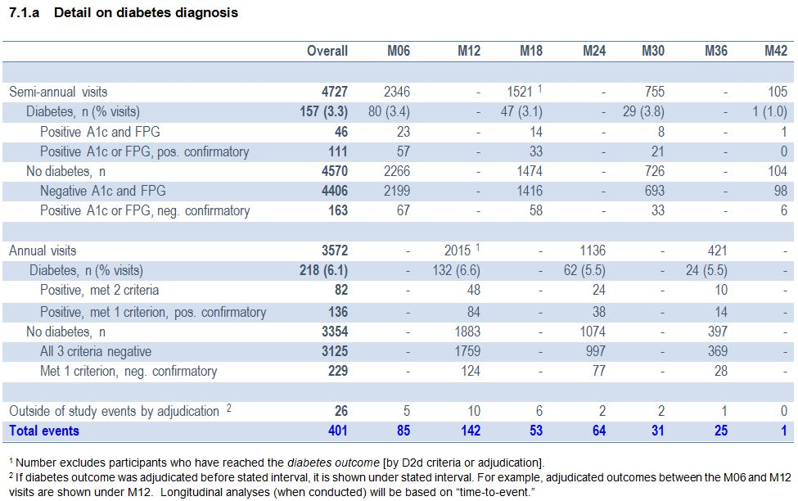
Detail on Diabetes Diagnosis (as of 10/03/17)

