Slide 1
The NIDDK Central Repositories
Beena Akolkar
National Institute of Diabetes, Digestive and Kidney Diseases, NIH

Slide 2
Central Repository Components
Contract funded since 2003
Biosample repository (Fisher):
Processing and archival storage of biological specimens
Heather Higgins, Director
Sandra Ke, Associate Director
Database repository (IMS):
Maintain archival datasets, Respond to queries about data and stored samples
Carol Giffen, Director
Leslie Carroll, Associate Director
Genetics repository (Rutgers Univ.):
Create immortalized cell lines, extract DNA from certain samples, distribute cell lines and DNA
Andy Brooks, Director
Brad Scherer
Dana Witt-Garbolino
Jennifer Liu

Slide 3
Advantages of a Central Repository
Allow additional studies on characterized samples, enhancing the value of each study
Ensure uniform storage conditions
Simplify access by other scientists to samples
Cost effective, economy of scale in processing pediatric genetic samples to create cell lines
Maintain databases after the study ends or investigator leaves the institution
Curate databases to assure their integrity and validity
Facilitate data sharing and reproducibility studies

Slide 4
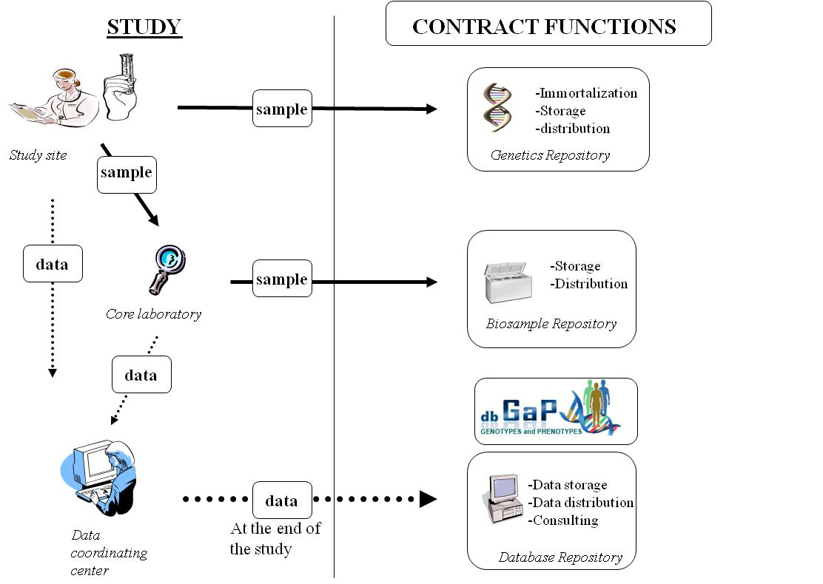

Slide 5
The NIDDK Central Repositories’ Holdings
>100 studies are storing samples and, eventually, data in the NIDDK repository
60 studies have data available for sharing, some with multiple datasets
44 studies have samples and data available
45 GWAS datasets available for sharing through dbGAP

Slide 6
Examples
Diabetes and Obesity Studies
DCCT/EDIC (The Type 1 Diabetes Control and Complications Trial/Epidemiology of Diabetes Interventions and Complications)
DPP (Diabetes Prevention Program)
DPPOS (The Diabetes Prevention Program Outcome Study)
LookAHEAD (Action for Health in Diabetes)
HEALTHY (Middle-School Based Primary Prevention Trial of Type 2 Diabetes)
TrialNet - (Type 1 Diabetes TrialNet)
TEDDY (The Environmental Determinants of Diabetes in the Young)
Kidney Studies
AASK Trial (The African American Study of Kidney Disease and Hypertension Study)
CRIC (Chronic Renal Insufficiency Cohort Study)
MDRD (The Modification of Diet in Renal Disease)
Liver Disease Studies
A2ALL (The Adult-to-Adult Living Donor Liver Transplantation Cohort Study)
HALT-C (The Hepatitis C Antiviral Long-term Treatment against Cirrhosis)
VIRAHEP-C (The Study of Viral Resistance to Antiviral Therapy of Chronic Hepatitis C)
Urology Studies
MTOPS (The Medical Therapy of Prostatic Symptoms)
SISTEr (The Stress Incontinence Surgical Treatment Efficacy Trial) – part of the Urinary Incontinence Treatment Network

Slide 7
The NIDDK Central Repositories’ Holdings
Biosample Repository
Genetics Repository
Affiliated Repositories
Total samples
9,752,720
153,179
166,910

Slide 8
Repositories are Expensive
Repository | costs 2003-2015 | average cost per year
Data | $14,570,009 | $1,266,957
Biosample | $32,434,059 | $2,820,352
Genetic | $34,757,807 | $3,022,418
Costs for acquiring samples
Biosamples - $0.70 - $7/tube depending on the study
Genetics samples - $70 - $800 to produce DNA or a cell line and DNA
Costs for maintaining samples
Biosamples – approximately $0.01/tube/year
Genetics samples - $10-$16/cell line/year

Slide 9
Expensive Resources have to be Useful-
the Repositories’ sharing policies
NIDDK has custodianship of all samples and data transferred to the Repositories and no IP protections are attached
The Steering Committee of each study or study group has control of the samples and data during a “proprietary period”
(2 years after the end of the study or study increment)

Slide 10
Study Milestones Used for Reference
Completion of recruitment
Completion Date (last study contact)
Date Locking of database for analysis
Primary of publication (appears on line)
End of funding period
End of study
In every case, the date for sharing refers to the date that the data are publicly available. Therefore, data must be delivered to the Repository well in advance of the date for sharing.

Slide 11
All Studies
Baseline data: either
  2 years after study recruitment is complete
  or, if it comes first,
  six months of the publication date of baseline paper
analytic set from baseline and other major publications – within 6 months of publication date

Slide 12
Interventional Studies
Primary outcome data - either
  2 years after the database is locked for analysis
  or, if it comes first,
  Six months of the publication date of primary outcome paper
Secondary outcome data - either
  2 years after the database is locked for analysis
  or, if it comes first,
  Six months of the publication date of secondary outcome paper
If there are specific data in the primary outcome publication dataset related to one or more secondary outcomes being prepared for a separate publication, the release of those data may be delayed

Slide 13
Interventional Studies
Complete dataset - either
  At the end of the study, when funding has ended
  or, if the study is continuing as an observational study,
  Three years after the last study contact

Slide 14
Year 1
Year 2
Year 3
Year 4
Year 5
Year 6
Year 7
Interventional Studies
Last patient contact
End of study
Database locked for analysis
Recruitment complete
Baseline shared
Primary outcome shared
All data shared

Slide 15
Observational Studies
Complete dataset - either
  At the end of the study, when funding has ended
  or, if the study is continuing ,
  Two years after the end of the prior competitive funding period
If there are specific data in the primary outcome publication dataset related to one or more secondary outcomes being prepared for a separate publication, the release of those data may be delayed

Slide 16
Sharing Plan
Name of dataset | Dates included | Proposed date or time-line for sharing | Policy for when data will be shared with other investigators
Baseline data |  |  | Two years after recruitment is complete (last initial visit) or within 6 months of publication date
Primary outcome publication – analytic dataset |  |  | Two years after database is locked for analysis or within 6 months of publication
Secondary outcome(s) publication(s) – analytic set(s) - LIST |  |  | Two years after the database is locked for analysis of these outcomes
Entire dataset from intervention study |  |  | Three years after last study contact (FDAAA’s primary completion date)
All complete data elements on full cohort in observational study |  |  | Two years after the end of each project period
Analytic dataset from major papers |  |  | 6 months after publication appears on line
Ancillary studies (list)
Pilot studies (list)

Slide 17
Benefits of Data Sharing
  Enables data generated from one study to be used to explore a wide range of additional research questions
  Increases statistical power and scientific value by enabling data from multiple studies to be combined
  Facilitates validation of research results
  Facilitates innovation of methods and tools for research

Slide 18
Expensive Resources have to be Useful – Make Data and Samples Available
The request process is Web-based
Data requests – reviewed administratively
DNA from cell lines - reviewed administratively
Ancillary requests – no scientific review
External sample requests – peer-reviewed requests:
  Apply for samples only: X01
  http://grants.nih.gov/grants/guide/pa-files/PAR-14-301.html
  Apply for samples and money: R01
  http://grants.nih.gov/grants/guide/pa-files/PAR-13-228.html

Slide 19
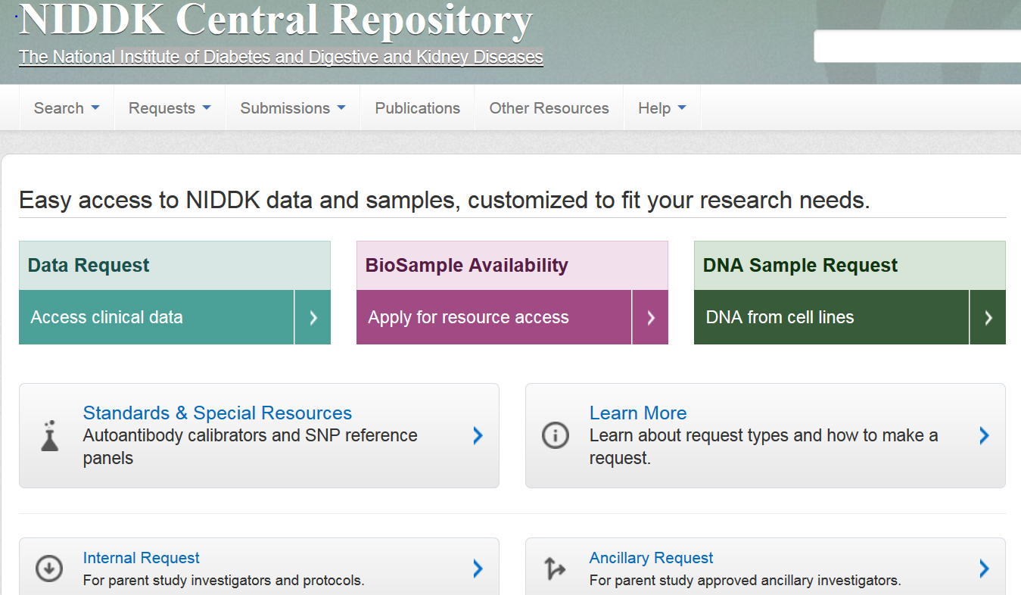
NIDDK Central Repository

Slide 20
Requests for Access
Requests for data and for renewable samples - reviewed administratively for scientific appropriateness. qualifications of the researcher, research environment, and ethical considerations.
Requests for non-renewable samples - regular NIH applications and reviewed by an external panel for scientific merit, qualifications of the researcher, research environment, and ethical considerations.
Year | Ancillary Request | BioSample Availability Request | Data Request | DNA Sample Request | Internal Request | Sample Inquiry | Special Data Request | Special Sample Request | Total
2003 |  |  |  |  | 7 |  |  |  | 7
2004 |  |  |  |  | 7 |  |  |  | 7
2005 | 1 |  | 4 |  | 21 |  |  |  | 26
2006 | 10 | 3 | 5 | 1 | 45 |  |  |  | 64
2007 | 21 | 1 | 14 |  | 33 |  |  |  | 69
2008 | 33 | 3 | 16 |  | 37 |  |  |  | 89
2009 | 22 | 8 | 36 |  | 92 |  |  |  | 158
2010 | 39 | 3 | 25 |  | 106 | 19 |  |  | 192
2011 | 37 | 4 | 36 | 5 | 126 | 40 |  |  | 248
2012 | 29 | 3 | 47 | 2 | 95 | 39 |  |  | 215
2013 | 31 | 7 | 46 |  | 94 | 56 |  |  | 234
2014 | 64 | 9 | 39 |  | 122 |  |  | 2 | 236
2015 | 45 | 5 | 22 | 2 | 92 |  | 1 | 1 | 168
Total | 332 | 46 | 290 | 10 | 877 | 154 | 1 | 3 | 1713

Slide 21
Using the Data and Samples
>150 publications by researchers who gained access to data and samples through the NIDDK Repository and dbGAP including:
  Papers based on the GWAS data sets in dbGAP
  Publications on novel analytic methods or markers in NIDDK Repository-supplied samples

Slide 22
NIDDK Repository Staff
Project Officers
Rebekah Rasooly
Beena Akolkar
Bob Karp
Lisa Spain
Contracting Specialist
Rich Bailey
Technology Transfer
Agnes Rooke
Repository Specialists
Kris Moen
Kay Mobley

