Slide 1
D2d Primary Outcome
Update
What was it?
Why change?
What is it now?

Slide 2
D2d Primary Outcome
Time to Diagnosis of Diabetes
  No change in definition
  Two ways to reach the outcome
    Within D2d, by central laboratory testing
    Outside of D2d, by adjudication of medical records if the participant is started on diabetes medications
  Process for determining outcome is modified

Slide 3
Key Operating Principles for D2d
Central laboratory results are the gold standard for the diagnosis of diabetes.
Very few participants will start diabetes medications prior to being diagnosed with diabetes by D2d central laboratory. This is STILL CRITICAL!
Participants and their clinician (PCP) need to commit to not starting diabetes medication while participants are followed for diabetes in D2d.

Slide 4
Original Assumptions
Once diabetes medication was started, it most likely would be chronic.
      (thus the case would be adjudicated).
Local lab results that the PCP reviews to evaluate glycemia would be equivalent to the central lab results the D2d investigators see.
However often these assumptions were not true.

Slide 5
D2d life is complicated
Local lab results have been on average higher than results from the D2d central laboratory.
  Result is that the PCP diagnosing diabetes earlier than within D2d.
Up until now, D2d central laboratory testing was being done prior to starting or during a temporary stoppage of diabetes medication, when there was the clear intent to start/resume chronic diabetes medication immediately after testing
Notes:
Remember to finish with the comment that those tested right before starting meds are mostly likely to not have diabetes by central labs even if they have diabetes by local labs!!
(most likely is rather strong statement and not completely true- as most participants have not started Metformin for diabetes, but for prediabetes.

Slide 6
  D2d is jeopardized!
Participants with rising glycemia are the ones for whom PCP will want to start diabetes medications.
Use of diabetes medications will delay or may even eliminate the development of diabetes during the timeframe of the trial (which is practically limited by participant consent, site commitment and available funds).
Danger of having too few diabetes cases and have insufficient power to conclude anything
  586 diabetes cases are required

Slide 7
Bias!
If a participant is placed on diabetes medication after testing by Central laboratory is negative, bias is introduced because:
If Vitamin D does reduce the risk of diabetes, then more participants in the placebo group will have gradual increases in A1c and glucose, prompting the PCP to prescribe diabetes meds lowering their risk of developing diabetes, thereby reducing the likelihood of detecting a difference between the two arms.

Slide 8
Intent is Crucial!
If either the PCP or the participant intends to take diabetes medications regardless of D2d glycemic results, then testing by central laboratory prior to starting diabetes medications may reduce the number of cases of diabetes
  Lower results by central lab results in diabetes NOT being diagnosed
  Use of diabetes meds reduces/eliminates future development of diabetes

Slide 9
Going Forward
Protocol v 1.8
It is absolutely ESSENTIAL that very few participants start diabetes medications prior to being diagnosed with diabetes by D2d criteria.
THIS IS CRITICAL!!!
Effective communication with the PCP must happen so that participants and their PCP commit to not starting diabetes medication before diabetes is diagnosed in D2d.
To reduce bias, when there is intent for chronic use of diabetes medications, PCP records and local laboratory test results should be sent to the CC for adjudication.
  lab testing during temporary withholding of diabetes medications will not be done.

Slide 10
What can you do? Prior to Randomization
Assess the participant’s willingness to not start a diabetes medication until diagnosed within D2d.
Inform PCP that participant has consented to the study, the goals of the study and that use of diabetes medications in the absence of diagnosis of diabetes (by D2d criteria or adjudication) is against the protocol. Open the lines of communication early on.

Slide 11
What can you do? After Randomization
At every visit, educate participants that the use of diabetes medication conflicts with the goal of the D2d study and they need to be followed for diabetes within D2d.
After every semi-annual and annual visit, inform PCP of participant’s glycemia outcome and reinforce that the use of diabetes medications in the absence of diagnosis of diabetes (by D2d criteria or adjudication) jeopardizes the study.

Slide 12
What can you do? If Diabetes Meds Are Prescribed
Site personnel will inform the site PI/study physician as soon as they become aware of the potential use of diabetes medication.
The site PI/study physician will initiate a discussion with the prescribing physician ASAP on the possibility of not using diabetes medication until diabetes is diagnosed within D2d.
Reassure the PCP that if diabetes is diagnosed within D2d, they will be promptly notified and the laboratory results will be provided to them.

Slide 13
What can you do? If Diabetes Meds are Started
If the use is for less than 31 days and there is commitment to not resuming diabetes meds, central laboratory testing should be done to confirm status (UNCO visit).
If the use is for 31 days or more or if the intent of the participant or PCP is chronic use of diabetes meds, then that case needs to be adjudicated.

Slide 14
What follow-up you do?
If Diabetes Meds are Started and the COC adjudication = No Diabetes
Continue to follow participants for diabetes until diagnosis is made by D2d testing or by COC adjudication.
  Semi-annual* FPG, HbA1c
  Annual* FPG, HbA1c, 2h OGTT (2hPG)
  *Participants should not take diabetes medications in morning prior to the visit

Slide 15
Why 31 days?
Needed a defined period for consistent implementation.
Important that it be widely accepted to be a short enough period not to affect the long term trajectory of glycemic risk.
1 week too short, 6 months too long

Slide 16
Your Role is Key!
To minimize the number of participants who start diabetes medications prior to a diagnosis of diabetes within D2d.
To communicate effectively with the participants’ PCPs both prior to the start of the study and immediately if diabetes medication is prescribed.
To recruit, retain and complete D2d successfully.
Thank you for all your hard work and commitment!

Slide 19

D2d study

Slide 20
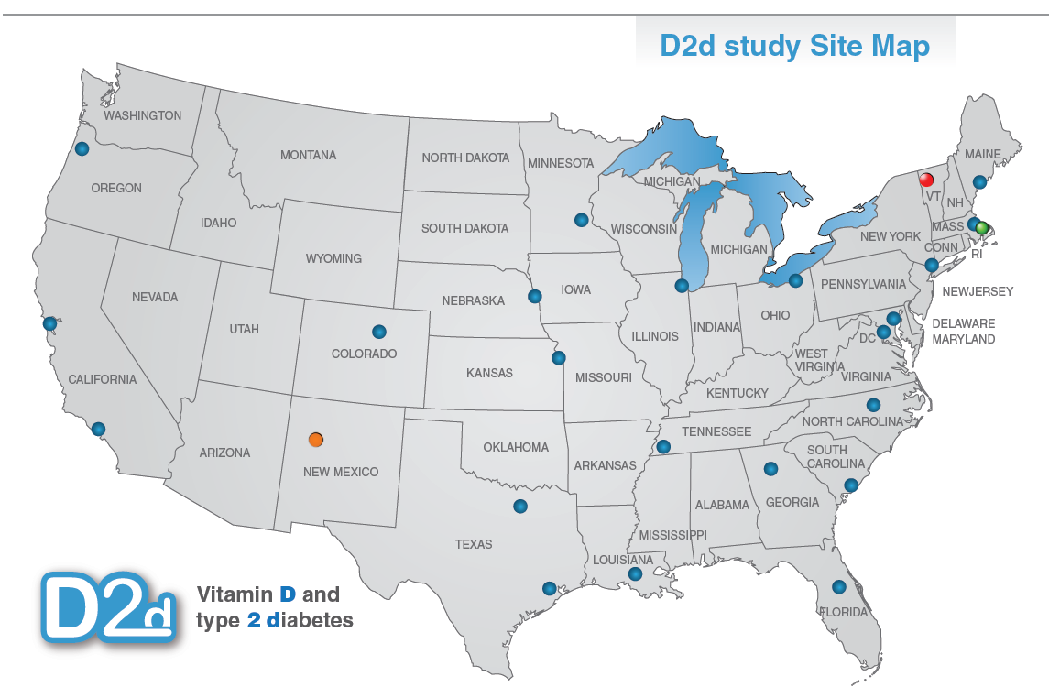
D2d collaborating clinical sites

