Slide 1
D2d glucose testing update
November 9, 2015

Slide 2
D2d glucose testing
From start of study: performed at LCBR with exception of New York State samples
  NYS samples tested at our affiliated hospital (University of Vermont Medical Center (UVMMC))
Testing performed on LCBR’s Roche Integra
  Backup plan: UVMMC (Ortho Vitros)
Summer 2015: Changes in Roche performance led to multiple service visits

Slide 3
LCBR QC / QA
Quality control (QC) at LCBR includes vendor-supplied controls and additional controls.
Additional quality assurance (QA) measures include:
  Periodic testing of aliquots of 20 serum lots to monitor assay performance longitudinally (serum set)
  CLIA-certified; CAP proficiency testing (PT)
  NGSP Level I certification for HbA1c
Glucose testing at our affiliated hospital
  CLIA- and NYS-certified; CAP PT; standard QC/QA
  LCBR sends aliquots from the serum set

Slide 4
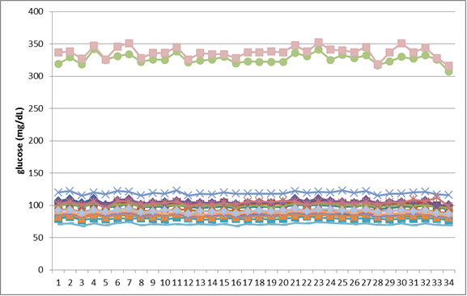
Serum set data

Slide 5
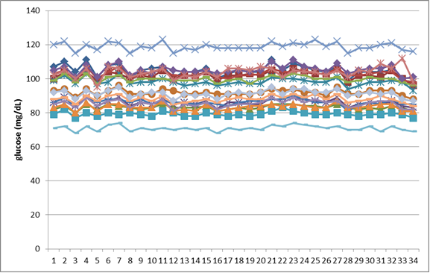
Serum set data

Slide 6
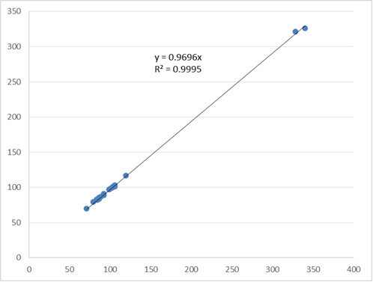
LCBR / UVMMC correlation

Slide 7
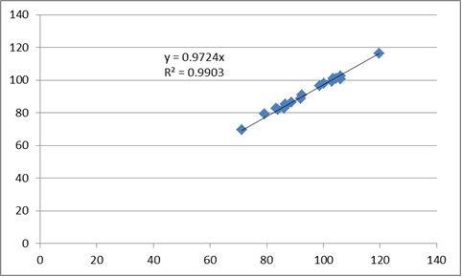
LCBR / UVMMC correlation

Slide 8
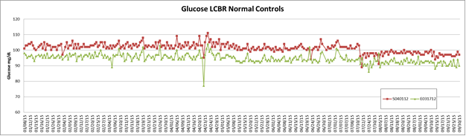
LCBR serum, plasma controls

Slide 9
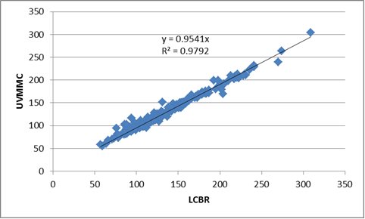
LCBR / UVMMC correlation: NYS

Slide 10
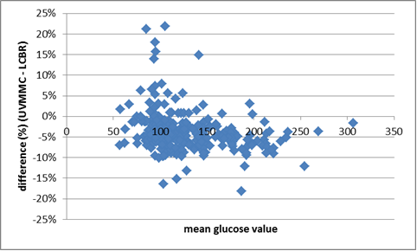
LCBR / UVMMC difference plot

Slide 11
Summary
UVMMC glucose < LCBR glucose
Magnitude of difference = 2.7 - 4.5%
LCBR’s Roche remains down
LCBR is working with EC, CC to address this issue in a manner that best supports D2d.

Slide 12
D2d glucose testing update
November 9, 2015

