Slide 1

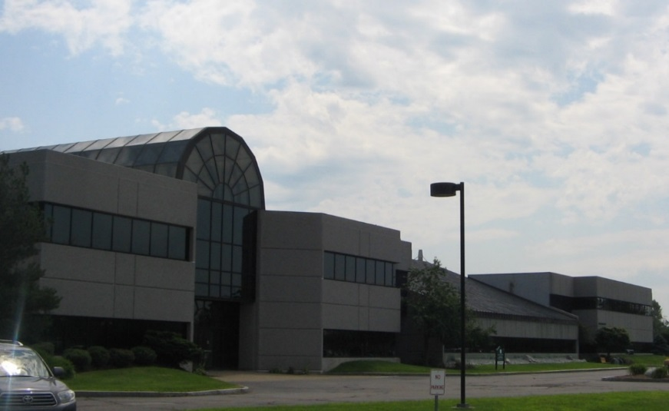


D2d Study at
The Central Laboratory
Dr. Michael Lewis
Medical Director of CLIA Laboratory
Lab Coordinator:
Elaine Cornell
Lab/Project Manager:
Rebekah Boyle
D2d Coordinator:
Lyndelle LeBruin
There are approximately 23 Technical staff, plus students, post-doctoral fellows and visiting scientists at the LCBR at any point in time
Russell P. Tracy, Ph.D.
is the Director of the Laboratory for Clinical Biochemistry Research (LCBR) established in 1986

Slide 2
Table of Contents
LCBR Overview and Background
Sample Receipt
Sample Aliquoting & Repository Storage
Data and Reporting

Slide 3
Section 1
Overview & Background

Slide 4
Colchester Research Facility(CRF)
Location of laboratory
The Colchester Research Facility:
Location of laboratory
  Colchester Research Facility (CRF) which is ~ 5300 sq ft for research divided into
  5 main areas:
    Sample receipt and processing
    General biomarker lab
    DNA preparation and analysis lab
    Cell and flow cytometry lab
    CLIA-certified clinical chemistry lab
Building and room access are limited to authorized personnel only

Slide 5
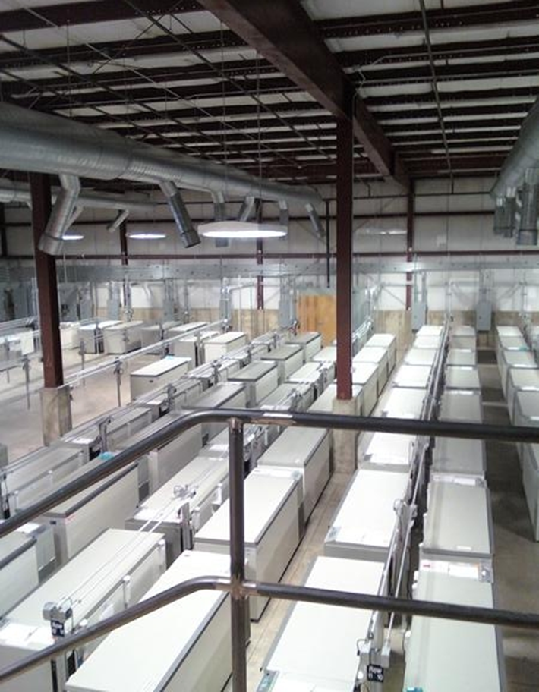
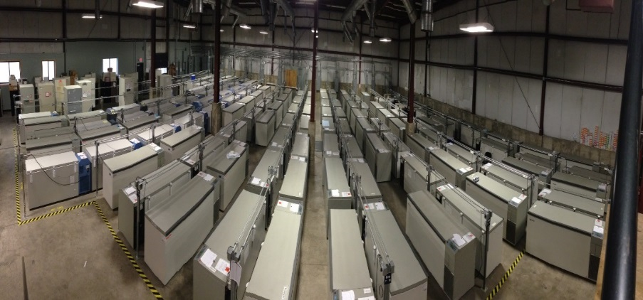
The Flynn Freezer Facility
Biospecimen Sample Repository
~ 10,000 sq ft facility housing 146 Ultracold -80˚˚C and -150˚C freezers
200 kW generator backup
Temperature controlled & monitored (both freezers & ambient)
All freezers are monitored 24/7 by Sensaphone Auto-Dialer systems for temperature and power failure
Sensaphones are programmed to dial out to a dedicated beeper monitored 24/7 by a trained LCBR “on-call” person
UVM Service Operations, UVM Police Services, Vermont Heating and Ventilation, Burlington Fire and Police Departments are available to respond when necessary
Freezer inspection, maintenance, and cleaning is performed on a routine schedule
Staff are trained on the LCBR Disaster Plan which is reviewed annually at a minimum,
Limited access via card swipe & all entries are tracked
Flynn Freezer Facility + CRF :
169 freezers
>4M samples
>100,000 subjects

Slide 6
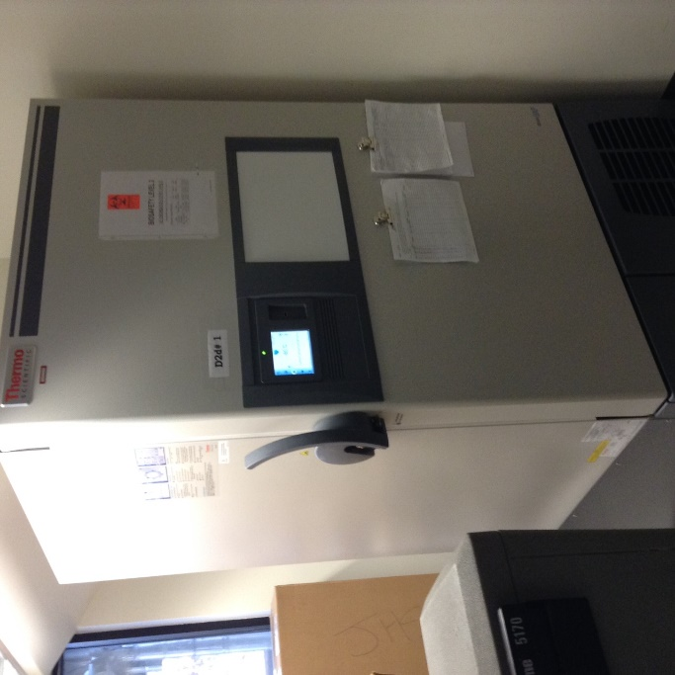
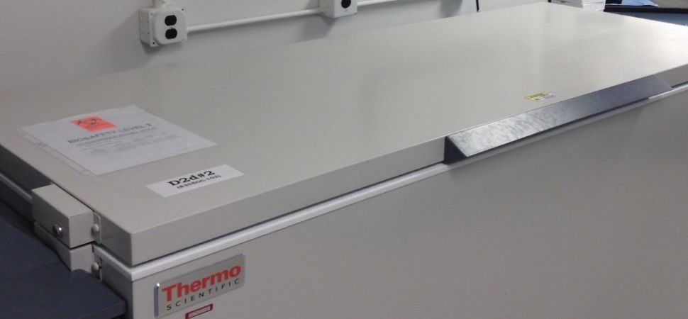
Colchester Research Facility(CRF)
Location of laboratory - Freezers
Fisher upright freezer will be shipped off to the NIDDK with samples
400 kW generator in case of power failure
Chest freezer stores samples at the LCBR
Temperature controlled & monitored (both freezer & ambient)
Access to CRF during non-business hours is limited to those with authorized CAT card (all entries are tracked)
Freezer rooms locked when not in use by LCBR staff
D2d freezers

Slide 7
Quality Assurance
&
Quality Control
Quality control (QC) at LCBR includes the use of vendor-supplied controls and additional commercial controls
Internal QA/QC for clinical assays: CLIA (Clinical Laboratory Improvement Amendments)-certified Clinical Laboratory
Additional quality assurance (QA) measures include:
  Periodic testing of aliquots of 20 serum lots to monitor assay performance longitudinally
  CAP (College of American Pathologists) proficiency testing (PT)
  NGSP (National Glycohemoglobin Standardization Program) Monitoring Level I certification for HbA1c
Glucose testing at our affiliated hospital- UVMMC
  CLIA- and New York State-certified; CAP PT; standard QC/QA
  Different instrument from LCBR (Ortho Vitros vs. Roche Integra)

Slide 8
Quality Assurance
&
Quality Control
Quality assurance programs (Extramural assays)
  WHO & IFCC (World Health Organization, International Federation of Clinical Chemistry) standards for calibration
Repository Quality Assurance
  ISBER Membership (International Society for Biological and Environmental Repositories)
  Use of NCI Best Practices for Biorepositories (NIH standard)

Slide 9
Study ID Design
Enrollment ID/Subject ID
Assigned to the participant through EDC system
Matched to KIT ID
Subject ID is matched to the Kit ID at the sites when specimens are collected
The visit type, visit date will also be captured and recorded
Matched to Repository ID (CBAL#)
Upon sample receipt at LCBR, a CBAL# will be assigned to all subjects/participants

Slide 10
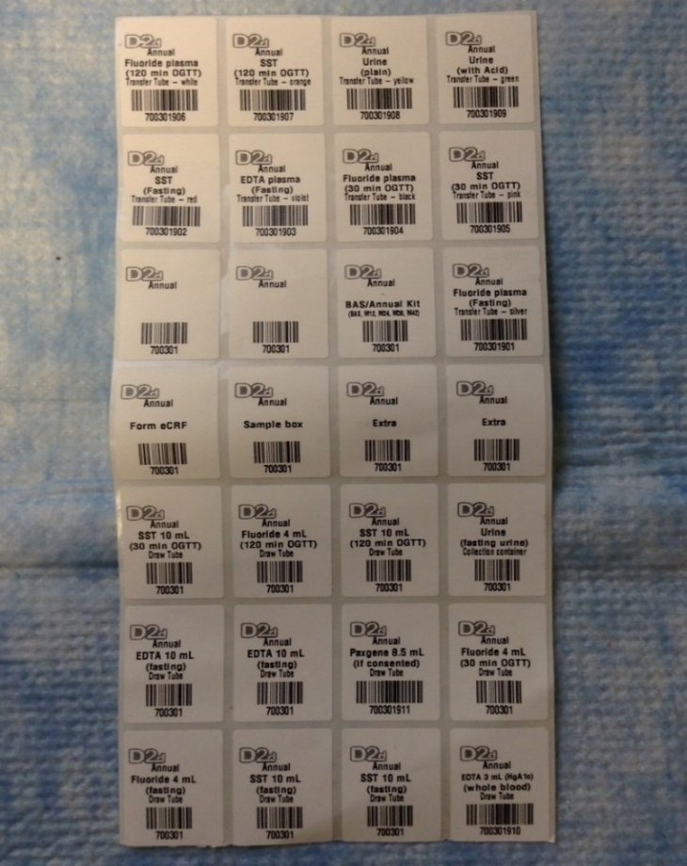
Tube Identifiers by Visit Type
D2d Visit | 6-digit Kit ID
Screening | 200000 - 299999
Baseline/Annual (BAS/Annual) | 700000 - 799999
M03 | 300000 - 399999
M06 | 600000 - 699999
Semi-annual(M18, M30, M42) | 500000 - 599999
Unscheduled/ Confirmatory (UNCO) | 400000 - 499999
End of Study (EOS) | 900000 - 999999
eCFR label
Sample box label

Slide 11
Sample Shipment to LCBR
Refrigerated Shipments (3 mL EDTA whole blood and PaxGene DNA):
Collection Ship Day
Monday Monday
Tuesday, Wednesday Wednesday
Thursday, Friday Monday
Frozen Shipments of blood and urine specimens are shipped Monday, Tuesday, Wednesday weekly

Slide 12
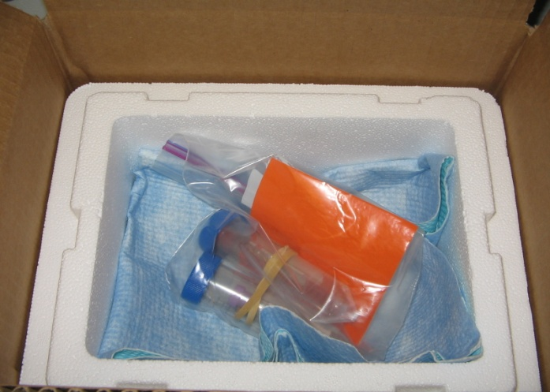
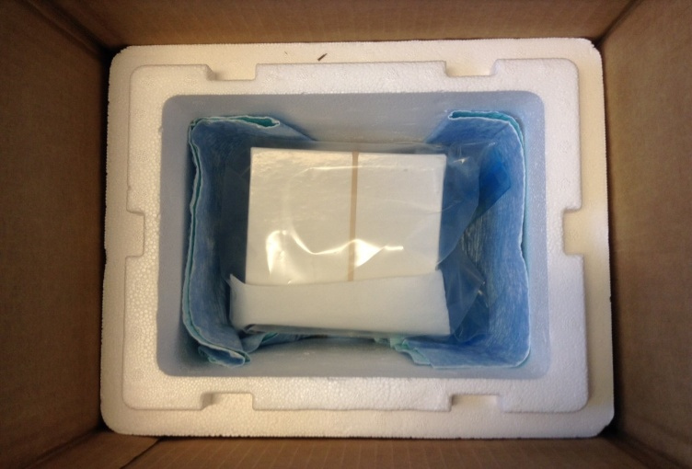
Shipments to LCBR
Refrigerated shipments
Frozen shipments
Ship 3 mL EDTA for HbA1c & PaxGene DNA tubes within 5 days of being drawn
Samples should be tested within 7 days of collection
Use two ice packs (minimum) per shipment
Add eCRF(s) in ziploc to top of Styrofoam box
Add sufficient dry ice to last 2 days of transit at minimum (be generous if possible ☺ ☺ ☺)
Use a rubberband to secure box contents
Add eCRF(s) in ziploc to top of Styrofoam box
Samples not tested if received thawed

Slide 13
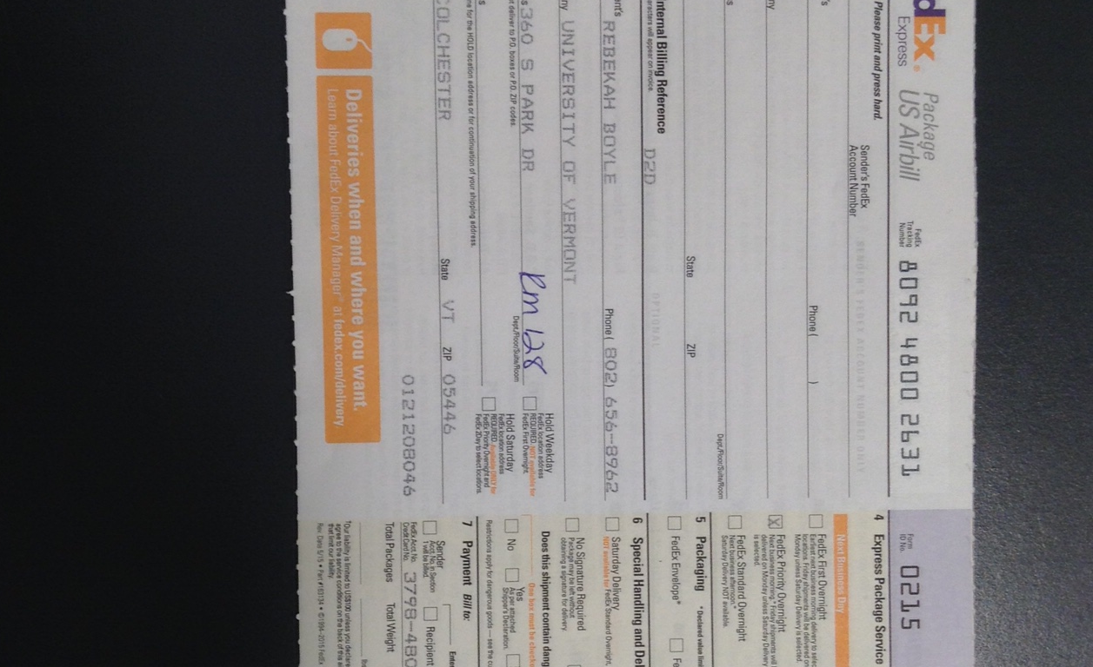
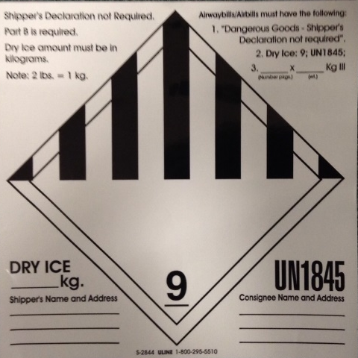

Sample shipments to LCBR
Address
Third party
&
Account #
Reference#
Fedex priority overnight

Slide 14
Section 2
Sample Receipt

Slide 15
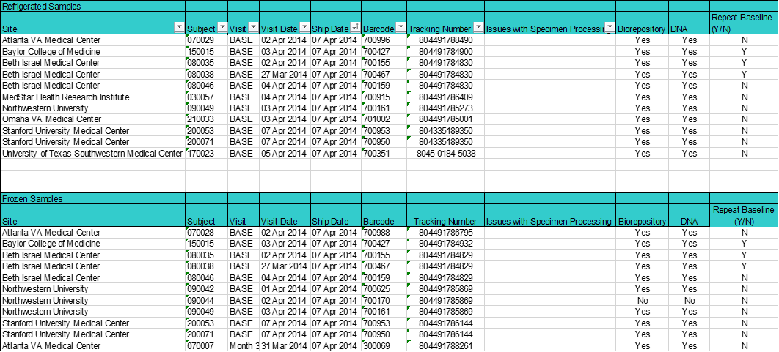

Sample Receipt
Kit ID
Consent information from Medidata
Fedex tracking #
Visit date
Subject ID

Slide 16
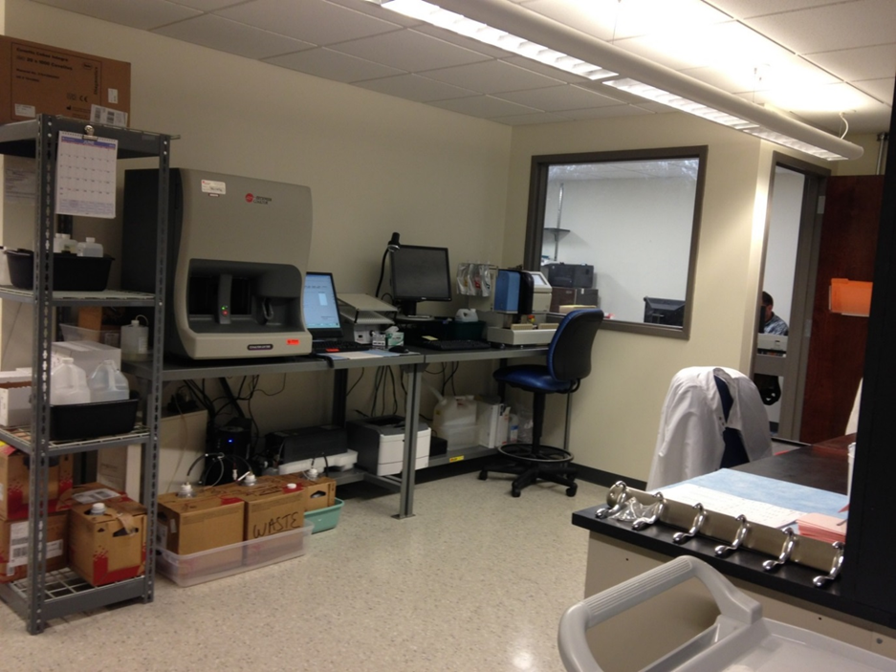
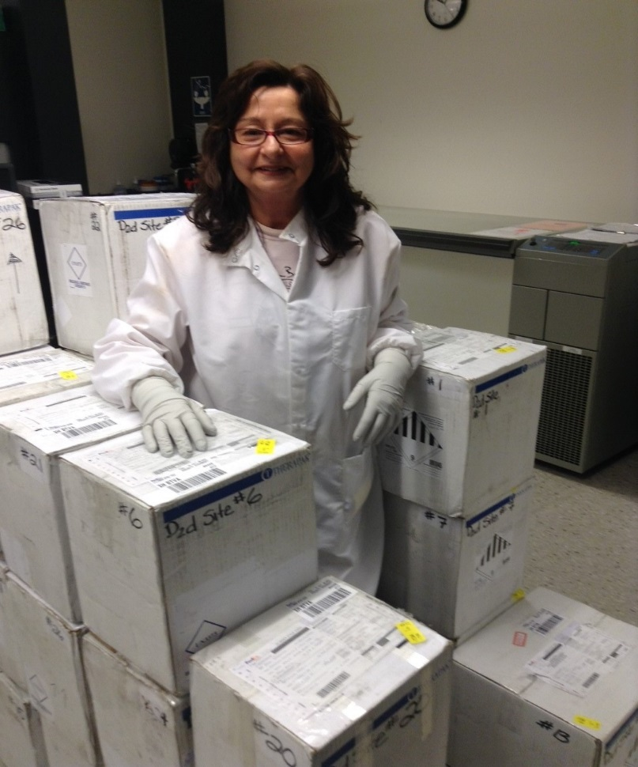
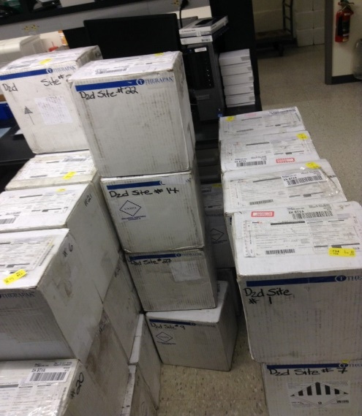
Sample Receipt

Slide 17
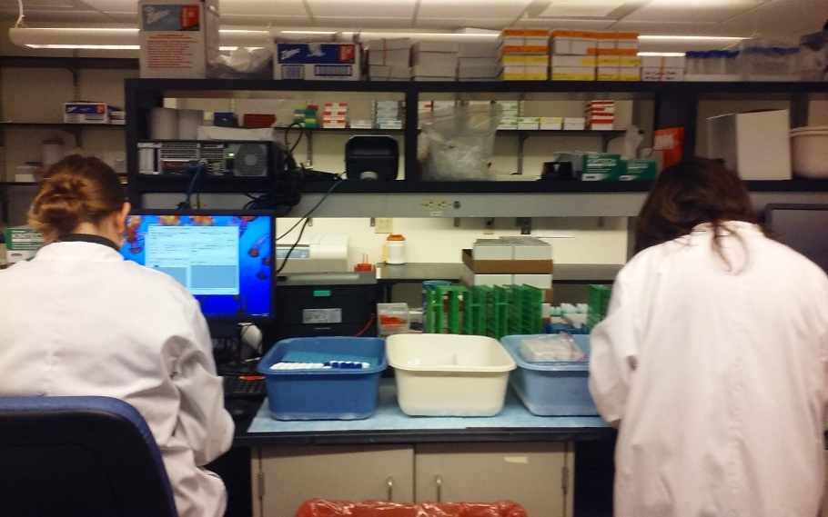
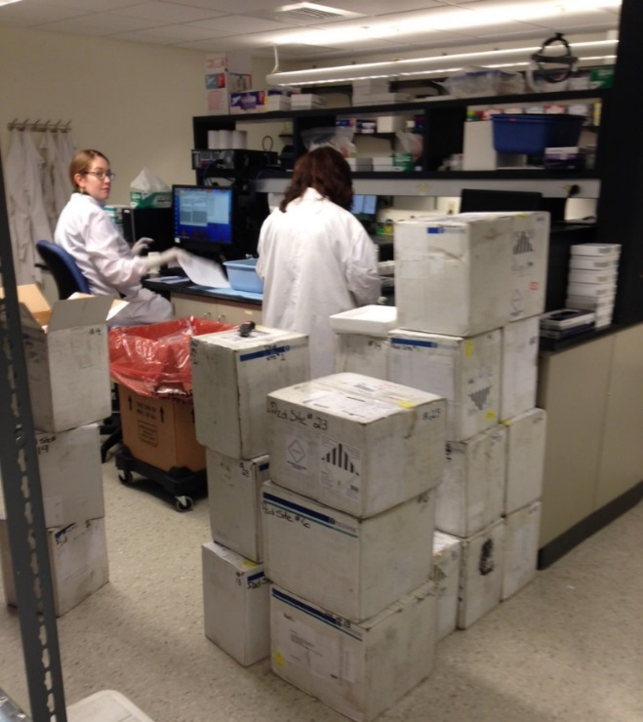
Sample Processing
Station 1
Station 2

Slide 18
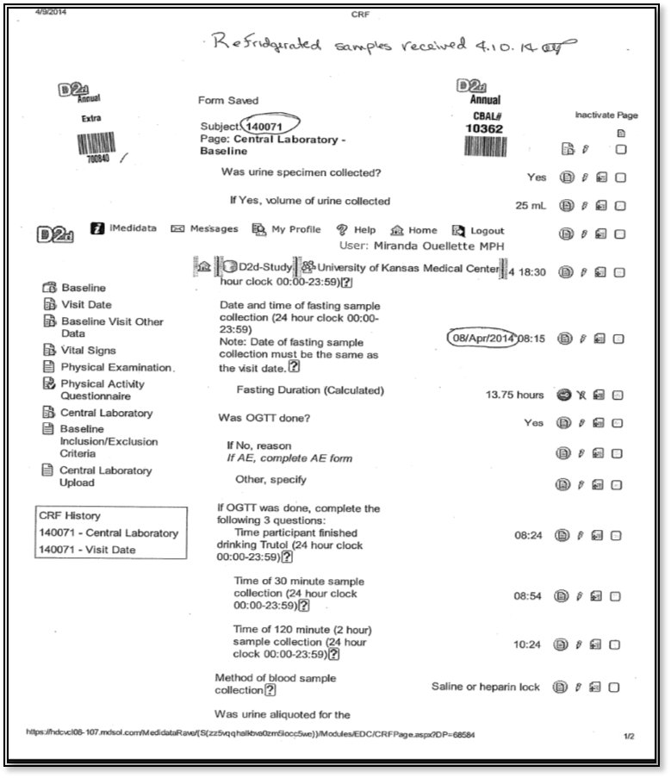
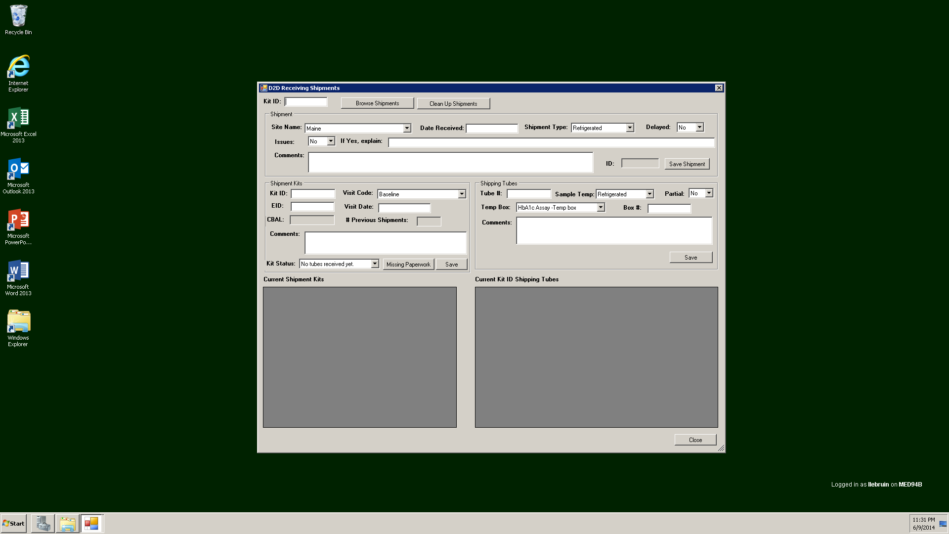
Sample Processing: eCRFs & Database
Entered into a database
Kit ID
Subject ID
Visit date

Slide 19
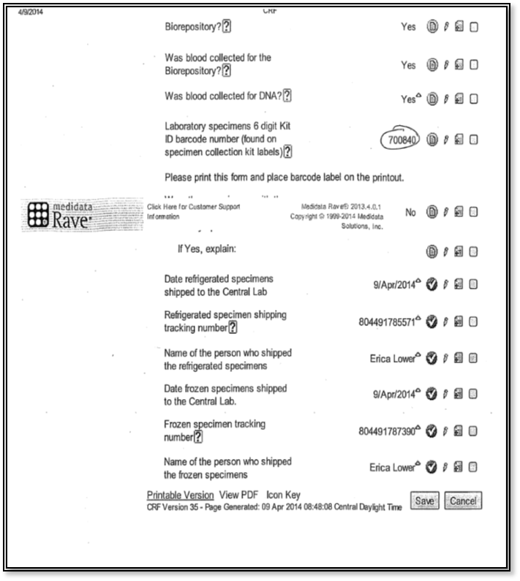
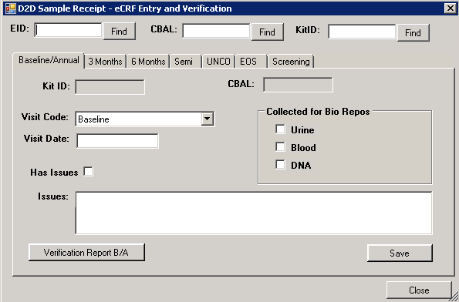
Sample Processing: eCRFs & Database
Note on lab form WHEN someone consented, but repository sample NOT OBTAINED
Collected for biorepository

Slide 20
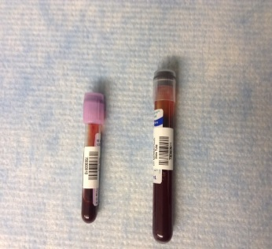
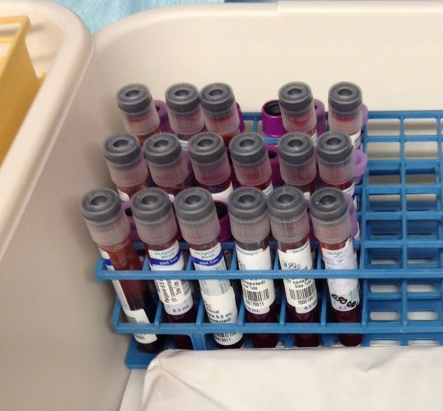
Sample Processing
Refrigerated shipments
PaxGene DNA (911 tube extension)
ONLY collected at BASELINE visit
No M12 or other ANNUAL collection
EDTA WB tube
Visit Type | Tube extension
BAS/Annual | 910
Month 6 (M06) | 916
Semi-Annual (M18, M30, M42) | 918
UNCO | 921
EOS | 924
Screening | 927
Place label(Kit ID) on each vacutainer tube

Slide 21
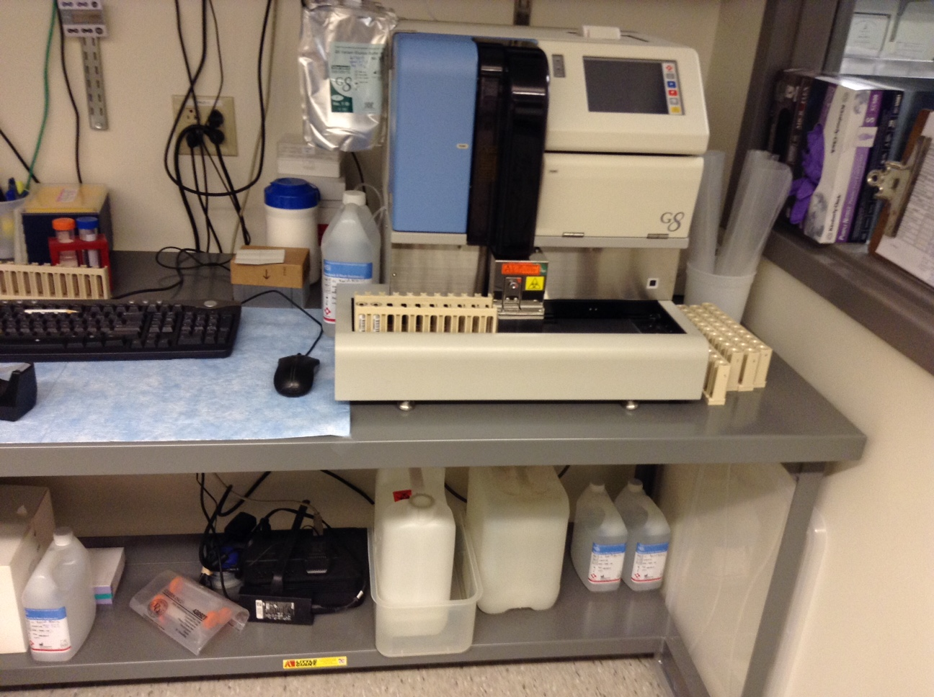
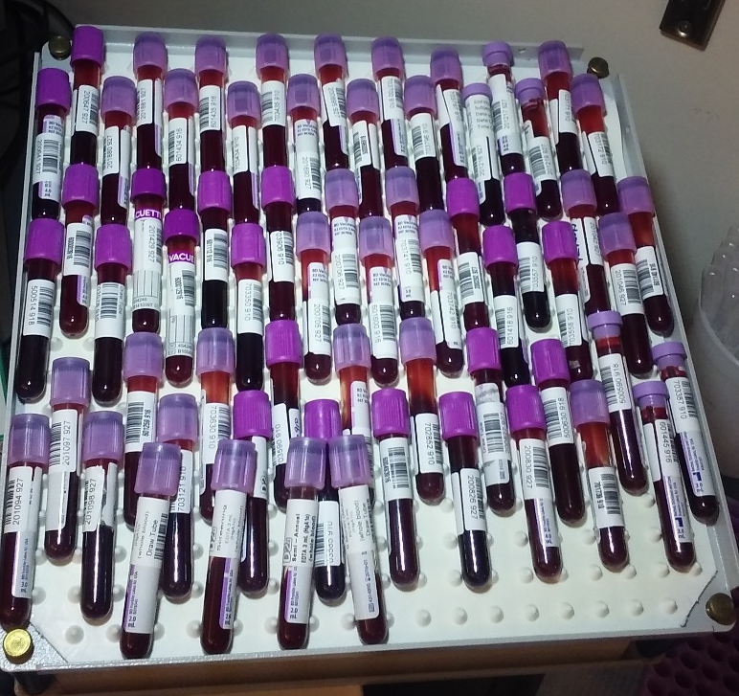
Sample Testing
Tosoh G8 for HbA1c testing

Slide 22
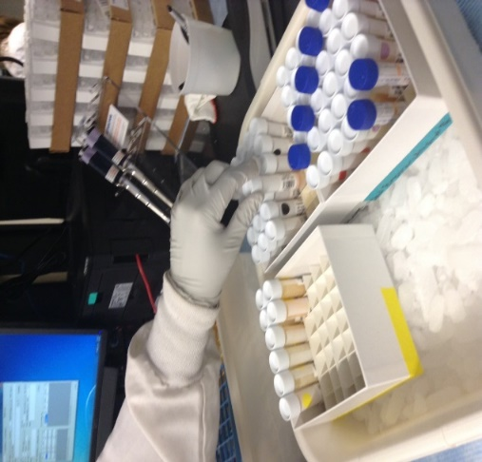
Sample Receipt
Frozen shipments
Sample Type ( tube extension) | Expected approximate volume
Screening Fasting Fluoride Plasma (928) | 2 mls
M03 plain urine (912) | 9 mls
M06 Fasting Fluoride Plasma (913) | 2 mls
M06 Fasting SST (914) | 5 mls
M06 Fasting EDTA(915) | 5 mls
UNCO Fasting Fluoride (919) | 2 mls
UNCO 120 min Fluoride Plasma (920) | 5 mls
UNCO plain urine ( 925) | 9 mls
EOS Fasting Fluoride Plasma (922) | 2 mls
EOS Plain urine (923) | 9 mls
Semi-Annual (M18, M30, M42) Fasting Fluoride Plasma | 2 mls
Moved to Analyzer
Moved to Aliquoting

Slide 23
Section 3
Aliquoting
&
Repository Storage

Slide 24
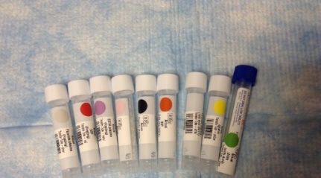
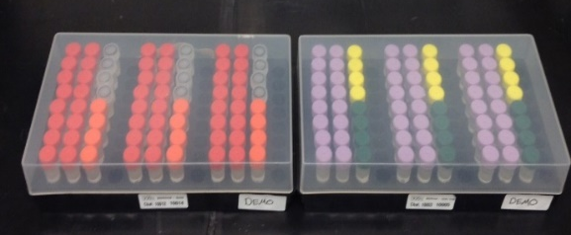
BAS/Annual Repository Design
One participant
50 cryovials per participant (CBAL) for full consent to repository

Slide 25
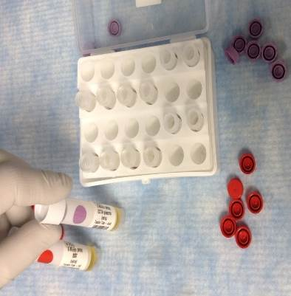
Month 6 Repository Design
Fasting Serum & EDTA samples
12 cryovials per participant (CBAL)
for consent to repository

Slide 26
Section 4
Data & Reporting

Slide 27
Test Results
Test results: HbA1c, GL, Urine calcium/creatinine (UCACR) ratio
Results are uploaded to Medidata
***S & C traits are confirmed before being reported; slight delay in reporting results
Principal Investigators & Primary Research Coordinators
are notified of
Abnormalities (HbA1c) & Critical values(GL)
prior
to data transmission

Slide 28
Reporting codes
Assay Codes
ASSAYC | ASSAY | UNITS
GLU0 | Glucose timepoint 0 | mg/dL
GLU30 | Glucose timepoint 30 | mg/dL
GLU120 | Glucose timepoint 120 | mg/dL
HbA1c | Hemoglobin A1c | %
UCACR | Urine calcium creatinine ratio
Result Codes
LCBR Assay Result Code
2 | Normal Result
3 | Poor quality-with result
4 | Out of Range-Low
5 | Poor quality-without result
6 | Out of range-High
7 | Quantity not sufficient
8 | No result-Other
Quality Codes
LCBR Quality Code
2 | Acceptable
3 | Hemolyzed
4 | Lipemic
5 | No sample
6 | Centrifuged

Slide 29
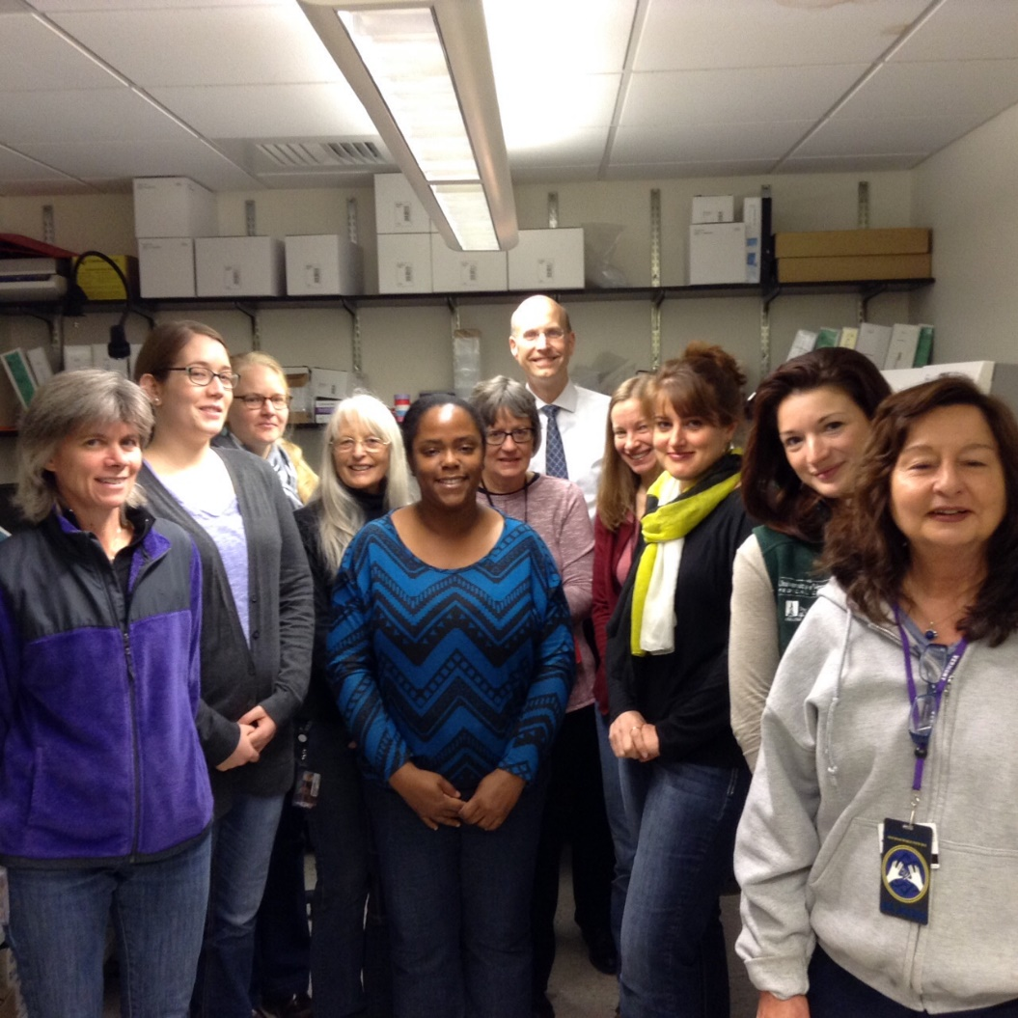
LCBR D2d Team

Slide 30
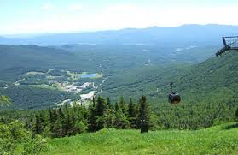


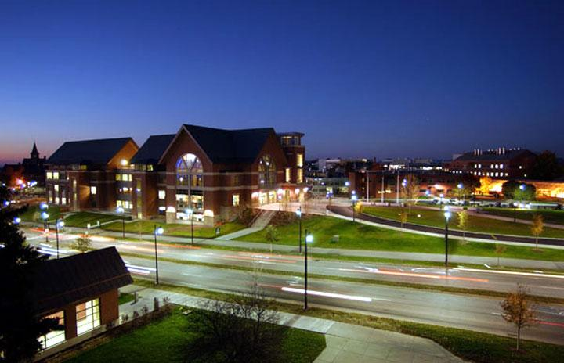
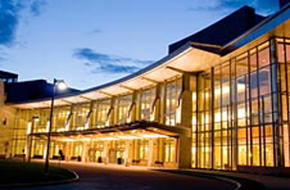
Questions?

