Slide 1
D2d Ancillary Studies Evaluation Subcommittee (ASES)
D2d Annual Meeting
November 9, 2015

Slide 2
Ancillary Studies Evaluation Subcommittee (ASES)
Develops, approves and oversees the ancillary studies policies and procedures
Solicits ancillary study applications
Evaluates ancillary study letter of intents and applications and makes recommendations to the Steering Committee regarding the proposals
Monitors progress of approved ancillary studies
Seeks guidance from other committees, as needed

Slide 3
ASES Members
Cyrus Desouza, Chair
Chhavi Chadha
Bess Dawson-Hughes
Sangeeta Kashyap
Michael Lewis
Taso Pittas
Richard Pratley
Philip Raskin
David Robbins
Cliff Rosen
Myrlene Staten

Slide 4
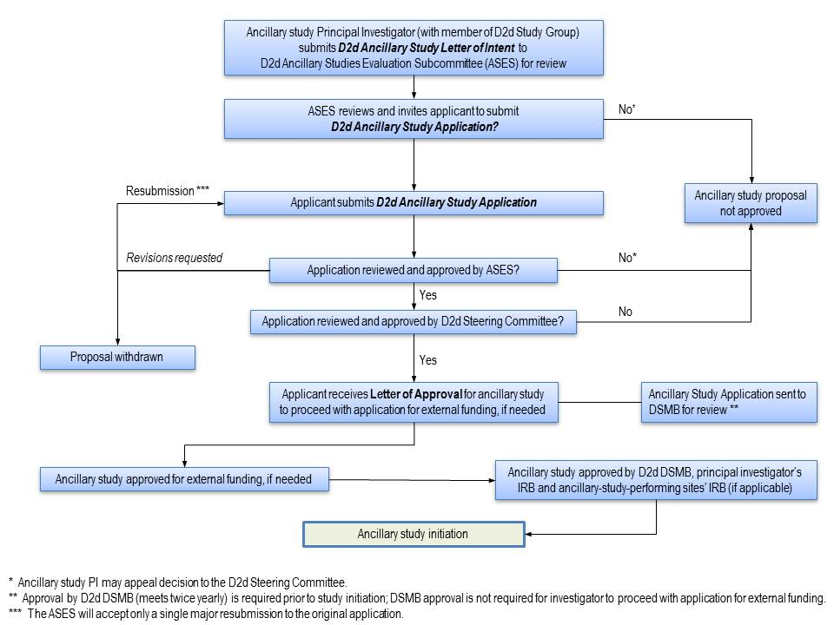

Slide 5
Submissions
Status updated since 11/1/2014
Title | Submission Date | Status
Effects of vitamin D on skeletal muscle mass and performance in pre-diabetes | 3/29/2013 | Not funded
The vitamin D, type 2 diabetes, and gut microbiome (D2d-GM) study | 10/22/2013 | Not funded
Effect of vitamin D supplementation on risk for common cancers | 2/10/2014 | Not funded
Contribution of free and total 25OHD in predicting progression to type 2 diabetes | 5/5/2014 | Not funded
Cognitive benefits of vitamin D in persons with pre-diabetes | 7/16/2014 | Not funded
Assessment of the (NDEP) GAMEPLAN toolkit in the D2d study | 5/23/2013 | Enrollment complete

Slide 6
Submissions
New since 11/1/2014
Title | Submission Date | Status
Vitamin D, depression, and cardiovascular risk in pre-diabetes | 10/31/2014 | LOI approved
Does vitamin D3 supplementation have an effect on markers of DNA damage | 12/5/2014 | Under review at funding agency
Time course of beta cell function decay in D2d subjects with prediabetes | 2/5/2015 | Withdrawn
Effects of VD3 on biomarkers of beta-cell injury and inflammation in prediabetes | 9/25/15 | Under review at funding agency

Slide 7
Next Steps
As recruitment winds down, less opportunity to generate new data from participant visits
Accepting proposals for ancillary analyses (data analyses and use of repository samples)
Feasibility questions: Have a question about the number of people who might fall into a population of interest? Email D2d and we can provide you with that information.

