Slide 1

Changing Your Behaviors
Rachel Tomko, M.A. & Patrick M. O’Neil, Ph.D.
Weight Management Center
Department of Psychiatry and Behavioral Sciences
Medical University of South Carolina
Charleston, South Carolina

Slide 2
“Diet and Exercise”
LIFESTYLE CHANGE
Diet: Learn about nutrition and make healthier food choices
Exercise: Maintain regular activity/exercise routine
Thoughts: Pay attention to beliefs about food/weight and reactions to dieting/exercise
Behavior: Monitor current behaviors by weighing regularly, recording exercise, and tracking food intake
Social Support: Maximize people in your life who support healthy behaviors
Notes:
Your habits and behaviors are part of your healthy lifestyle—and they impact your weight.
Losing weight and maintaining weight loss more than just doing exercise and watching what you eat—changing your behaviors means changing your lifestyle.
So, diet and exercise are important, but there is more to it than just that. Today we’ll focus on your thoughts and behavioral strategies to help you make these changes.

Slide 3
Self-Monitoring
Tracking your behavior is the first step in changing it!
What can you track?
Weight
Food/liquid consumption
Activity
Sleep
Goal progress
Notes:
In order to be able to increase healthy behaviors, you first need to ask yourself—”what am I currently doing?”
The best way to find out about your current habits is to record them. This can be done in a number of ways and we’ll talk more about that in a bit. First, let’s talk about WHAT to record.
1) You can track your weight and see how this changes over time.
2) You can track your food intake by writing down what you eat and when. Likewise, you can track water consumption to make sure you are getting adequate amounts of water.
3) If you record your activity for a week, you may have a better sense of how many calories you typically burn and what your body needs for energy. You can track the number of steps you take, the number of minutes you spend in physical activity, the number of repetitions you do on a particular weight training exercise and the amount of resistance (weight) that you are able to move. There are so many different types of physical activity and so many ways to track it. Maybe your goal is to increase walking speed. You can record your pace over time. These are just some examples.
4) We know that adequate sleep is also important for weight loss and health. It’s often a good idea to track the number of hours you are getting each night.
5) Finally, you can track whether or not you are meeting your goals. This is important so that you can adjust goals accordingly to make them more achievable or to push yourself further. We’ll talk about setting goals later today.

Slide 4
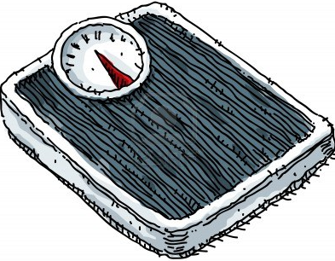
Why Keep Track?
People who track more regularly tend to lose more weight
People who weigh more regularly are more likely to lose weight and keep the weight off
Tracking increases your awareness of your behavior and things that affect your behavior
Tracking keeps you accountable
Notes:
Why should you record these things?
Because we know it works. People who track more lose more weight and keep it off.
Tracking increases your awareness of your behavior. We often hear people say, “had I paid any attention to the fact that I was gaining the weight, I could have intervened earlier. I knew I was gaining, but I didn’t realize how quickly or how much I was gaining.”
Also, tracking helps keep you accountable. People don’t like to write down things they aren’t proud of.

Slide 5
Tips for Self-Monitoring
More effective if close in time to behavior
Example: track meal immediately after or during the meal
Track regardless of whether you did well
It’s fun to write it down if you feel you did well, but just as important if you did not do well!
Some records are better than no records
Notes:
When possible, track behavior immediately after you do it. For example, after you eat, immediately write down what you eat. After you walk a mile, record your pace and other information you want to know.
This provides you with real-time feedback on how you are doing and keeps you thinking about this throughout the day (rather than just at night when it’s time to write it down).
Also, like I mentioned earlier, some people don’t like to track when things aren’t going well…but, it’s just as important! Get in the habit of tracking both the good and the bad.
If you can’t remember what you had for breakfast and you didn’t write it down, it’s not too late to start tracking at lunch time. Some records are always better than no records.

Slide 6
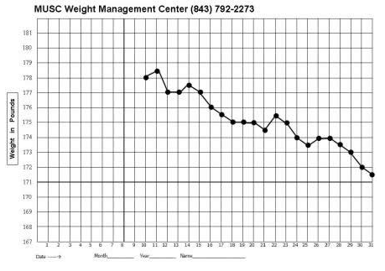
Weight Graph
Notes:
At the Medical University of South Carolina Weight Management Center, all patients are encouraged to keep a weight graph. This provides a visual of progress over time. One important point here is that, no one data point is all that important—it is the pattern that is important. If you don’t feel like stepping on the scale one day because you don’t think you did well, remember, it’s just one data point in the bigger picture.
Also, most people don’t realize that day to day fluctuations are mostly water weight. You have to expend 3500 calories more than you consume to lose 1 pound, but it only takes 1 pint of water to make a pound.

Slide 7


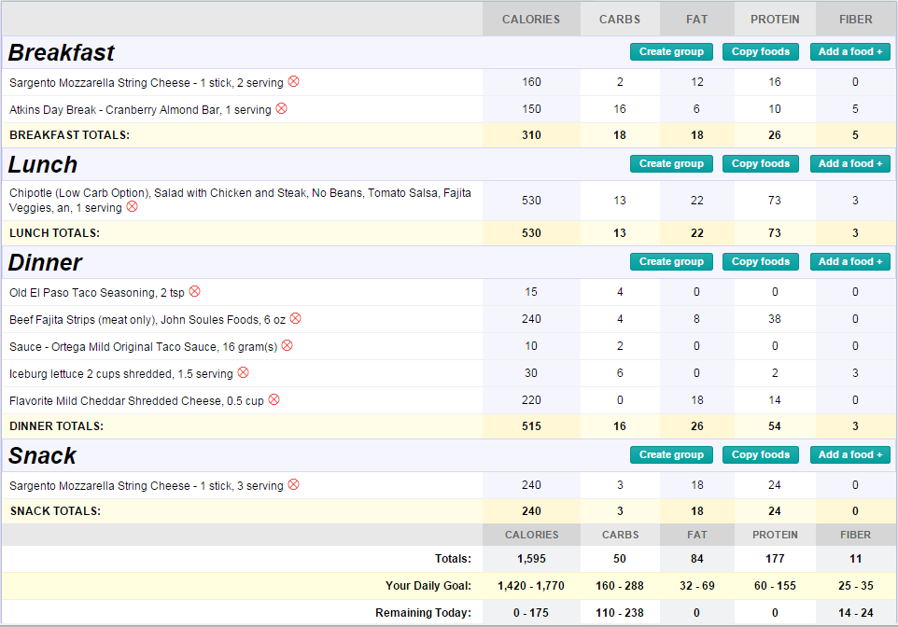



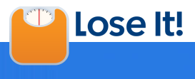


Online Tools for Tracking
Notes:
There are plenty of online tools for tracking diet and exercise and many of them have an app available as well so that you can track on your phone. These have made tracking less time consuming and they also can provide helpful reports of your progress over time. In fact, many will produce a graph similar to the paper and pencil weight graph you just viewed.
Here are several popular tracking websites (on the right). Please note that D2d has no affiliation with any of these products and is not endorsing any specific brand:
Free Online Tracking Tools:
Myfitnesspal
Fatsecret
Sparkpeople
Mapmyfitness
Cronometer
Livestrong.com

Slide 8
Setting Goals
Tracking behavior can:
Provide a baseline of current behavior
Help you identify areas for change
Help you see progress when you make changes!
Goal setting is an important part of behavior change
Notes:
If you track your current behavior for awhile without making any changes, you can get a good idea about your current “norm.”
From there, you might see some areas for improvement. This is where goal setting becomes important.

Slide 9
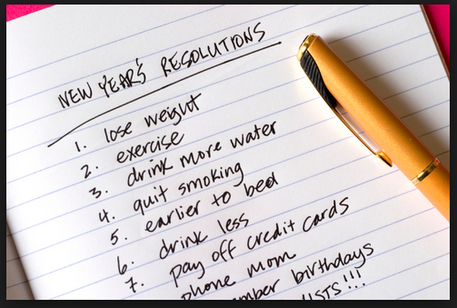
What’s Wrong With These Goals?
Notes:
What’s wrong with these goals? (gather ideas from group)
-They aren’t very specific.
-It’s better to have a time frame—when will you complete this by?

Slide 10
SMART Goals
Specific
Measurable
Attainable
Rewards
Timeframe
Notes:
So, how do you set good goals? We use the acronym SMART goals.
Your goals should be specific, measurable, attainable, and should specify an end time. You should also come up with some sort of reward for yourself for meeting your goals. Let’s go through these in more detail.

Slide 11
SMART Goals Example- “Exercise More”
Specific
What exactly are you going to do?
“I’m going to ride my bike more.”
How much/how often will you do it?
“I’m going to ride my bike 6 times a week for 60 minutes each time.”
Measurable
What’s realistic? Consider your
current behavior.
“I’m going to ride my bike 3 times a week for 30 minutes each time.”
Attainable
Rewards
What’s going to keep you motivated?
“I’m going to ride my bike 3 times a week for 30 minutes
each time. If I meet my goal, I’m going to reward myself
with a new book.”
Timeframe
When will your goal end?
“I’m going to ride my bike 3 times in the next week for
30 minutes each time. If I meet my goal, I’m going to reward myself with a new book.”
Notes:
Let’s take the common New Year’s Resolution—”I’d like to exercise more.”
First, let’s define specifically what we mean when we say exercise. So a more specific goal might be, “I’m going to ride my bike more.”
Okay, that’s more specific. But, what do we mean by “more”? How much more? You want to set a very, clear cut-off so that you can measure your success. So, “I’m going to ride my bike 6 times a week for 60 minutes each time” would be a measurable goal.
We also have to consider current activity. If you’re already riding your bike 5 times a week for 45 minutes, this is a great goal. What if you’re not riding your bike at all? This might not be a realistic starting point. We want our goals to be attainable. Maybe a more realistic goal is “3 times a week for 30 minutes each time.”
It’s important to consider rewarding yourself as well. These aren’t always necessary, but are important if you’re having trouble meeting your goals. There are some immediate benefits of exercise, such as feeling accomplished and a rush of endorphins—but, weight loss is not immediate. So, figure out ways to keep you motivated. Rewards should be something you would not normally give yourself.
Lastly, you need a deadline. A deadline gives you time to evaluate your progress, reward yourself, and set new goals!
[Can stop here and do a SMART goal activity—either ask for a few volunteers and go through examples as a group, or pass out worksheet and have everyone write down 1-2 SMART goals.]

Slide 12
What if I don’t meet my goals?
A lapse = one instance of straying from diet/exercise/behavior plan
Examples:
Eating more calories than planned at a restaurant
Not riding bike when planned on a specific day
Not tracking weight/calories/activity one evening
A relapse = a series of lapses or a return to old patterns of behavior
Examples:
Making unhealthy dietary choices for a week
Not exercising for several weeks
A collapse = an extended relapse, requiring more help and support to overcome
Example:
Regaining a significant amount of weight lost
Notes:
So, you’ve set good, SMART goals…what if you find that you aren’t meeting your goals? First, ask yourself, were they really attainable? Are they attainable for you right now given your current situation? If not, adjust slightly and allow yourself to have some successes…then build back up to the original goal.
If that doesn’t work, step back and evaluate what’s going on. Did you have a lapse, relapse, or collapse?
A lapse is one instance of straying from your plan. A relapse is a series of lapses, such that you seem to be returning to old patterns. A collapse is an extended relapse.

Slide 13
Early Intervention is Key
If you make appropriate adjustments when you slip, you can prevent a relapse
If you intervene early in a relapse, you can prevent a collapse
Notes:
Keep in mind that lifestyle change is an ongoing process—some slips are inevitable.
The key is that you can intervene early and make adjustments when you have a slip, to prevent it from coming a relapse. The early you intervene the easier it is to get back on track.

Slide 14
All-or-None Thinking
Tendency to view things in absolutes
“I’m on my plan” or “I’m off my plan”
“I don’t have 45 minutes for the gym. I’ll go tomorrow.”
“I’m on a diet, so I can’t go out to eat with friends.”
“I already ate too much today, I might as well get dessert.”
“I’m on vacation, so I’ll eat whatever I want and get back to it next week.”
Can make a lapse turn into a relapse
Notes:
One problem that people sometimes run into is “all or none thinking.” This is the mentality that you’re either doing something 100% or you’re not doing it at all. You’re meeting your goals or you’re not—and you’re ignoring all the shades of gray in between.
If we expect perfection, we’re going to be disappointed and give up when we don’t achieve perfection. If the plan was to go to the gym for 45 minutes, and you’re running short on time, that doesn’t mean you can’t get in 20 minutes of walking, for example.
As another example, some people take their goals to an extreme—to the point that they miss out on other things. “I can’t control myself if I’m out at a restaurant, so I just won’t go.” However, over time, you’ll start to feel deprived and feel like you’re missing out on LIVING by being on a diet.
Another risk of all-or-none thinking is that some people tend to use this as an excuse to make unhealthy choices ….”well, I already made one bad decision this vacation—I’ll just start my diet next week.” Or, “I already ate too much at lunch, why not order dessert?”

Slide 15
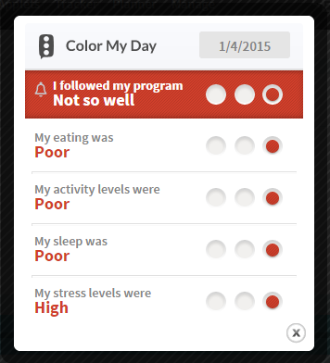
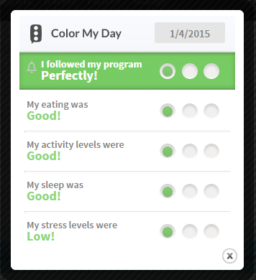
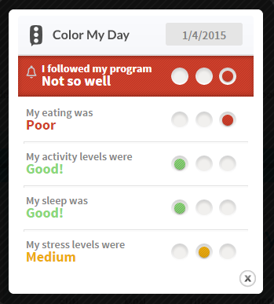
All-or-None Thinking
It’s easier to “bounce back” if you have fewer adjustments to make!
Notes:
People who tend to think in absolutes are either “completely off” or “completely on”
One online tracking program used by a weight loss center asks people to rate how they did that day in terms of following the program and diet and exercise.
If you have an “all bad day”, like the example on the left, it can feel really overwhelming to try and get back to your goals—it feels like you have so far to climb.
If you have an “all good day”, that’s great! But, just know that if you do have a lapse, it’s a learning experience…and it’s part of the process.
It’s easier to bounce back if you have fewer adjustments to make and if you intervene early.

Slide 16
Counter-Thoughts
All-or-None Thinking | More Helpful Thought
“I already ate too much today, I might as well get dessert.” | “I’ve had more calories than I planned, but every extra calorie counts, so I’ll pass on dessert.”
“I don’t have 45 minutes for the gym. I’ll go tomorrow.” | “I don’t have 45 minutes for the gym, but I can go for 20 minutes. I’ll burn more calories than if I didn’t go at all.”
“I haven’t lost much weight. I might as well quit the program and try to lose weight again some other time.” | “I haven’t lost as much weight as I had wanted, but I have lost some. It’s never too late to make changes and every little bit of weight lost reduces health risks.”
Notes:
If you’ve ever said some of these things to yourself before….take some time to come up with counter thoughts that you can tell yourself in the moment. Here are some examples.

Slide 17
Keys to Behavior Change
Monitor Your Behavior
Weigh regularly
Track food/liquid intake
Track activity
Set SMART Goals
Monitor goal progress
Learn From Your Lapses
Prevent a Relapse
Every minute of activity counts, every calorie counts
Remember: if you feel like you’re headed in the wrong direction, it’s never too late (or, too early!) to make a change
Notes:
In summary, there are three keys to behavior change: monitoring your behavior (which is getting easier with the availability of apps and tracking tools), setting goals and monitoring goal progress, and adjusting behavior when you have a lapse as early as possible.

Slide 18
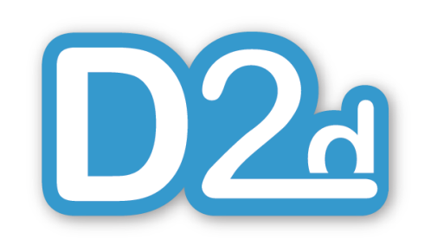
Thank You!

