Slide 1

Welcome to the D2d Nutrition Game Show!
Notes:
Site preparation: what will you need?
Presenter with nutrition background (RD if available) – to explain the answers and put them in context
Someone to keep score
2 small white boards and dry erase pens for participant teams to write answers
Have visual references, e.g. food models (if available) or empty food containers – to demonstrate portion sizes
Plan for how to divide attendees into two teams. Each team will work together as a group and come up with an answer to each question. Each team will select a “captain” who will write the team’s answer on their white board and hold the board up when time is called.
Have a prize for the winning team, such as entering each team member into a drawing to win a gift card to Whole Foods
It’s OK to edit individual slides if necessary, e.g. remove holiday slides if they are not relevant to the current time of year

Slide 2

Intro Slide/Game Show Rules
Each question is worth 1 to 3 points based on level of difficulty.
Each nutrition question will be presented and both teams will have an opportunity to answer
After each team has selected its chosen answer, we will share the correct answer and provide additional information on each question
Team members from the winning team will enter today’s gift card drawing.

Slide 3
Question # 1 – 1 point
MyPlate is a tool that can be used for planning healthy meals and practicing healthier portion sizes. Which of the following food groups should fill up the largest section of your plate each meal?
Fruits
Protein
Whole grains
Non-starchy vegetables
Notes:
Answer is d
http://www.diabetes.org/food-and-fitness/food/planning-meals/create-your-plate/
Nonstarchy vegetables are going to provide many vitamins, minerals and fiber for minimal calories
Making ½ your plate non-starchy veggies can help with weight loss because you increase volume of food eaten and help control calories
There’s ~5-30 calories in a cup of non-starchy veggies to ~200-220 calories in a cup of starch

Slide 4
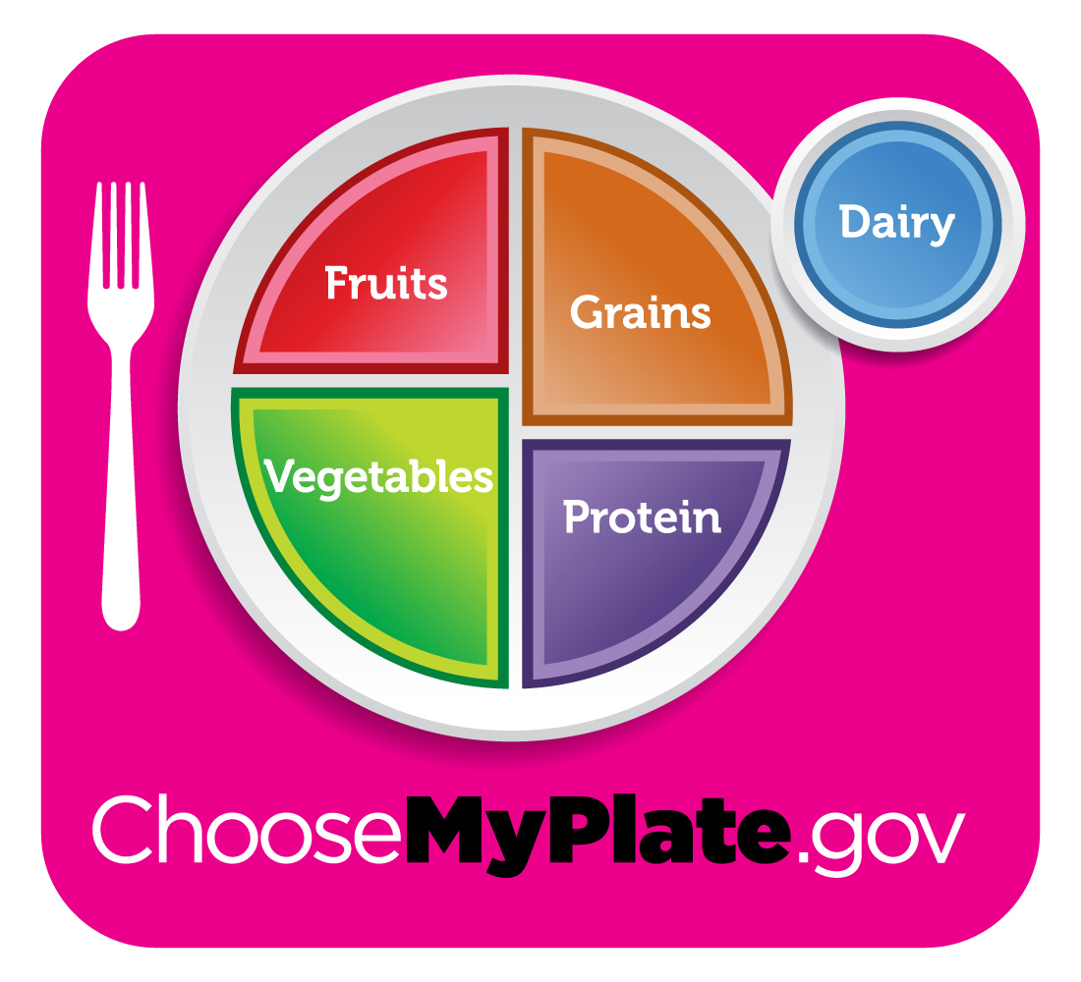
MyPlate Method
Helps to select healthy portion sizes to limit blood sugar fluctuations and achieve weight loss.
Fill the largest portion with non-starchy vegetables and smaller portions with fruits, grains and proteins
Consider adding a serving of dairy if limited starchy veggies/grains and fruit are on the plate
Notes:
https://www.choosemyplate.gov/MyPlate
Try these seven steps to get started:
Using your dinner plate, put a line down the middle of the plate. Then on one side, cut it again so you will have three sections on your plate.
Fill the largest section with non-starchy vegetables. See this list of non-starchy vegetables.
Now in one of the small sections, put grains and starchy foods. See this list of grains and starchy foods.
And then in the other small section, put your protein. See this list of protein foods.
Add a serving of fruit, a serving of dairy or both as your meal plan allows.
Choose healthy fats in small amounts. For cooking, use oils. For salads, some healthy additions are nuts, seeds, avocado and vinaigrettes.
To complete your meal, add a low-calorie drink like water, unsweetened tea or coffee.

Slide 5
Question # 2 – 2 points
Which one of the following vegetables should NOT be placed in the largest section of your plate, according to MyPlate.gov?
Carrots
Cabbage
Green Peas
Tomatoes
Notes:
Answer is c
Starchy vegetables are great sources of vitamins, minerals and fiber . The best choices do not have added fats, sugar or sodium.
Try a variety such as:
Parsnip
Plantain
Potato
Pumpkin
Acorn squash
Butternut squash
Green Peas
Corn
American Diabetes Association. Grains and Starchy Vegetables. Retrieved from <<<http://www.diabetes.org/food-and-fitness/food/what-can-i-eat/making-healthy-food-choices/grains-and-starchy-vegetables.html>>>

Slide 6
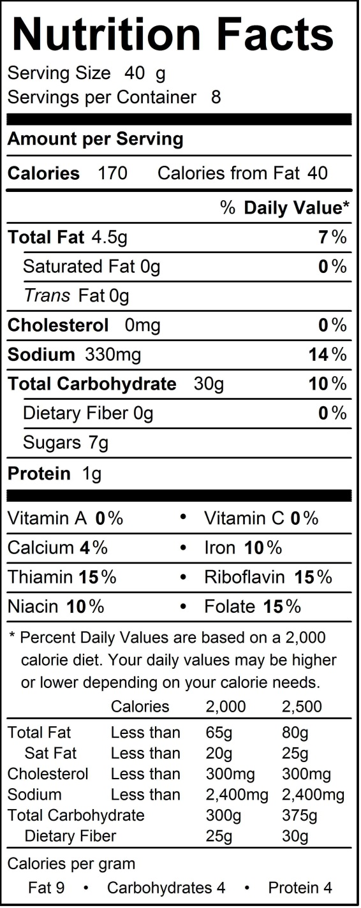

Question #3 – 2 points
White bread mix
When a grain is processed or refined, which of the following nutrients are removed from the grain?
B vitamins (thiamin, niacin, riboflavin, folate, B6)
Fiber
Iron
All of the above
Notes:
Answer is D
Refining grains removes b vitamins, fiber and iron, but many grains are enriched to add these b vitamins and iron back in
Fiber is not added back to enriched grains, which is why it is preferred to choose whole grain products
The more fiber there is in a grain, that helps to slow down the rise in blood sugar after eating
The amount of grain servings that a person would need depends on their age, sex, and level of activity. Generally women 6 oz/day and men 7-8 oz/day
1 oz = 1 slice bread, ½ cup cooked rice, 1 oz ready to eat cereal
Goal would be to have at least ½ of your grains for the day be whole
https://www.choosemyplate.gov/grains

Slide 7
Question # 4 – 3 points
Which of the following combination of fruit items will fulfill the recommended daily intake of fruit?
½ cup of strawberries and one cup of 100% orange juice
½ cup of strawberries, ¼ cup of unsweetened dried fruits (e.g. raisins), and 1 whole banana
½ cup of strawberries and 1 whole banana
½ cup of strawberries, ½ cup of dried fruits, and 1 cup of 100% orange juice
Notes:
Answer is b
Recommended daily fruit serving for women in 1.5-2 cups per day for women and 2 cups per day for men
½ cup strawberries = ½ serving
¼ cup dried fruit = ½ serving
1 banana = 1 serving
Note that bananas do have more CHO (30 g) and dried fruit (22 g), so try and choose fresh or frozen options more often
https://www.choosemyplate.gov/fruit

Slide 8
Question #5 – 3 points
How many grams of carbohydrate are in ½ cup strawberries, ¼ cup unsweetened dried fruit and 1 whole banana?
67 grams
37 grams
82 grams
53 grams
Notes:
Answer is A
Strawberries: 7 g
Raisins: 30 g
Banana: 30 g
~67 g?

Slide 9
Question # 6 – 1 point
Which of the following may be considered part of both protein and vegetable food groups?
Legumes (aka beans, lentils, peanuts and peas)
Spinach
Avocado
Almond milk
Notes:
Answer is a
Beans and legumes are great sources of plant protein and supply other important nutrients, such as iron, zinc, folate, potassium and of course fiber
Most people aren’t eating as many legumes as they are animal proteins
While beans and legumes may cause a large rise in blood sugar after the meat than animal protein alone, they still offer the positive benefits of more fiber and nutrients.
In ½ cup cooked beans there is 8 grams protein and 20 grams carbs, but also 6 grams of fiber
https://www.choosemyplate.gov/vegetables-beans-and-peas

Slide 10
Question # 7 – 2 points
What is the recommended limit for daily sodium intake for people without high blood pressure?
1,000 mg/day
1,500 mg/day
2,300 mg/day
3,400 mg/day
Notes:
Answer is c
Those with diabetes are at a greater risk for cardiovascular disease and kidney disease. Having high blood pressure can compound or lead to both of those conditions
If you have high blood pressure, the recommendation is 1,500 mg or less of salt per day
The average American takes in ~3,400 mg salt per day
1 tsp of salt = 2,300 mg
We find most of our salt intake comes from processed, packaged foods or from adding salt to foods
One way to become more aware of salt intake is to start reading foods labels, a low sodium food will have
Salt can also be sneaky in some products, even “sweet” foods tend to have added salt, so be on the look out for that
A “low sodium food” will have 140 mg or less per serving of salt
http://www.diabetes.org/food-and-fitness/food/what-can-i-eat/food-tips/cutting-back-on-sodium.html
http://my.clevelandclinic.org/health/treatments_and_procedures/hic-your-sodium-controlled-diet
https://sodiumbreakup.heart.org/how_much_sodium_should_i_eat
http://clinical.diabetesjournals.org/content/32/3/106

Slide 11
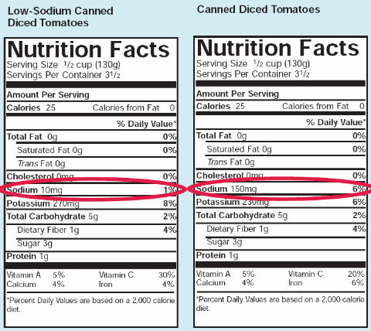
Sodium Intake
Recommended Sodium Intake (w/o high BP) | 2,300 mg/day
Average Sodium Intake by average American female | 2,980 mg/day
Average Sodium Intake by average American male | 4,240 mg/day
Recommended Sodium Intake for people with high BP | 1,500 mg/day
Look at the Label!
For Reference:
1 teaspoon salt = 2,300 mg sodium
Notes:
High CVD and high blood pressure rates associated with higher sodium intake
Calorie intake is highly associated with sodium intake (i.e., the more foods and beverages people consume, the more sodium they tend to consume).
Most sodium consumed in the U
Strategies to lower sodium intake include using the Nutrition Facts label to compare sodium content of foods and choosing the product with less sodium and buying low-sodium, reduced sodium, or nosalt-added versions of products when available. Choose fresh, frozen (no sauce or seasoning), or no-salt-added canned vegetables, and fresh poultry, seafood, pork, and lean meat, rather than processed meat and poultry.
nited States comes from salts added during commercial food processing and preparation.
Here are the approximate amounts of sodium in a given amount of table salt:
1/4 teaspoon salt = 575 mg sodium
1/2 teaspoon salt = 1,150 mg sodium
3/4 teaspoon salt = 1,725 mg sodium
1 teaspoon salt = 2,300 mg sodium
(American Heart Association. How much sodium should I eat? Retrieved from <<<https://sodiumbreakup.heart.org/how_much_sodium_should_i_eat>>>

Slide 12
Question # 8 – 2 points
What is the difference between unsaturated and saturated fats?
Saturated fats are more commonly found in animal foods than plant foods, and they increase both LDL and HDL cholesterol
Saturated fats are solid at room temperature whereas unsaturated fats are typically liquid
Unsaturated fats are mostly found in plant-based foods and they increase LDL cholesterol
Both a and b
Notes:
Answer is D. Unsaturated fat lowers LDL and has either a neutral effect on HDL (mono) or may modestly raise HDL (omega 3 PUFA). Dietary studies of cholesterol can be mixed depending on what the baseline/comparison diet is – low fat/high carb? High saturated fat? When replacing saturated fat with unsaturated fat, HDL and LDL both may decrease.
Portion size is still important when having healthy fats, such as nuts, ¼ cup nuts ~160-200 calories, which is a pretty small serving. If we are not measuring out these foods, we tend to eat more of them and take in more calories
1 Tbsp PB = ~100 cal

Slide 13
Question # 9 – 2 points
Which of the following fats are heart healthy?
Pork fat (lard)
Tropical Oils (e.g. palm and coconut)
Butter
None of the Above
Notes:
Answer is d
All of the above fats are saturated fats, which are less heart healthy
Recently coconut oil has become very popular, but it is still a saturated fat
In a study released in 2014 by Dr. Laurence Eyres from the New Zealand Institute of Chemistry, “The study found that coconut oil, which is 92 percent saturated fat, raises LDL (bad) cholesterol less than butter does, but significantly more than unsaturated plant oils do.”
http://www.heartfoundation.org.nz/uploads/Evidence_paper_coconut_August_2014.pdf
https://www.washingtonpost.com/lifestyle/wellness/getting-past-the-hype-surrounding-coconut-oil/2016/10/11/831635ac-8b16-11e6-b24f-a7f89eb68887_story.html

Slide 14
Question # 10 – 1 point
Dietary cholesterol- essential for certain physiological functions – is NOT found in which of the following foods?
Eggs
Milk
Poultry and meat (beef and pork)
Peanut butter
Shellfish
Notes:
Answer is d
LDL = “bad” cholesterol
HDL= “good” cholesterol
Triglycerides = another type of fat in the blood that raises chanced of heart attack or stroke
Things that can help cholesterol:
Weight loss, exercise ~30 minutes/day,
More plant based diet with veggies, fruits, moderate in fats/healthy fats (oils)
Cholesterol also affected by blood pressure and blodd sugar – if both are high cholesterol can be high too
http://www.diabetes.org/are-you-at-risk/lower-your-risk/cholesterol.html?referrer=https://www.google.com/

Slide 15
Question # 11 – 1 point
Which of the following foods are high in cholesterol but low in saturated fat?
Eggs
Dairy products
Poultry and meat (beef and pork)
Shrimp and shellfish
a and d
Notes:
Answer is d
Eggs aren’t as bad for our cholesterol as we once thought, but the yolks do contain saturated fat. It is thought that up to 1 egg yolk a day is ok for individuals without diabetes, heart disease or high cholesterol. For those with diabetes, heart disease or high cholesterol, experts recommend limiting to less than 3 yolks a week. Egg whites are a great source of protein, do not have significant saturated fat or cholesterol and do not need to be limited in the same way as the yolks.
LDL = “bad” cholesterol
HDL= “good” cholesterol
Triglycerides = another type of fat in the blood that raises chanced of heart attack or stroke
Things that can help cholesterol:
Weight loss, exercise ~30 minutes/day,
More plant based diet with veggies, fruits, moderate in fats/healthy fats (oils)
Cholesterol also affected by blood pressure and blodd sugar – if both are high cholesterol can be high too
http://www.diabetes.org/are-you-at-risk/lower-your-risk/cholesterol.html?referrer=https://www.google.com/

Slide 16
Question # 12 – 3 points
Seafood provides significant amount of polyunsaturated omega-3 fatty acids such as EPA and DHA as well as Vitamin B12 and Vitamin D. Thus, weekly consumption of 2 (unfried) fish meals is recommended for heart health. However, seafood consumption should be limited to 12 ounces per week due to contamination with toxins like mercury, lead, and PCBs. Rank the following four fish types from lowest to highest mercury levels.
Tuna, halibut, swordfish, and salmon
Salmon, halibut, swordfish, and Tuna
Salmon, halibut, tuna, and swordfish
Halibut, Salmon, swordfish, and tuna
Notes:
Answer is c
Tip for presenter: At Northwestern, we provided all participants with a “healthy fish guide” pocket card available for printing online http://here.doh.wa.gov/materials/healthy-fish-guide
High mercury intake can cause damage to the kidneys, nervous system and can interfere with brain development
Predatory fish, such as ahi tuna and swordfish, tend to have higher amounts of mercury
Try to purchase wild caught fish vs farm raised, as they tend to have less chemicals/antibiotics added
Generally the smaller the fish, the less mercury it has since it is lower on the food chain
https://www.nrdc.org/stories/smart-seafood-buying-guide
https://www.nrdc.org/stories/mercury-guide

Slide 17
Question # 13 – 2 points
Recent dietary guidelines encourage individuals to limit intake of added sugars to less than 10% of total daily calories. Based on a 1,500 calorie/day diet, that accounts for less than 150 calories/day from added sugars. How much added sugar is present in a 12 oz. can of coke?
19 grams (~5 teaspoons ~80 calories)
25 grams (~6 teaspoons ~96 calories)
39 grams (~10 teaspoons ~160 calories)
45 grams (~11 teaspoons ~180 calories)
Notes:
Answer is c
Avoid sweetened beverages like regular pop, juice and sweetened teas/coffees – these sugary beverages can raise blood sugar far too high
Chose calorie free and low cal options like water, carbonated water, low calorie drink mixes, unsweetened or diet teas, plain coffee, low-fat and fat free milk
Watch alcohol – can have a lot of sugar and calories
http://www.diabetes.org/food-and-fitness/food/what-can-i-eat/making-healthy-food-choices/what-can-i-drink.html?referrer=https://www.google.com/

Slide 18
Question #14 – 1 point
Which of these sweeteners will have the least effect on your blood sugar?
a) Honey
b) Agave
c) Sugar
d) Stevia
Notes:
Answer is D
Source: http://www.diabetes.org/food-and-fitness/food/what-can-i-eat/understanding-carbohydrates/artificial-sweeteners/
http://www.diabetesforecast.org/2016/jan-feb/5-must-know-facts-about-sweeteners.html?loc=morefrom
Alternative sweeteners can sometimes help to curve cravings for sweets without adding many calories or carbohydrates to the diet
Honey and agave will raise blood sugar just like regular sugar
Foods that are labeled “sugar-free”, “reduced sugar,” or “no sugar added” don’t always mean that they are carbohydrate free
Stevia is a purified product that comes from the Stevia plant, and is approved as generally recognized as safe by the FDA
Current research is not conclusive, but some scientists believe that using alternative sweeteners can increase hunger, appetite and calories intake by decreasing the sense of fullness or causing someone to crave sweets
Sugar and Maple Syrup: 2.5-4.6 grams carbs/teaspoon, 10-18 calories/teaspoon
Powdered Sugar: 2.5 grams carbs/teaspoon and 10 calories/teaspoon
Agave and honey have 5.3-5.7 grams carbs/teaspoon and 21 calories/teaspoon

Slide 19
Question #15 – 2 points
The amount of fiber that the average person should be getting each day is ______ grams.
a)10-15 grams
b)15-20 grams
c) 20-35 grams
d) 5- 10 grams
Notes:
Answer is C
Fiber is a type of carbohydrate, but because it is not broken down by the body, it does not contribute any calories
Foods that have fiber include vegetables, fruits, whole grains, beans and lentils, and nuts and seeds
The grams of fiber in a food can be subtracted from the total grams of carbohydrate you are eating
Fiber can also add “bulk” to your meals and help you feel more full after meals, which can help with weight loss
Remember it is important to get enough hydration when increasing fiber in your diet, so aim for at least 8 glasses of water per day.
Source: http://www.joslin.org/info/how_does_fiber_affect_blood_glucose_levels.html

Slide 20
Question # 16 – 2 points
Carbohydrate counting can be used to determine the carbohydrate amount of a meal and can help consume a consistent amount of carbohydrates to help minimize blood sugar fluctuations. According to the American Diabetes Association, what is the suggested amount of carbohydrates that should be consumed per meal?
15-30 grams
30-45 grams
45-60 grams
60-75 grams
Notes:
Answer is c
This is a good starting point and can be adjusted based on how in control your blood sugars are
Looking at the food label for “total carbohydrate” is important
Also important to look at serving sizes, calories, saturated and trans fats, and salt
http://www.diabetes.org/food-and-fitness/food/what-can-i-eat/understanding-carbohydrates/carbohydrate-counting.html?referrer=https://www.google.com/

Slide 21
Question # 17- 2 points
Glycemic Index (GI) describes the effect of carbohydrate containing foods on blood glucose levels. Which of the following may impact GI of a food?
Food qualities (such as ripeness)
Food processing and preparation methods
Other macronutrients (e.g. protein, fat, fiber) in a meal
All of the above
Notes:
Answer is e
By definition, the GI compares equal quantities of available carbohydrate in foods and provides a measure of carbohydrate quality.
The GL provides a summary measure of the relative glycemic impact of a “typical” serving of the food.
http://care.diabetesjournals.org/content/28/7/1839

Slide 22
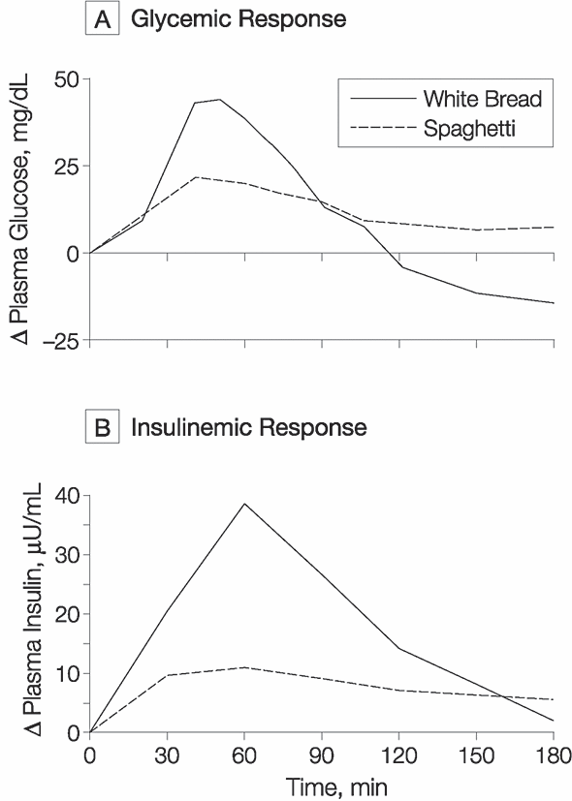
Glycemic and Insulinemic Responses
After Ingestion of 50 g of Carbohydrates
Foods with similar carbohydrate content can affect blood glucose levels differently
Ludwig, D. S. JAMA 2002;287:2414-2423.
Notes:
GI introduced by Jenkins in 1981. Determining the GI of a particular food:
The 2-hour area under the curve for blood glucose is compared to that of a reference food (glucose), which by convention has a GI of 100.
The GI value of a food is determined by feeding 10 or more healthy people a portion of the food containing 50 grams of digestible (available) carbohydrate and then measuring the effect on their blood glucose levels over the next two hours. For each person, the area under their two-hour blood glucose response (glucose AUC) for this food is then measured. On another occasion, the same 10 people consume an equal-carbohydrate portion of glucose sugar (the reference food) and their two-hour blood glucose response is also measured. A GI value for the test food is then calculated for each person by dividing their glucose AUC for the test food by their glucose AUC for the reference food. The final GI value for the test food is the average GI value for the 10 people.

Slide 23

Potato
Instant oatmeal
White bread
Watermelon
Basmati rice
Stoneground whole wheat bread
Raisins
Pineapple
Kidney beans
Chocolate ice cream
Oatmeal made with steel-cut oats
Spaghetti, al dente

Slide 24
Question #18 – 1 point
For individuals with prediabetes, which of the following lifestyle modifications will help reduce the risk of diabetes?
Calorie restriction with a goal of 5-10% weight loss
30 minutes of brisk walking (moderate activity) most days
Vitamin D 4000 units a day
a and b
All of the above
Notes:
Answer: d
A and b are the results from the DPP – modest weight loss through lifestyle change, reduced risk of diabetes by almost 60%. We don’t yet know whether vitamin D will reduce risk of diabetes, so we need your continued efforts in the D2d study!

Slide 25
Question #19 – 1 point
For individuals with diabetes, which of the following lifestyle modifications may improve diabetes control and reduced risk for complications?
Calorie restriction with a goal of 5-10% weight loss
30 minutes of brisk walking (moderate activity) every other day
Carbohydrate counting meals and snacks
Glycemic Index/load counting of meals and snacks
All of the above
Notes:
Answer: E
5-10% weight loss can have very positive effects when it comes to weight loss and helping to manage DM
Carb counting or GI counting helps you to manage CHO intake and monitor blood sugar levels in response to certain foods (some foods will raise your blood sugar more than others, that’s important to know)

Slide 26
Question #20 – 1 point
According to the American Diabetes Association, one should not go more than ___ days without structured exercise, in order to enhance insulin sensitivity and action.
1
2
3
4
Notes:
Answer is B
Information put out by American Diabetes Assoc
Exercise can help those with DM2 by reducing A1C percentage, triglyceride levels, blood pressure, and can increase insulin sensitivity
Prolonged sitting should be broken up with light activity every 30 minutes for blood glucose benefits in people with DM2.
After low intensity aerobic exercise lasting at least 60 minutes, insulin action was enhanced for at least 24 hours after.
Most adults with DM2 should participate in a total of 150 minutes or more of moderate intensity activity at least 3 days per week.
http://care.diabetesjournals.org/content/39/11/2065.full

Slide 27
Daily Double: Holiday Carb Counting – 4 points
Imagine you are at your Thanksgiving or holiday gathering, looking at all of the food options that you may choose. You decide to have 1 cup mashed sweet potatoes, 6 oz roasted turkey, 1 ½ cup stuffing, ¼ cup gravy, ½ cup cranberry sauce and 2 cups mixed green salad. How many carbohydrates are you having at the meal?
a) 223 grams
b) 86 grams
c) 157 grams
d) 112 grams
Notes:
ANSWER IS C
Sweet potato – 44 g
Stuffing – 63g
Cranberry sauce – 44g
Gravy: 6 g

