Slide 1
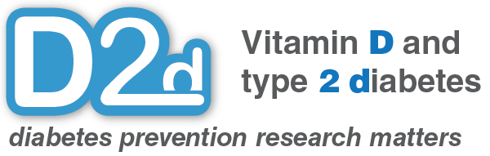
Prediabetes

Slide 2
Glucose
Your body changes much of the food you eat into a type of sugar called glucose
Your body cells need this sugar to give you the energy you need to be healthy
After you eat, your blood sugar (glucose) rises, and your body reacts by releasing a hormone called insulin
Insulin works like a key that allows the sugar to enter the cells

Slide 3
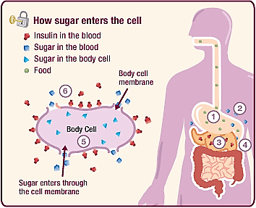
Notes:
Food is ingested
Glucose rises after food ingestion
Pancreas releases insulin
Insulin travels through blood stream to target tissues
Insulin binds to receptor on target cells (such as muscle), which
Allows glucose in the blood to enter the cell to be used as energy

Slide 4
Insulin Resistance
When your body (liver, muscle, fat) does not respond to insulin properly and cannot use glucose as well
Your pancreas then has to produce larger amounts of insulin—this puts a strain on your pancreas
Risk Factors:
Weight gain
Physical inactivity
Aging
Sleep disorders
Smoking

Slide 5
Supply and Demand
Insulin need vs. insulin supply
WORKLOAD
RESPONSE
Insulin resistance
Food intake
Activity
Liver production of sugar
Pancreatic beta cell (insulin-making) reserve

Slide 6
Diabetes
Insulin resistance
High carb/sugar intake
Inactivity
supply
demand
Diminished reserve

Slide 7
Common risk factors for diabetes
Age > 45 yo
African-Am, Hispanic, Asian, Native Am ethnicities
Family history (parent or sibling)
Having diabetes during pregnancy
Sedentary lifestyle
High blood pressure
Excess weight
Notes:
Metabolic syndrome: low HDL, high trigs
Sleep disorders includes OSA, chronic sleep deprivation, and night shift workers

Slide 8
Pre-diabetes states
Fasting Glucose
Normal Pre-Diabetes Diabetes
IFG
100 mg/dl
126 mg/dl
75g, 2h OGTT
Normal Pre-Diabetes Diabetes
IGT
140 mg/dl
200 mg/dl
HbA1c
Normal Pre-Diabetes Diabetes
5.7%
6.5%
Notes:
For A1c: 5.5-6.0: 9-25% risk of DM in the next 5 years
6.0-6.5: 25-50% 5 year risk of DM (Zhang Diabetes Care 2010)

Slide 9
Prediabetes
When sugar is higher than normal, but not high enough to be in the diabetes range
Your body (your pancreas) is just starting to not be able to keep up with your needs
About 10% of patients with pre diabetes will progress to diabetes every year

Slide 10
Can I Prevent Diabetes?
YES

Slide 11
Diabetes Prevention Program
3234 patients with
pre-diabetes
1082
Conventional
Lifestyle
Modification
1073
Metformin
1079
Intensive
Lifestyle
Intervention
Average follow up: 2.8 years

Slide 12
DPP Conclusions
Lifestyle changes (i.e. diet and exercise) are the most effective ways to prevent diabetes: Risk reduced by nearly 60%!
Metformin reduced risk by only about half as much
Modest lifestyle changes have a significant impact:
Exercise goal in study: 150 min/week (or 30 min/day, 5 days a week)
Weight loss goal 7% of body weight
Notes:
Per DPP results, lifestyle changes reduced risk by 58%, and metformin reduced risk by 31%

Slide 13
Lifestyle: Exercise
Better cardiovascular health
Increases glucose uptake in muscle
Moderate intensity as good as vigorous
Helps achieve weight loss goals
Even modest weight loss will improve sugars, blood pressure, and cholesterol
Notes:
4

Slide 14
Lifestyle: Nutrition
Avoid sweetened drinks
Juice
Regular soda
Iced teas, Gatorade, Vitamin Water, etc.
Limit simple carbohydrates
Pasta
Breads
Rice
Potatoes
Sweets/desserts

Slide 15
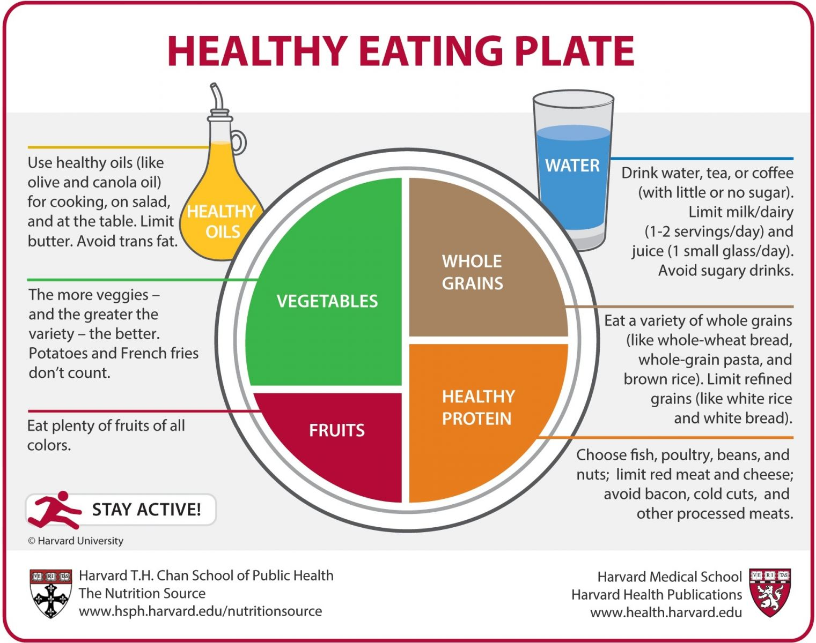
What should I eat?

Slide 16
Preventing diabetes also prevents these complications from diabetes
Blindness
Patients with diabetes need to check eyes yearly with a dilated eye exam
Kidney disease, dialysis
Patients with diabetes also need to have their urine checked every year
Nerve damage
Can be painful (burning, pins and needles), tingling or numbness
Notes:
Note: recommendations (dilated eye exam, urine test) are for patients with diabetes

Slide 17
Conclusions
Pre-diabetes is the beginning of when your pancreas is starting to fail
But this is also the time when you can make a lifestyle change, and tip the scale back in your favor
Demand

Slide 18
Conclusions
Reduce your insulin demands:
Eat healthy
Exercise
Lose weight
Stop smoking

Slide 19
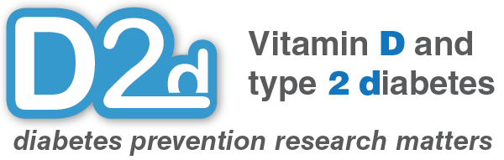
Thank You!
Presentation developed by Pauline Liao, MD, Assistant Professor of Medicine, Icahn School of Medicine, New York, NY

