Slide 1


Keeping Your Cool in a Stressful World

Slide 2
Taking a Closer Look at Stress
Stress is part of everyone’s life. Stress means different things to different people, and what causes stress for one person may not cause it for another.
If not managed properly, stress can lead to illness, increased blood glucose levels, increased anxiety, or depression and mood swings.
Managing stress is an important lifestyle step that can aid efforts at preventing type 2 diabetes as well as other chronic diseases.

Slide 3
What causes stress?
Notes:
Ask participants to name things that cause stress before showing next slide.

Slide 4
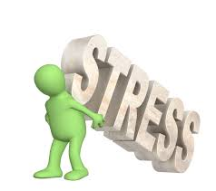
What causes stress? A few examples are:
Fever, pain, illness
Weather, noise, housing concerns, traffic
Concerns over money
Job and family demands
Having to make a big decision
Guilt or loss
Lifestyle change
Notes:
This slide should serve to affirm participant responses (as opposed to giving “correct” answers)

Slide 5
What are some of the symptoms of stress?
Notes:
Once again, ask participants to come up with examples before showing the next slide

Slide 6
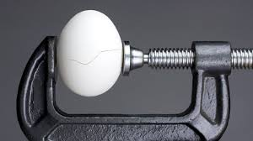
What are some of the symptoms of stress?
Sleeping too much or not enough
Changes in appetite (eating more or less)
Trouble with memory and/or concentration
Muscle tension
Feeling low or depressed
Irritability
Etc.

Slide 7
How can stress be harmful?
Increases blood glucose levels, pulse, and blood pressure
Generally causes wear and tear on the body
Can increase one’s risk of developing type 2 diabetes
May promote weight gain

Slide 8
Stress and You Please take a moment and think about stress and how it affects your life.
How often do you feel stressed?
Often
Sometimes
Seldom
How do you know you are stressed? Describe what happens.
List some of the things that are making you feel stressed right now.
What are some ways you deal with the stress in your life?
Which of these ways of dealing with stress do you think are negative or unhealthy?
Which of these ways of dealing with stress do you think are positive or healthy?
Notes:
Optional: circulate handout for participants to use as a worksheet

Slide 9
Stress: It’s Not ALL In Your Head, But…
“Not things, but opinions about things, trouble men.”
Epictetus, 55-135 AD
These 4 slides by Lauren Holland, MS, Medical University of South Carolina Weight Management Center

Slide 10
ABC Model of Stress
A = Activating Event (Stressor)
B = Beliefs (Perception/Beliefs about the event)
C = Consequences (Emotions, behaviors, thoughts)
What does this mean?
Thoughts and perceptions can play a large role in how we feel.
How we experience a stressor can depend in part on our beliefs and perceptions about the stressor itself
For this reason, not everyone experiences a given stressor the same way
Notes:
A → B → C
Negative Event (A) → Irrational Belief (B) → Consequence (C)

Slide 11
ABC Model of Stress: Example
A = Activating Event (Stressor)
B = Beliefs (Perception/Beliefs about the event)
C = Consequences (emotions, behaviors, thoughts)
(A) Activating Event | (B) Beliefs | (C) Consequences
Making a mistake at work | “I’ll get the sack” “I’m stupid” “This is a difficult problem and mistakes are understandable” | Worry Anxiety Calm second try
Giving a presentation | “I’ll make a fool out of myself” | Frightened/Scared
Partner has not returned home at usual time | “They have been in an accident and are in the hospital” | Frightened, Anxious
Notes:
A → B → C
Negative Event (A) → Irrational Belief (B) → Consequence (C)

Slide 12
Managing Stress by Challenging Your Interpretation of the Stressor
Am I immediately assuming the worst possible outcome, however unlikely?
Am I making assumptions about what others are thinking about me?
Am I thinking that the event says more about me than it really does?
Are there alternative explanations for the stressor/event?

Slide 13

Managing stress with physical strategies
Sleeping well
Physical activity
Relaxation
Meditation
Belly breathing
Laughter

Slide 14
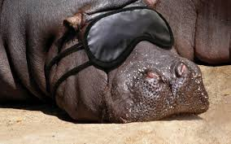
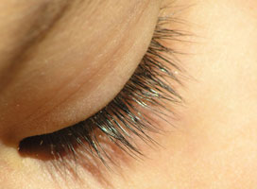
Sleeping well
Getting enough sleep is recognized as an essential part of chronic disease prevention and health promotion.
People are better able to deal with stressors during the day if they have had enough sleep.
Being well-rested can make it easier to build healthy behavior changes.

Slide 15
Helpful hints for sleeping well:
Go to bed when you are sleepy, not before.
Get out of bed if you are not asleep after 20 minutes.
Find something else to do that will make you feel relaxed; once you are relaxed go back to bed.
Begin rituals that help you relax each night before bed, such as reading, a warm bath, or soothing music.
Keep a regular schedule of getting up and going to bed at approximately the same time every day.
Don’t try to compensate with a nap if you have a bad night’s sleep

Slide 16
Helpful hints for sleeping well:
Stop checking/watching electronic devices an hour or two before bed, and turn them off or leave them in a different room during the night.
Avoid caffeine after lunch.
Limit or avoid alcohol and nicotine within a few hours of your bedtime.
Go to bed when you are not hungry or overly full.
Avoid vigorous physical activity within a few hours of your bedtime.
Avoid sleeping pills, or use them cautiously.
Make your bedroom quiet, dark, and a little bit cool.

Slide 17
Physical activity
Virtually any form of exercise, from aerobics to yoga, can act as a stress reliever. If you're not an athlete or even if you're out of shape, you can still make a little exercise go a long way toward stress management.
Exercise increases your overall health and your sense of well-being, which puts more pep in your step every day. But exercise also has some direct stress-busting benefits.
Source: www.mayoclinic.org

Slide 18
How does physical activity help reduce stress?
Increases your brain’s feel-good chemicals (endorphins)
Improves your mood (lowers the symptoms associated with mild depression and anxiety)
Increases your self-confidence
Helps relax you
Improves your sleep
Source: www.mayoclinic.org
Notes:
Put question to audience first, and wait for responses
Animation: click on the slide’s title for each of 5 bullet points to appear (can talk about them one at a time as they appear)

Slide 19
Belly breathing: relaxation technique
Lie down or sit comfortably. Bend your knees, with your feet on the floor about eight inches apart. Make sure your spine is straight.
Now put one hand on your belly. Put the other hand on your chest. Breathe in slowly and deeply through your nose.
Gently press down on your belly as you breathe out your nose. Let your belly push your hand back as you breathe in. Let your chest move just a little, as it should follow the movement of your belly.
Notes:
Leader should encourage entire group to practice belly breathing during the session

Slide 20
Belly breathing: relaxation technique
Use belly breathing when you notice yourself getting tense. Once you have learned the technique, you can do it while sitting or standing. Try it while you are stuck in rush hour traffic or waiting in line at the grocery store – you will be surprised what a difference it can make!
Notes:
Try this activity with participants in attendance

Slide 21
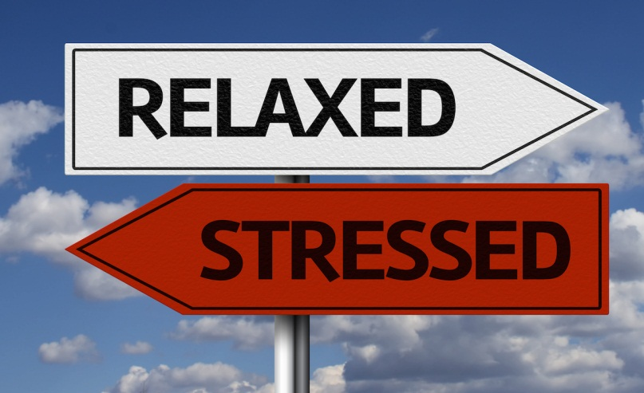
It may be a stressful world out there…
…but you
can keep
your cool!

Slide 22

Thank You!
Materials used are from the National Diabetes Prevention Program and American Diabetes Association, the Medical University of South Carolina Weight Management Center, and the Mayo Clinic

