Slide 1

Get Active in your Daily Living
Notes:
Emphasis: prediabetes/vitamin D study (diabetes prevention study)
Note to presenter:
Some participants may request more information on specific exercises or exercise regimens, however the D2d Study cannot provide any information beyond what is currently available in the handouts and group presentations. These are general lifestyle recommendations that are being provided as standard-of-care information on diabetes prevention, and are not part of the study intervention. You may, however, refer them to the ADA, CDC, or NDEP websites for more information on exercise for diabetes prevention.

Slide 2
Health Benefits of Physical Activity
Reduces risk of
    Diabetes
    Obesity
    Heart disease
And is essential for
long-term weight control
Notes:
References and recommended readings
Mayo Clinic. Exercise: 7 benefits of regular physical exercise. Available at:
http://www.mayoclinic.com/health/exercise/HQ01676.
MedlinePlus. Exercise and immunity. Available at:
http://www.nlm.nih.gov/medlineplus/ency/article/007165.htm.

Slide 3
Physical Activity Guidelines for Americans
Minimize inactivity
Perform at least 150 minutes of moderate-intensity activity/week
    Example: 30 minutes 5 days a week
    Should be at least 10 minute bouts
Perform resistance training or muscle strengthening exercise twice a week
Notes:
http://www.health.gov/paguidelines/ 2008 Guidelines
Non-exercise activity (standing, fidgeting, pacing, etc.) can actually burn a significant number of calories over the course of a day compared to inactivity (sitting or sleeping)
“Moderate-intensity” will be defined in a few slides
Define resistance training: it is a form of physical activity that is designed to improve muscular fitness (strength, tone, mass, and/or endurance) by exercising a muscle or a muscle group against external resistance. There are many positive health outcomes of resistance training.

Slide 4

Avoid Inactivity
Sitting is a risk factor for all-cause mortality even if people meet minimum physical activity recommendations
Aim to stand up or be active for at least 10 minutes every hour
Notes:
Stand up whenever you can (ie. standing when chatting on the phone, standing when taking the subway or bus, standing during commercial breaks when watching TV)
Walk more whenever you can (ie. using the more distant restroom, going to someone’s office instead of calling them, parking at the far end of the parking lot, getting off the subway or bus stop early, taking a walk during lunch)
Fidgeting (bouncing your knee, shaking your foot, tapping your toes, raising your heels while sitting)

Slide 5
If you do more than 150 minutes/week, do the benefits increase?
        Yes
        No
http://www.cdc.gov/physicalactivity/everyone/guidelines/
Notes:
Answer: Yes - there is no ceiling for the amount /time of physical activity per day.
Preventing weight gain or limiting weight gain can improve your health as well
For weight loss= 250-300 minutes/week PA

Slide 6
What does physical activity best predict?
Weight loss
Weight gain
Weight loss maintenance
Notes:
Answer C
Diet alone is usually more effective for weight loss compared to exercise alone in achieving a significant calorie deficit.
Without dietary changes, regular aerobic exercise by itself usually results in only modest weight loss
Exercise improves the odds of maintaining weight loss over time and maintenance of lean body mass
Exercise also builds your fitness capacity, making it easier to do more physical activity

Slide 7
Get Moving!
Activities of Daily Living
  What can you do to increase activity throughout the day?

Slide 8
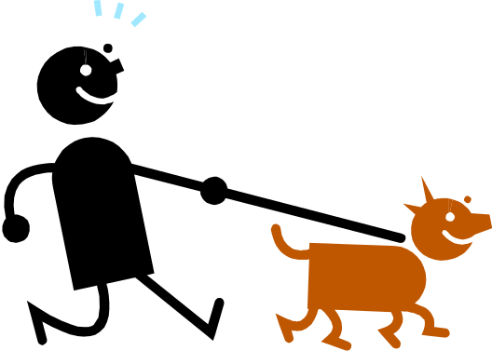
As part of your routine daily activities:
Walk or bike ride more, drive less
Walk up stairs instead of taking an elevator
Get off the bus a few stops early and walk
Rake leaves
Garden
Walk the dog
Dance to the radio while
cooking

Slide 9
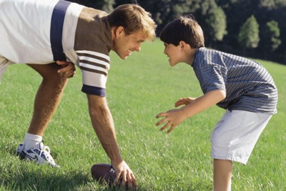
Clean the house
Take a brisk 10-minute walk in the morning, at lunch, and after dinner
Play outdoors or indoor games with kids
Walk on a treadmill, pedal a stationary bike, or lift light weights while watching television

Slide 10

What Can You Do?
At Home
At the Office
At Play
How Can YOU Fit Fitness into Your Busy Life ???

Slide 11
At Home
Do housework
Work in the garden or mow the grass. Using a riding mower doesn't count! Rake leaves, prune, dig and pick up trash.
Go out for a short walk before breakfast, after dinner or both! Start with 5-10 minutes and work up to 30 minutes.
Walk or bike to the corner store instead of driving.
Notes:
Find an activity you love. Think of your favorite hobby or pastime. Do you have trouble finding time to do it? Most likely, you make time for it because you enjoy it so much. It's the things we don't enjoy that we put off and don't feel bad about missing. That's why it's best to choose a physical activity that you actually enjoy and look forward to. Not only are you more likely to do it, but it also adds more fun into your life. And we all could use some more fun in our busy lives, right?

Slide 12
At Work
Brainstorm project ideas with a co-worker while taking a walk.
Stand while talking on the telephone.
Walk down the hall to speak with someone.
Take the stairs instead of the elevator. Or get off a few floors early and take the stairs the rest of the way.
Schedule activity as an appointment.
Notes:
Schedule an appointment. If you had scheduled a doctor's appointment, you wouldn't miss it would you? How about that important business meeting? Of course not. Working out is actually as important as going to the doctor or any other obligation that you prioritize, because it helps you perform better as a worker, parent, student or volunteer, and it’s one of the best things you can do to stay healthy. So whether it's scheduling in an hour to go to that group exercise class, investing in personal training sessions or even making a date with yourself to do that workout DVD over your lunch break, write it in pen in your calendar and treat it like any other appointment you can't miss!

Slide 13
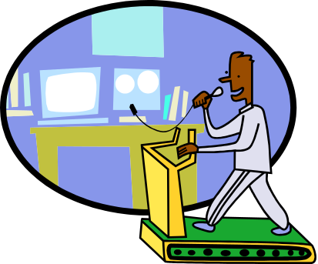
At Work
Walk to your co-worker’s desk instead of email
Walk to the farther bathroom or water cooler
Walk around your building
Take public transportation
  Get off a stop earlier
Park farthest away from the door

Slide 14
At Play
Plan family outings and vacations that include physical activity (dancing, bowling, swimming)
See the sights in new cities by walking, jogging or bicycling.
Make a date with a friend to enjoy your favorite physical activities. Do them regularly.
  Mix social hour and activity hour!
Play your favorite music while exercising, something that motivates you.
Notes:
Make it part of your routine. One reason it's so challenging to fit exercise into a busy schedule is because we're not used to doing it. Heck, it takes time to brush your teeth in the morning, but you do it, don't you? Start making some form of exercise—whether it's walking the dog, doing 10 minutes of yoga or going for a bike ride after dinner—part of your daily routine
Mix socializing with exercising. Make your social time more active by planning events that get all of you moving. Go for a family hike on a beautiful Saturday morning, play a game of tag football with your buddies during halftime, or make a date with your significant other or best friend on the treadmill. There are so many options for squeezing in more activity.

Slide 15
Exercise at a level that feels moderate to somewhat hard.
Where would this fall on a scale of 0 (extremely easy) to 10 (extremely hard)?
  A. 5-6 on a 10-point scale
  B. 10 on a 10-point scale
  C. 3-4 on a 10-point scale
Notes:
Answer : A

Slide 16
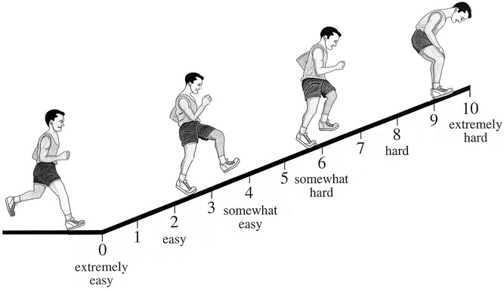
Keep your effort level in the 5-6 range (moderate to somewhat hard)
Notes:
5-6 range is consistent with standard-of-care recommendations, and we are not pushing for higher levels since exercise is not part of D2d intervention.

Slide 17
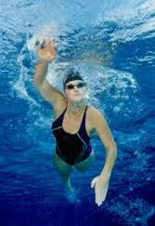
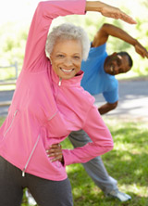

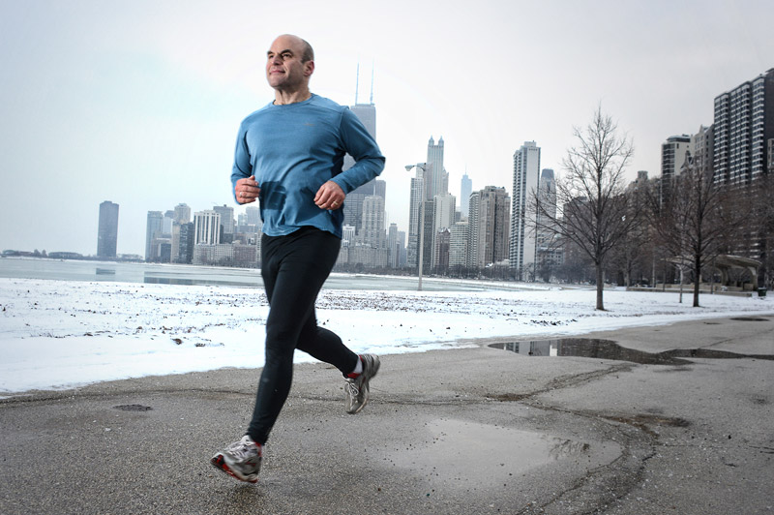
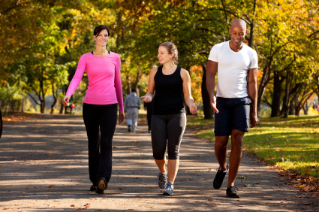
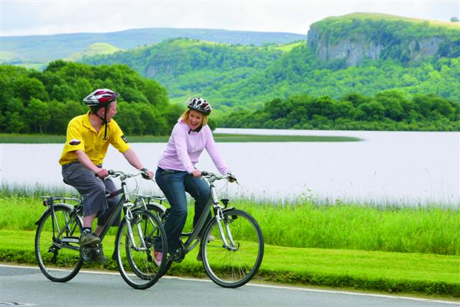
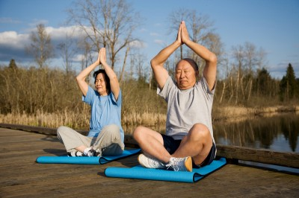

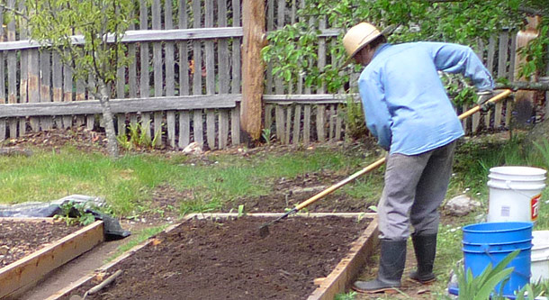

Notes:
How would you rate each of these activities in terms of effort level? There are no right or wrong answers – it depends on your current fitness level and how each activity affects your own heart rate and breathing.
Note: The answers are complicated, and the purpose of this slide is to generate discussion!

Slide 18
Pedometer: Track your steps
Slowly increase your steps to prevent injury.
Keep track of your daily steps for 1 week and then take the average for that week.
Increase your daily average by 500 steps for the next week, then by 500 more each week after that, until you reach your goal.
There are many options available for pedometers and activity monitors.
Notes:
Establish your own “baseline” first, and increase from there

Slide 19
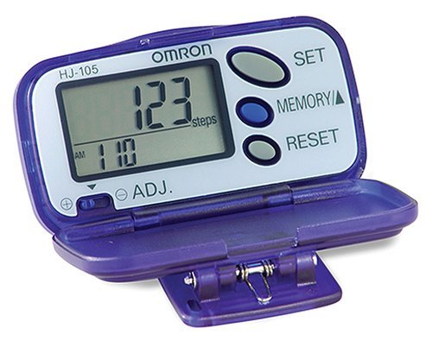
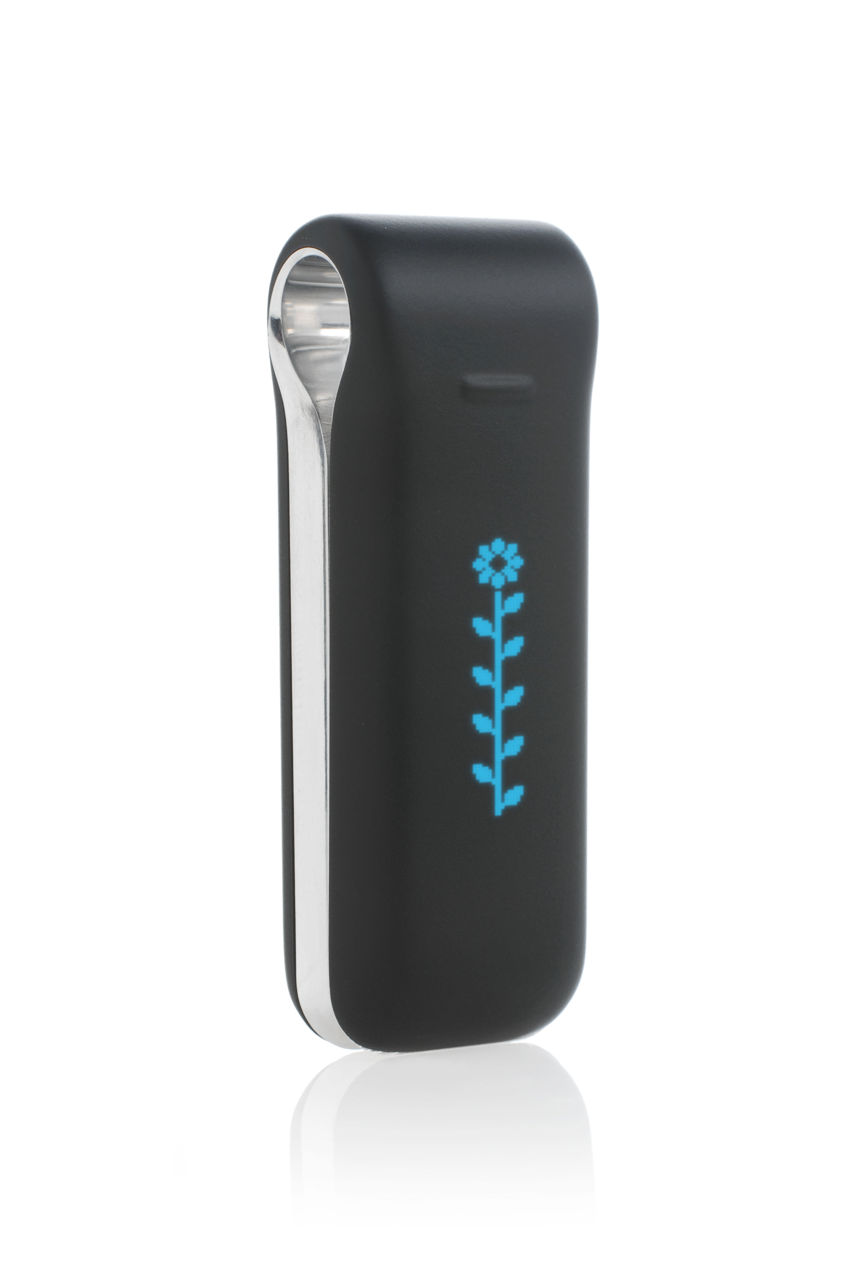
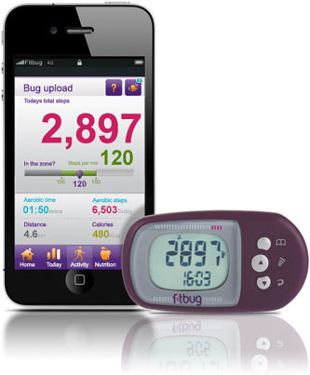
Classification of pedometer-determined physical activity
<5,000 steps/day
  Sedentary Lifestyle
5,000-7,499 steps/day
  Low active
7,500-9,999
  Somewhat active
10,000 steps/day
  Active
>12,500 steps/day
  Highly active
Notes:
D2d does not recommend or have an affiliation with any specific commercial products.

Slide 20
Map your Route
Try using Google Maps to plan your route
  www.mapmywalk.com
  Application: Map My Walk
Notes:
Whether you are walking, driving or taking public transportation, visit the Google Maps Web site and enter your starting location for detailed directions

Slide 21
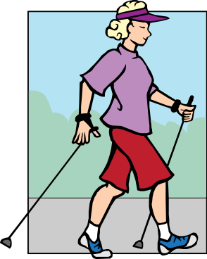
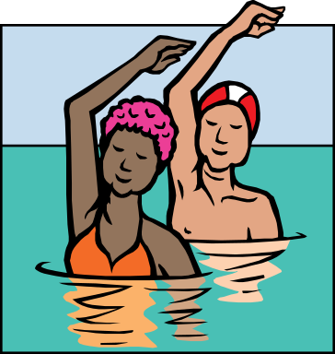
Lots of Resources Available!
Local organizations (walking, swimming, dance, tennis, yoga, etc.)
Online websites, videos and smartphone apps
TV programs (PBS, cable, Netflix videos)
Notes:
Available for all ages and ability levels
See handout for some examples – modify to be site-specific

Slide 22
If you have any concerns, speak with your doctor before starting any new strenuous activities or exercise regimens, and start slowly!

Slide 23
Let’s Move
You Can Do It!

Slide 24
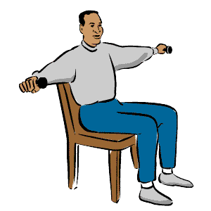
For your arms
Sitting with your back straight, raise both arms straight out to the sides (parallel to the ground). Make sure your shoulders are relaxed. Rotate your arms in circles—10 times to the front and 10 times to the back.
Keeping your elbow at your side, bend your arm to bring one hand upward toward your shoulder. Do 10 sets on each arm.
Notes:
Tip: Use “weights” (either light dumbbells or a heavy can from the kitchen) to help increase the resistance. Hold the weight in your hand as you move your hand upward toward your shoulder

Slide 25
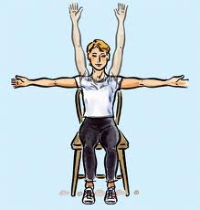
For your shoulders
Raise one hand high above the head (careful—do not strain too hard). Keep your shoulder relaxed. Repeat 10 times for each arm.
Keeping your shoulders relaxed, place your hands on your shoulders (right hand on right shoulder, left hand on left shoulder). Bring your elbows together so they touch. Repeat 10 times.

Slide 26
For your legs
Place both feet flat on the floor, with your feet directly below your knees (your legs should make a 90º angle). Raise one foot up, so that your whole leg is extended straight out. Lift your leg only as high as you can. Repeat 10 times, repeat using the other leg.
Place both feet flat on the floor, with your feet directly below your knees (your legs should make a 90º angle). Raise your heels up as high as you can, while keeping your toes on the ground (your toes will point downward). Repeat 15 times.
Notes:
Place a book (not too heavy) on your lap, so that the edge of the book is at your knees. This will help increase the resistance while you raise your heels.

Slide 27
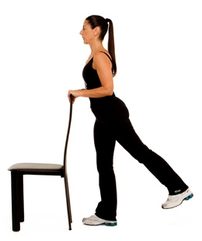
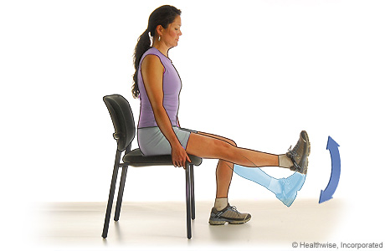
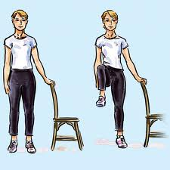
Glute Lifts
Quadricep Lifts
Knee Lifts using Chair
Notes:
Leg lift back
Quad lift in chair
Knee lift using chair for balance

Slide 28
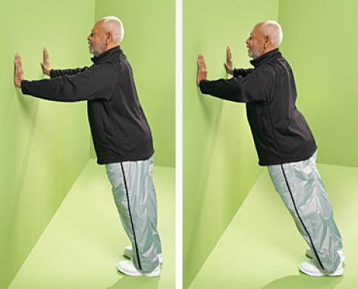
Push-ups and Chest
Chest Press:
The muscles of the upper torso are targeted in this exercise. Place your hands at chest height on each side of an open doorway or wall. Your feet should be 6 to 10 inches behind your body, so that you are leaning forward. Press your body back like a push-up and return. Make sure that your feet are securely placed on the floor, moving any rugs that may cause you to slide.

Slide 29
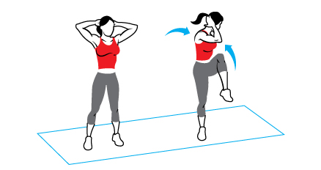
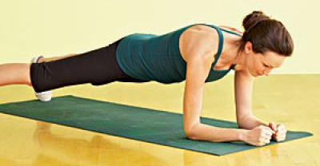
Core strength
Plank
Squat against Wall
Knee Lifts
Knee Twists
Knee Twist
Plank
Notes:
Picture_ plank on bottom
Hold your body either on elbows or hands ; straight alignment from top head to heels
Abdominals tight (belly button to your back)

Slide 30
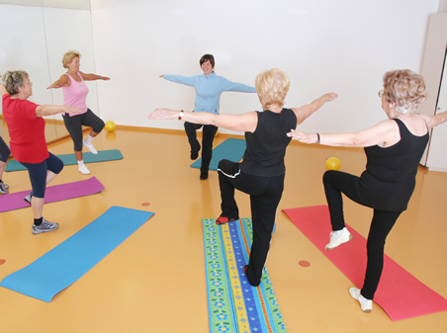
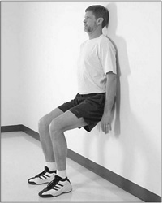
Knee Lifts
Wall squats
Notes:
Knee Lifts
Wall squats

Slide 31
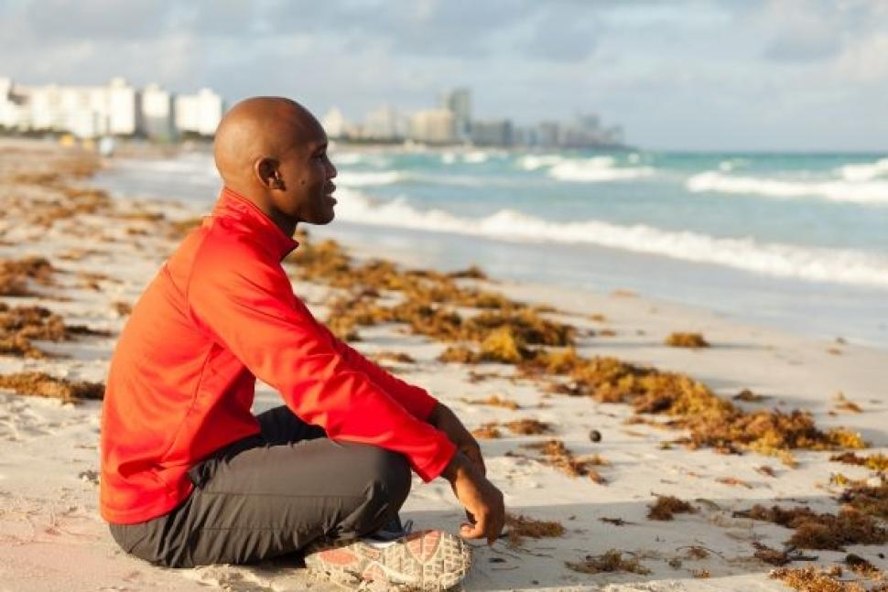
Balance & Rest
Meditation
  Apps=
    Calm
    Headspace
Sleep
Relaxation
Time for yourself
Just Breathe
Yoga, Pilates
Notes:
Calm app: users can invoke serenity; delivering scenic backgrounds, soundscapes and guidance for meditation. 2-30 minutes in length
Provide anxiety release, confidence, compassion, creativity , motivation and more.
Headspace: lighthearted practice of meditation. 10 -10 minute sessions on basics meditations

Slide 32
*Exercise gives you energy and keeps you healthy to keep going in that busy life of yours!
*So don't think of exercise as just another to-do item to squeeze into your already busy schedule.
*Instead, think of it as maintenance for your health, a way to de-stress and do something beneficial for you!
Notes:
Exercise will soon become something that you really enjoy and look forward to each day.

Slide 33
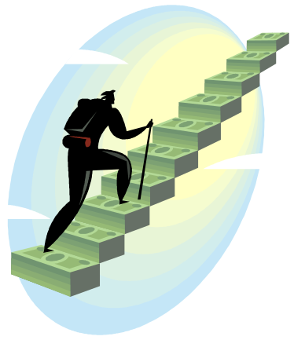
Thank You!
Adapted from a presentation developed by Erin McCarthy, ACE, CSSD of the Center for Lifestyle Medicine, Northwestern University, Chicago, IL

