Slide 1
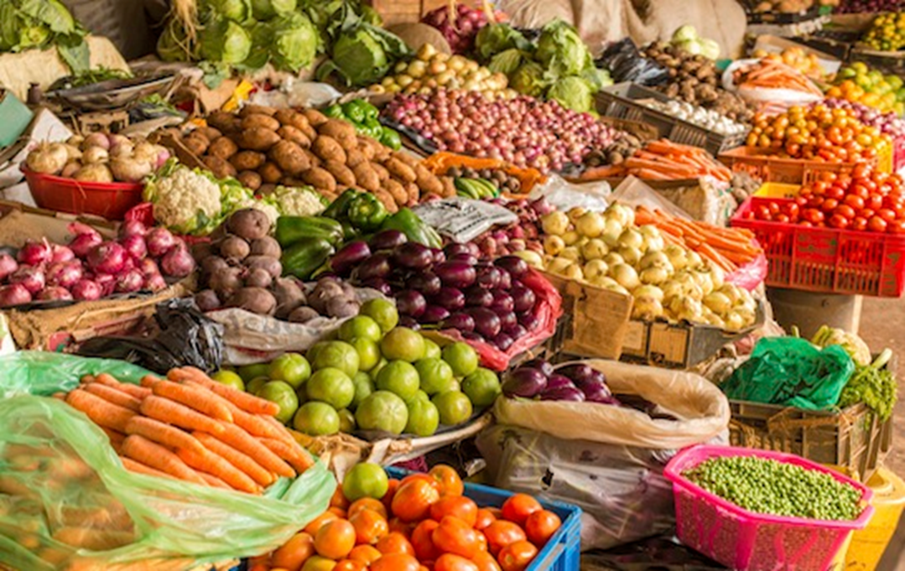

Welcome to the Support and Education Program
Healthy Eating:
MyPlate and Enjoying Seasonal Produce

Slide 2
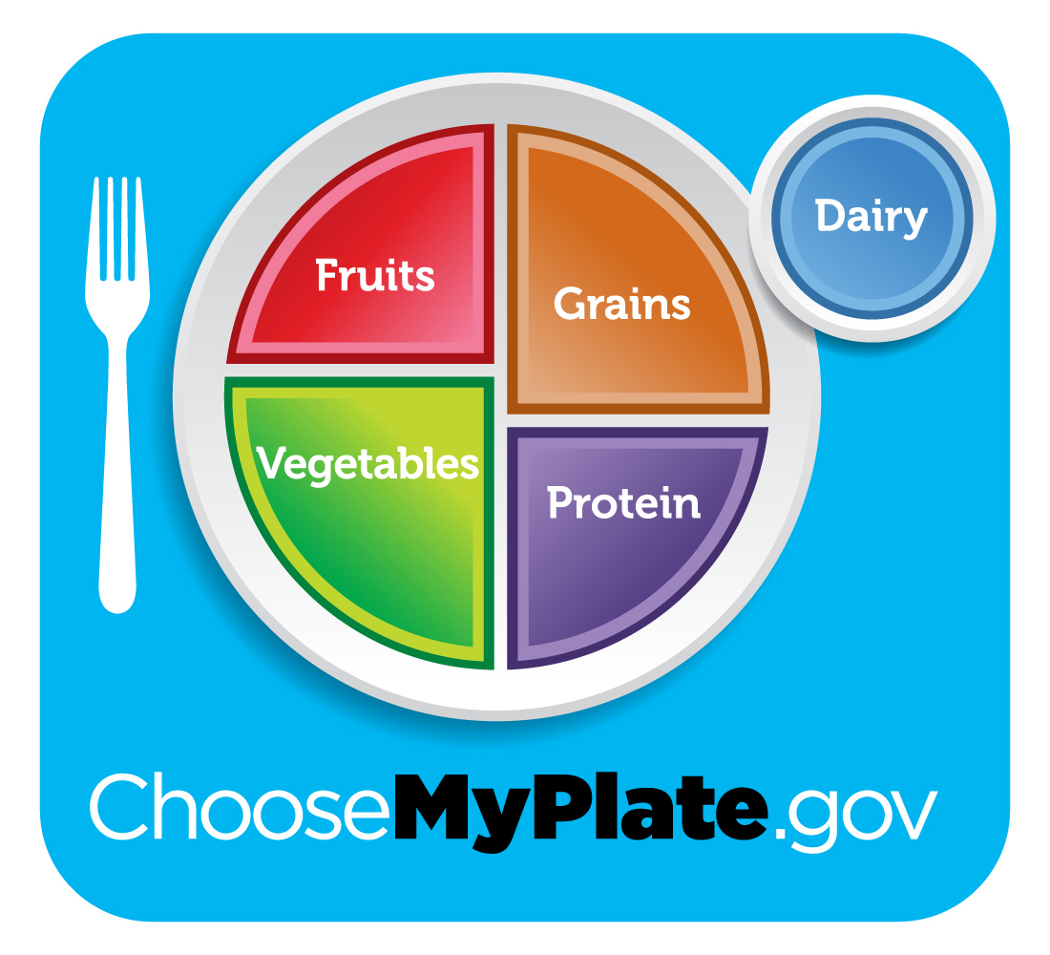
MyPlate is a general guide to healthy eating.
It is based on the latest research about nutrition and health.
Source: U.S. Department of Agriculture, ChooseMyPlate.gov

Slide 3
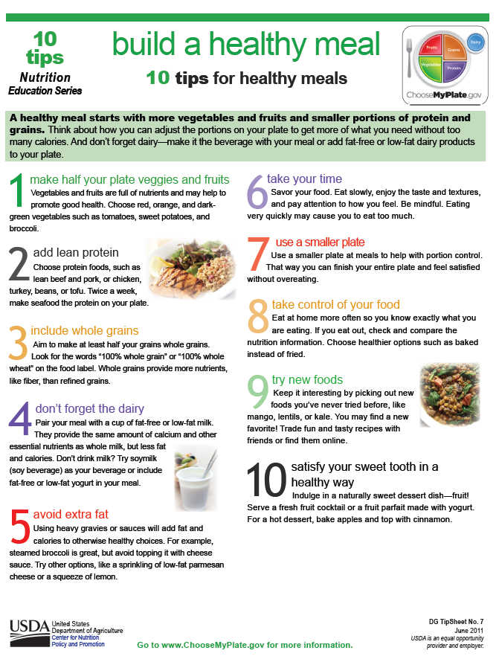

Slide 4
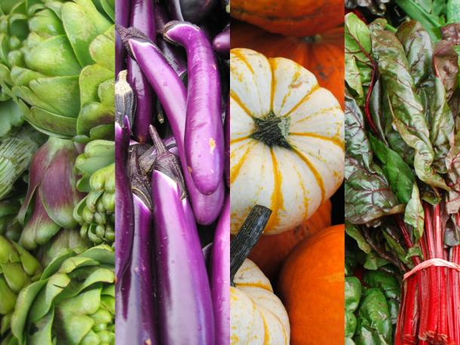
A healthy diet is one of the most important lifestyle changes you can make to help reduce your risk for type 2 diabetes.
Vegetables and fruits are central to a healthy diet. And when you eat them in season, they are:
Fresher
Better tasting
More nutritious
Grown locally
Cheaper to buy

Slide 5
Nutritional Benefits
Fruits and vegetables have been found to decrease your risk of certain diseases. So what’s in fruits and vegetables that can provide such protection?
Antioxidants – Beta-carotene, vitamin C, vitamin E and selenium are all nutrients in fruits and vegetables, which are responsible for protecting body cells from damage as well as keeping your immune system healthy and reducing your risk for cancer.
Phytochemicals – Phytochemicals give the plant color, aroma and flavor. They are divided into three major families: Carotenoids, Flavonoids, and Phenolic Compounds. They may have beneficial health effects.
Fiber – Fruits and vegetables are an excellent source of fiber. There are two forms of fiber: soluble and insoluble. Soluble fiber, found in oats, peas, beans and certain fruits helps lower cholesterol and prevent heart disease. Insoluble fiber found in wheat, potatoes and certain fruits and vegetables helps to maintain regularity and prevent colon cancer.

Slide 6
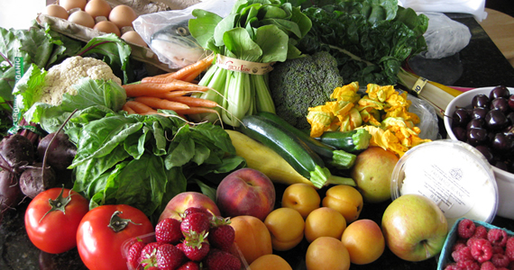
Yellow/Orange fruits and vegetables contain varying amounts of antioxidants such as vitamin C
as well as carotenoids and flavonoids
Blue/Purple fruits and vegetables contain varying amounts
of phytochemicals such as anthocyanins (a flavonoid)
and phenolic compounds
Green fruits and vegetables contain varying amounts of potent phytochemicals such as lutein
(a carotenoid)
and indoles (a phenolic compound)
White, tan, and brown fruits and vegetables contain varying amounts of phytochemicals
including allium compounds, a phenolic compound found in the onion family.
Red fruits and vegetables contain lycopene
(a carotenoid) and anthocyanins (a flavonoid).
Besides being low in calories and high in fiber, fruits and vegetables are also rich in antioxidant vitamins and phytochemicals, and may be beneficial in reducing risk of type 2 diabetes.

Slide 7
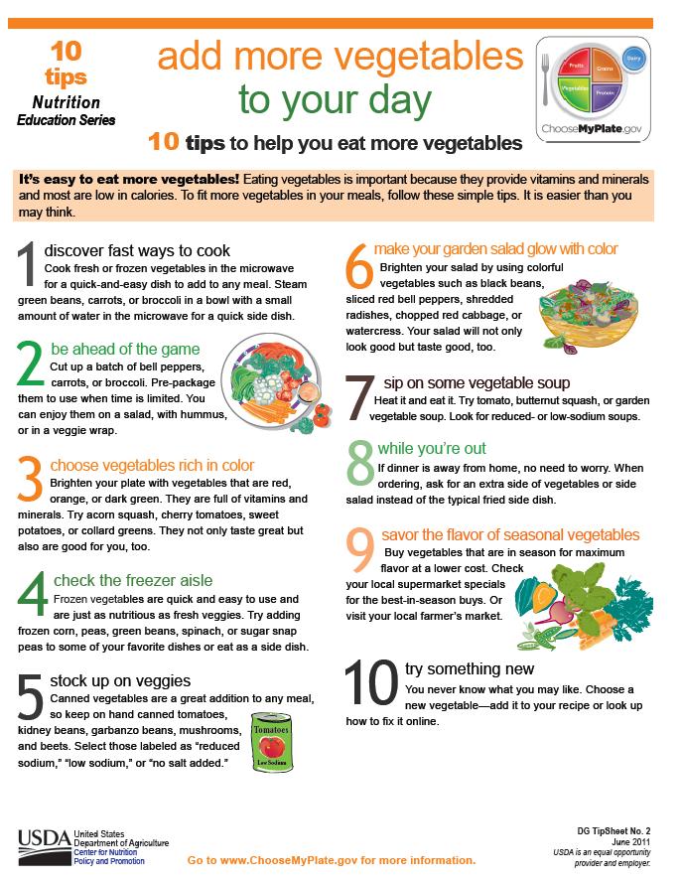

Slide 8
A Beginner's Guide to Seasonal Eating:
1. Consult a growing guide. Each state will usually have a growing guide specific to produce grown there, and that's an excellent indicator of what's fresh when.
2. Pay attention to grocery store displays. You know that gorgeous moment when your local grocery store has gigantic bins of sweet corn and a courtesy trash can nearby for throwing husks and silks into? That's a clear indicator that corn season is in full swing. It's at that point that corn is abundant and cheap -- after all, they have to move that product quickly before it spoils, so it can be had at a bargain. Look for what's bountiful and prominently displayed in your grocery store.
3. Pay attention to your farmers' market. If you live in an area with a farmers' market, those people are super familiar with what's in season. You can get crops that were picked within the last 24 hours.
4. Ask a farmer. If you have a local farm that you go to, or a farmer in your friend circle, or a produce vendor you are acquainted with, ask them about what's in season, what's about to go away, what's coming in soon. They are usually all too happy to tell you, and you may be able to score some really cool produce opportunities.
- from Food Riot by Dana Staves

Slide 9
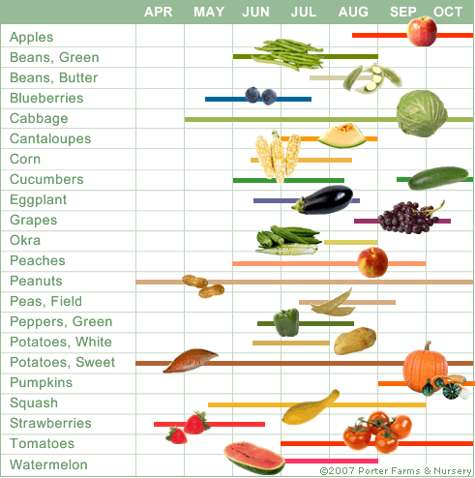
Examples of local produce availability calendars

Slide 10
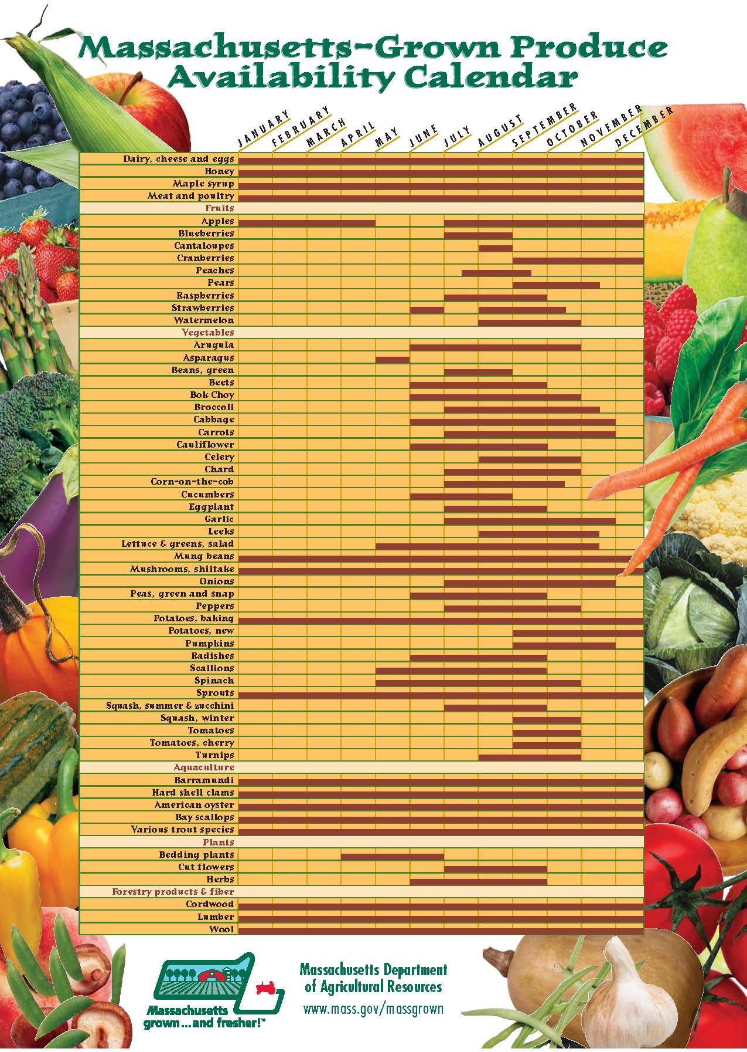

Slide 11


Slide 12
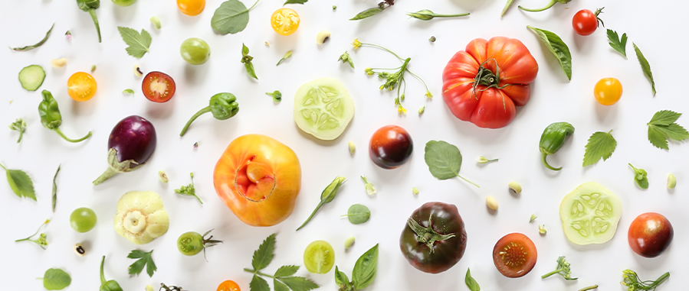
Thank You!
julieskitchen.me

