Slide 1
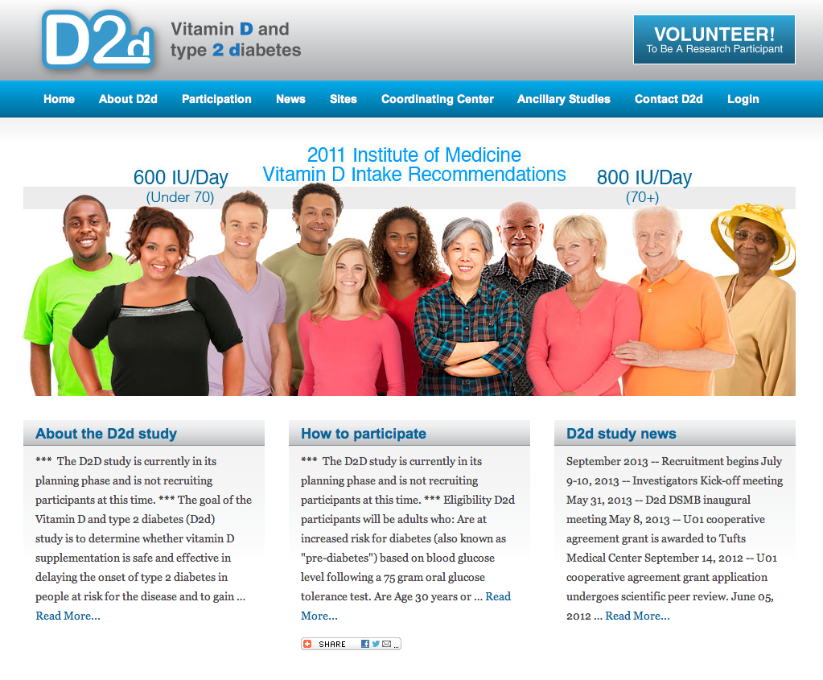
D2d study

Slide 2
Background & Rationale

Slide 3

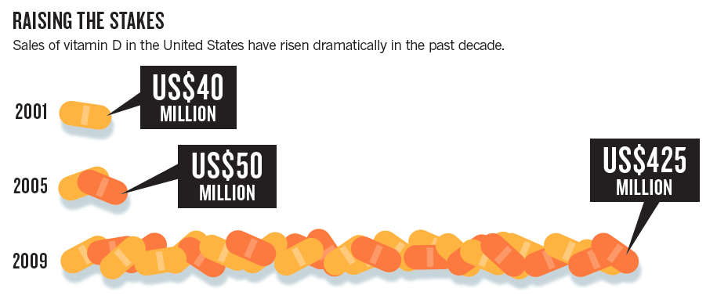
Vitamin D is now Big Business

Slide 4
Risk of Incident Type 2 Diabetes by Joint Categories of Vitamin D and Calcium Intake
Prospective Observational; Nurses Health Study cohort
↓Risk by 33%
↓Risk by 33%
Pittas et al Diabetes Care 2006 29:3:650
Notes:
>>>Women with the highest calcium (>1200 mg/day) and vitamin D (> 800 IU/day) intake (1.3% of the cohort) had a 33% lower risk of diabetes compared to women with the lowest calcium (<600 mg/day) and vitamin D (<400 IU/day) after multivariate adjustment for a variety of known risk factors.

Slide 5
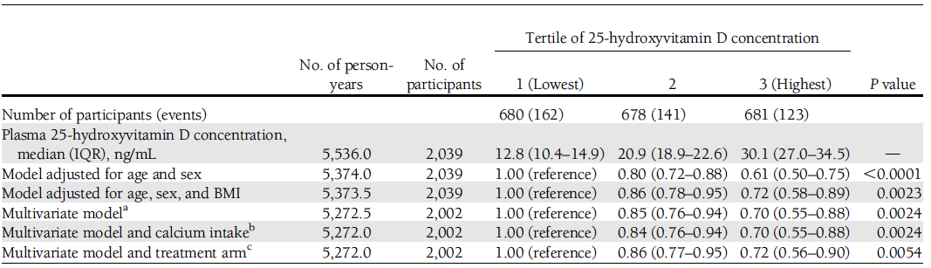
Association of 25OHD with Incident Type 2 Diabetes
Lifestyle and metformin arms of Diabetes Prevention Program
Supported by NIDDK R01DK9003
Pittas et al, Diabetes Care 2012

Slide 6
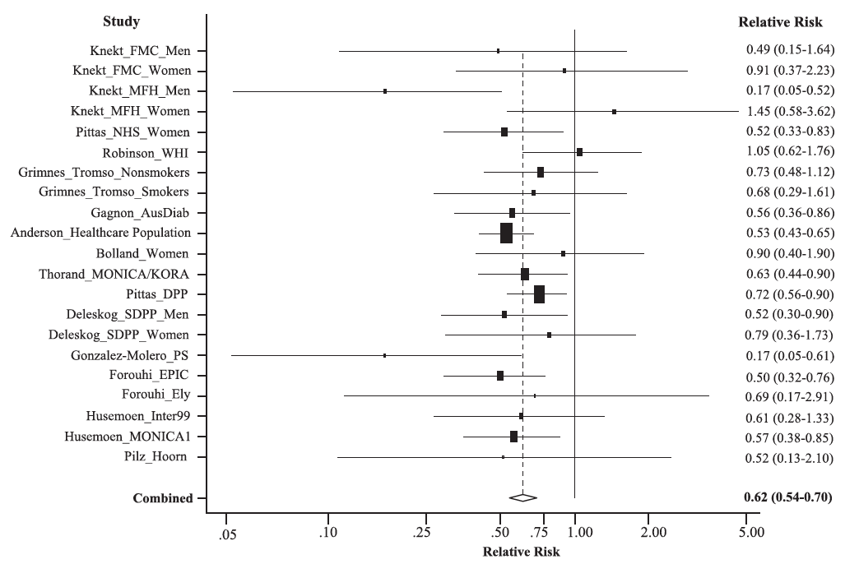
Association of 25OHD with Incident Diabetes Meta-analysis of Longitudinal Observational Studies
Risk decreases by 35%
for 25OHD (ng/mL) >25-30 vs. <8-20
Song et al Diabetes Care March 2013

Slide 7
Prerequisites for Causal Association of Vitamin D with Diabetes
✓
Biological plausibility
Specificity [not required]
Temporal relationship: longitudinal studies
Strength of the association: high relative risk
Dose response (except in thresholds)
Experimental evidence
Cessation/removal of exposure, intervention [RCT]
Consideration of alternative explanations
Coherence [consistency among studies]
X
✓
✓
✓
X
✓
X
Bradford Hill’s criteria

Slide 8
Pitfalls of Observational Studies with Vitamin D and Disease
(Residual) Confounding
Is vitamin D simply a marker of
increased risk for disease
Association ≠ “supplementation would be beneficial”
Need
Randomized Clinical Trials

Slide 9
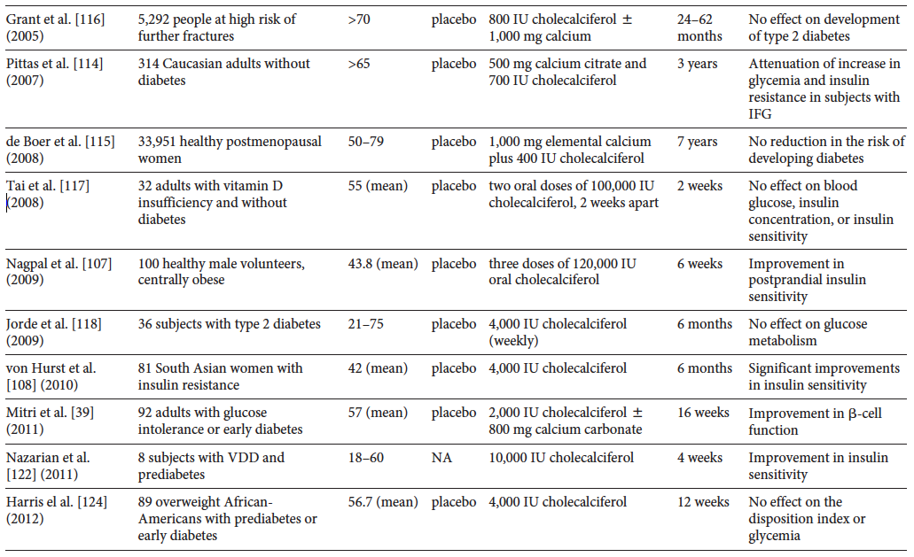
Trials in pre-diabetes / diabetes

Slide 10
Limitations of Published Trials on Vitamin D Supplementation and Type 2 Diabetes
Small, underpowered studies
Inadequate duration
Large dropout rates [20-40%]
Post-hoc analyses
Choice of vitamin D regimen
Large infrequent doses
Populations studied
Normal glucose tolerance [unlikely to benefit]
Established type 2 diabetes [difficult to show]

Slide 11
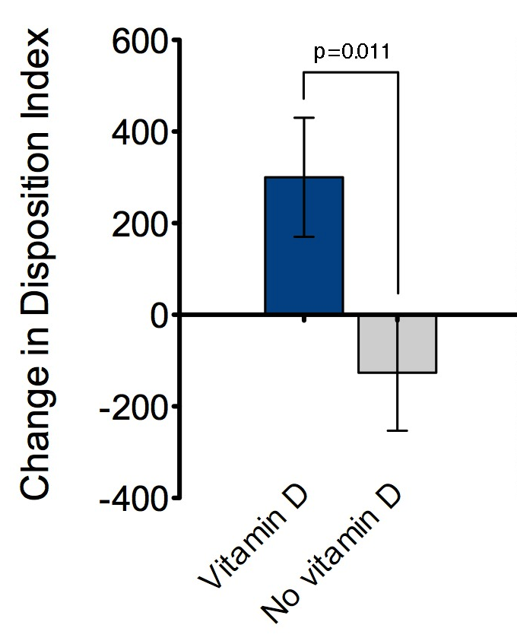
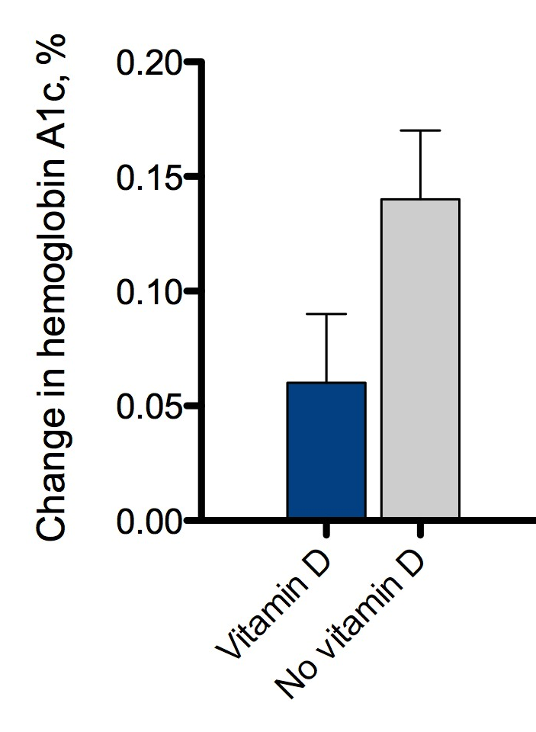
Effect of Vitamin D₃ Supplementation (2,000 IU/day) on Disposition Index (beta-cell function) and HbA1c
Supported by NIDDK/ODS R01DK76092
Participants at risk for diabetes (IFG, IGT)
p=0.08
Mitri et al AJCN 2011

Slide 12
Calls for a randomized trial on vitamin D supplementation for prevention of type 2 diabetes
The insufficient evidence to date and the need for such a trial has been recognized in recent editorials and reviews ¹⁻²⁶ and by several research bodies, including the Institute of Medicine (IOM)^{27,28} and Endocrine Society.²⁹⁻³¹
1.Scragg R. Vitamin D and type 2 diabetes: are we ready for a prevention trial? Diabetes. Oct 2008;57(10):2565-2566.
2.Holick MF. Diabetes and the vitamin d connection. Curr Diab Rep. Oct 2008;8(5):393-398.
3.Witham MD. Vitamin D deficiency: More evidence is needed before general supplementation. BMJ (Clinical research ed. Jun 28 2008;336(7659):1451.
4.Alfonso B, Liao E, Busta A, Poretsky L. Vitamin D in diabetes mellitus-a new field of knowledge poised for D-velopment. Diabetes Metab Res Rev. Jul 2009;25(5):417-419.
5.Michos ED. Vitamin D deficiency and the risk of incident Type 2 diabetes. Future Cardiol. Jan 2009;5(1):15-18.
6.Pittas AG, Chung M, Trikalinos T, et al. Systematic review: Vitamin D and cardiometabolic outcomes. Ann Intern Med. Mar 2 2010;152(5):307-314.
7.Barengolts E. Vitamin D role and use in prediabetes. Endocr Pract. May-Jun 2010;16(3):476-485.
8.Jolobe OM. Optimization of vitamin D status as an alternative strategy for primary prevention of cardiovascular events in type 2 diabetes mellitus. Journal of the American Geriatrics Society. Apr 2010;58(4):806-807.
9.Baz-Hecht M, Goldfine AB. The impact of vitamin D deficiency on diabetes and cardiovascular risk. Curr Opin Endocrinol Diabetes Obes. Apr 2010;17(2):113-119.
10.Mathieu C. Vitamin D and diabetes: the devil is in the D-tails. Diabetologia. Aug 2010;53(8):1545-1548.
11.Guallar E, Miller ER, 3rd, Ordovas JM, Stranges S. Vitamin D supplementation in the age of lost innocence. Ann Intern Med. Mar 2 2010;152(5):327-329.
12.Osei K. 25-OH vitamin D: is it the universal panacea for metabolic syndrome and type 2 diabetes? J Clin Endocrinol Metab. Sep 2010;95(9):4220-4222.
13.Takiishi T, Gysemans C, Bouillon R, Mathieu C. Vitamin D and diabetes. Endocrinol Metab Clin North Am. Jun 2010;39(2):419-446, table of contents.
14.Alvarez JA, Ashraf A. Role of vitamin d in insulin secretion and insulin sensitivity for glucose homeostasis. Int J Endocrinol. 2010;2010:351385.
15.Maxwell CS, Wood RJ. Update on vitamin D and type 2 diabetes. Nutr Rev. May 2011;69(5):291-295.
16.Aloia JF. The 2011 report on dietary reference intake for vitamin d: where do we go from here? J Clin Endocrinol Metab. Oct 2011;96(10):2987-2996.
17.Engelman CD. Vitamin d recommendations: the saga continues. J Clin Endocrinol Metab. Oct 2011;96(10):3065-3066.
18.Shapses SA, Manson JE. Vitamin D and prevention of cardiovascular disease and diabetes: why the evidence falls short. Jama. Jun 22 2011;305(24):2565-2566.
19.Mitri J, Muraru MD, Pittas AG. Vitamin D and type 2 diabetes: a systematic review. Eur J Clin Nutr. Sep 2011;65(9):1005-1015.
20.Friedman TC. Vitamin D supplementation to prevent the progression of prediabetes to diabetes: getting closer to a recommendation. Transl Res. Nov 2011;158(5):273-275.
21.Sattar N, Welsh P, Panarelli M, Forouhi NG. Increasing requests for vitamin D measurement: costly, confusing, and without credibility. Lancet. Jan 14 2012;379(9811):95-96.
22.Forouhi NG, Ye Z, Rickard AP, et al. Circulating 25-hydroxyvitamin D concentration and the risk of type 2 diabetes: results from the European Prospective Investigation into Cancer (EPIC)-Norfolk cohort and updated meta-analysis of prospective studies. Diabetologia. Apr 15 2012.
23.Maxmen A. Vitamin D on Trial. The Scientist. 2012.
24.Afzal S, Bojesen SE, Nordestgaard BG. Low 25-hydroxyvitamin D and risk of type 2 diabetes: a prospective cohort study and metaanalysis. Clin Chem. Feb 2013;59(2):381-391.
25.Mezza T, Muscogiuri G, Sorice GP, et al. Vitamin D deficiency: a new risk factor for type 2 diabetes? Ann Nutr Metab. 2012;61(4):337-348.
26.Song Y, Wang L, Pittas AG, et al. Blood 25-Hydroxy Vitamin D Levels and Incident Type 2 Diabetes: A meta-analysis of prospective studies. Diabetes Care. May 2013;36(5):1422-1428.
27.Institute of Medicine Dietary Reference Intakes for Calcium and Vitamin D. Washington, DC: The National Academies Press; 2011.
28.Rosen CJ, Abrams SA, Aloia JF, et al. IOM committee members respond to endocrine society vitamin D guideline. J Clin Endocrinol Metab. Apr 2012;97(4):1146-1152.
29.Holick MF, Binkley NC, Bischoff-Ferrari HA, et al. Evaluation, treatment, and prevention of vitamin D deficiency: an Endocrine Society clinical practice guideline. J Clin Endocrinol Metab. Jul 2011;96(7):1911-1930.
30.Holick MF, Binkley NC, Bischoff-Ferrari HA, et al. Guidelines for Preventing and Treating Vitamin D Deficiency and Insufficiency Revisited. J Clin Endocrinol Metab. Mar 22 2012.
31.Rosen CJ, Adams JS, Bikle DD, et al. The Nonskeletal Effects of Vitamin D: An Endocrine Society Scientific Statement. Endocr Rev. May 17 2012.

Slide 13


Slide 14
Primary Aim
To evaluate the safety of oral daily vitamin D supplementation and its effect on the time to onset of clinical diabetes in participants at risk for diabetes (with pre-diabetes).

Slide 15
Secondary Aims
Variability of response to vitamin D supplementation in subgroups defined by baseline characteristics:
Race and ethnicity (as proxies for skin pigmentation)
BMI
Waist circumference
Age
Geographic location (proxy for sun exposure)
Calcium intake
25OHD concentration
Variability of response to vitamin D supplementation by :
Adherence based on pills counts
Achieved 25OHD concentration
Glycemia and glucose-insulin dynamics (continuous variables):
HbA1c, FPG and 2hPG
Insulin resistance, secretion, disposition index (OGTT-based indices)

Slide 16
Secondary Aims (cont.)
Plasma 25OHD concentration and identification of phenotypic characteristics associated with variability on achieved plasma 25OHD concentration
Cardiovascular risk factors
Blood pressure
Safety and tolerability of vitamin D supplementation
Major adverse cardiovascular events (as part of AE/SAE)

Slide 17
Inclusion criteria
Pre-diabetes (“at increased risk for diabetes”), meeting 2-out-of-3 criteria at baseline:
Fasting plasma glucose (FPG) 100-125 mg/dL ^{SCR, BAS}
2-hour plasma glucose (2hPG) 140-199 mg/dL ^{BAS}
Hemoglobin A1c (HbA1c) 5.7-6.4% ^{SCR, BAS}
Age ≥ 30 years
BMI ≥ 25 (≥ 23 if Asian) and ≤ 40 kg/m²
Written informed consent

Slide 18
Exclusion criteria
Diabetes
Medication use
Glycemic criteria (at screening [local] and baseline [central])
Safety concerns
Hyperparathyroidism
Nephrolithiasis
Hypercalcemia
Any medical condition (past 3 years) that in the opinion of the site investigator may increase risk for nephrolithiasis or hypercalcemia during the trial (e.g., sarcoidosis)
Use of tanning beds

Slide 19
Exclusion criteria | Medication and Supplements
Vitamin D supplement > 1000 IU/d
Calcium supplement > 600 mg/d
Use of medications or conditions (e.g. untreated celiac disease) that would interfere with absorption or metabolism of vitamin D
Weight management medication
Use of thiazide greater than 37.5 mg/day
Use of anticonvulsant (=valproate) started within 6m of screening
Intolerance to vitamin D

Slide 20
Exclusion criteria | Other Medical History
Symptomatic cardiovascular disease based on history and physical examination
History (1 yr.) of myocardial infarction, percutaneous coronary intervention or coronary artery bypass graft
History (1 yr.) of cerebrovascular disease
Any type of cancer (5 yrs.) except for basal cell skin cancer
Prostate cancer (for men over age 55) or well-differentiated thyroid cancer not expected to require treatment (except for suppression with thyroid hormone) over the next 4 years, are not exclusions
History (past 6 m) of treatment with oral (for > 7 days) or intravenous glucocorticoids or disease likely to require oral or intravenous glucocorticoid therapy during the study
Inhaled glucocorticoids are not excluded

Slide 21
Exclusion criteria | Other Medical History (cont.)
History (past 1 year) of substance abuse or unstable psychiatric disorder that in the opinion of the site investigator would impede competence or adherence with study procedures or hinder completion of the study or increase risk
History of bariatric surgery (e.g. Roux-en-Y Gastric Bypass) or planned bariatric surgery in the next 4 years
A life-threatening event within 30 days of screening or currently planned major surgery
Any other unstable active medical condition that in the opinion of the site investigators would impede competence or adherence with study procedures or increase risk
Uncontrolled hypertension (SBP > 160 or DBP > 100 mmHg)
Poor venous access

Slide 22
Exclusion criteria | Laboratory Evaluation
Serum liver transaminase higher than 3 times ULN
Anemia, transfusion (within 6m of screening or chronic requirement), blood donation (within 3m of screening) or other condition (hemolysis, hemoglobinopathy) rendering HbA1c results unreliable as indicator of chronic glycemia
Transfusion or blood donation does not exclude participant
Low platelet count (< 50,000)
Chronic kidney disease, [GFR] < 50 mL/min per 1.73m²
Hypercalcemia, defined as serum calcium concentration greater than or equal to the upper limit of normal, measured at the clinical site’s laboratory
Hypercalciuria, defined as spot urine (morning void) calcium-creatinine ratio > 0.275 ^{SCR, BAS}

Slide 23
Exclusion criteria | Other
Participation (within 30 days of screening) in another interventional research study
Previous randomization in D2d
Participants who did not qualify after screening may be screened again if the prior reason for exclusion has been addressed (e.g. high blood pressure is treated)
Any other reason that in the opinion of the site investigator would impede adherence with study procedures or hinder completion of the study or increase risk

Slide 24
Exclusion criteria | Women only
Pregnancy (past 1 year by report or positive pregnancy test at screening), intent to become pregnant in the next 4 years or unprotected intercourse
History of gestational diabetes is not an exclusion criterion
Currently breastfeeding
Use of oral contraceptives started within 3 months of baseline
Stable regimen of oral contraceptives or any other hormonal method of contraception (e.g. implantable) is allowed

Slide 25
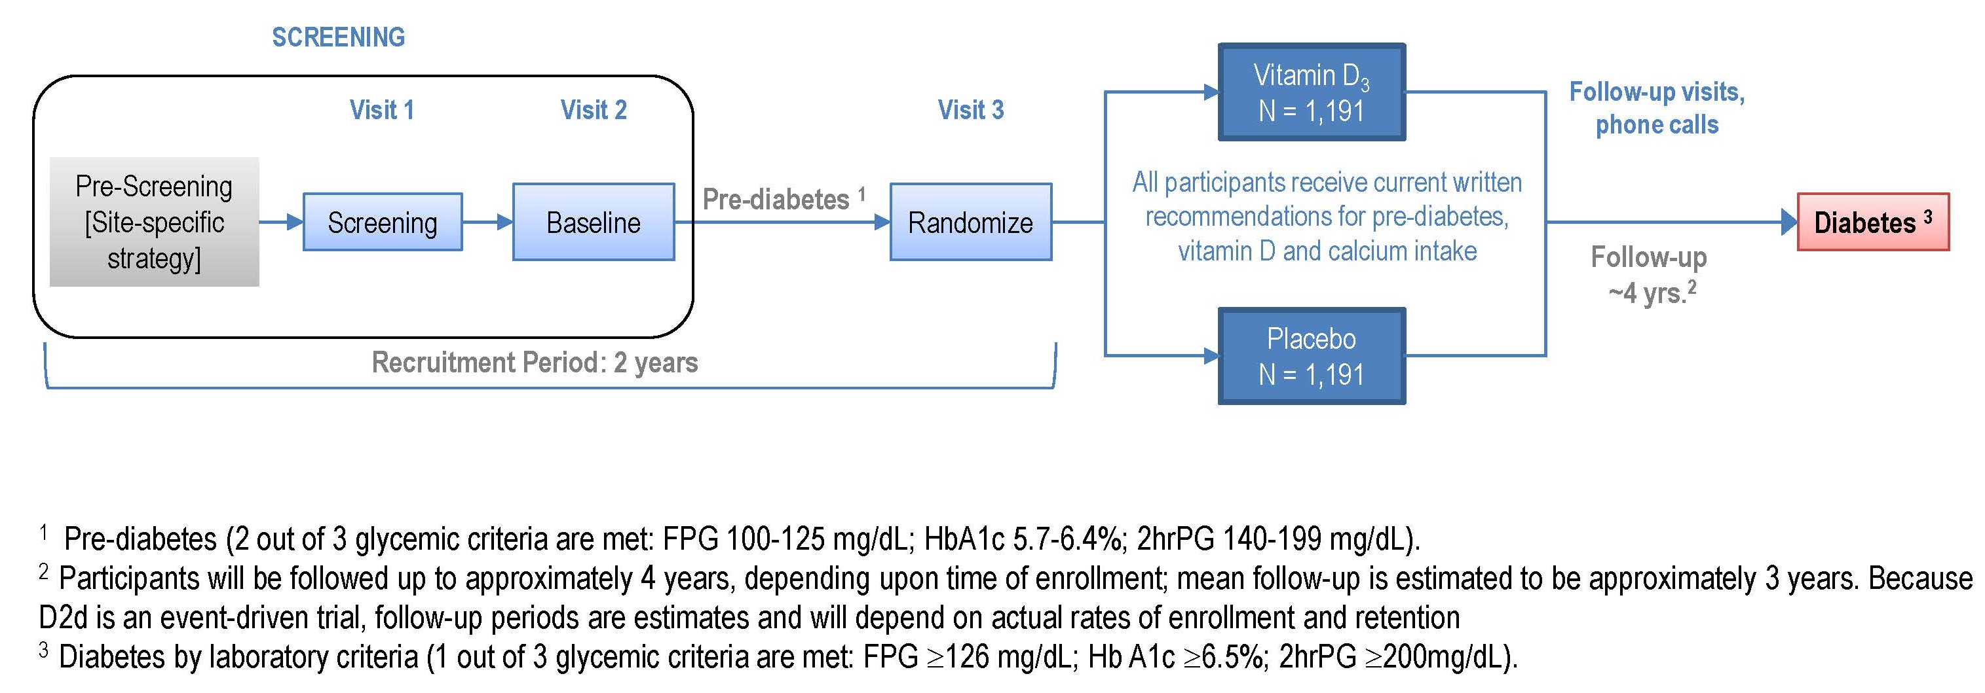
D2d study design overview

Slide 26
Intervention – Rationale for Dose and Frequency cholecalciferol 4,000 IU/day
Efficacy
Achieve adequate difference in 25OHD between active and placebo arms
4,000 IU/day expected to increase 25OHD ~40-45 ng/mL [Vieth, 2004; Aloia, 2008; Mitri, 2011; Gallagher, 2012]
Safety
4,000 IU/day is the IOM Tolerable Upper Intake Level
Large infrequent doses may not be physiologic and may be associated with adverse skeletal outcomes

Slide 27
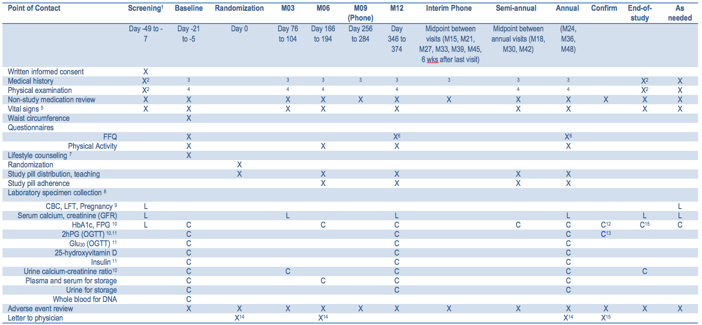
Study Visits Overview

Slide 28
Study Visits | Screening
Goal
Determine preliminary eligibility
Visit Activities
Informed consent process for D2d and the D2d Specimen Repository
Process conducted by a person trained to do so with in-depth understanding of D2d

Slide 29
Study Visits | Screening (cont.)
Obtain demographic information
Physical Measurements
Vital signs (blood pressure, heart rate), height, and weight
Medical history (with emphasis on inclusion/exclusion)
Review concomitant medications and supplements
Daily total intake of non-dietary vitamin D
e.g. multivitamin (400 IU/day), Fosamax+D (2800 IU/week)
= total 800 IU/day
Daily total intake of non-dietary calcium

Slide 30
Study Visits | Screening (cont.)
Laboratory specimen collection
Analyzed at each site’s clinical laboratory
Results provided to participants and their health care provider(s)
Complete blood count
Liver transaminases (AST, ALT)
Serum calcium
Serum creatinine and estimated creatinine clearance (GFR, calculated centrally)
Pregnancy test for women of reproductive potential
FPG (preliminary)
HbA1c (preliminary)

Slide 31
Study Visits | Baseline
Goals
Confirm eligibility (glycemic and urine calcium)
Obtain baseline data
Visit Activities
Interim medical history
Physical examination
Review of concomitant medications and supplements
Physical Measurements
Vital signs (blood pressure, heart rate), height, weight, and waist circumference

Slide 32
Study Visits | Baseline (cont.)
Laboratory specimen collection
FPG, HbA1c, 2hPG (75 gram OGTT)
Urine calcium-creatinine ratio
Analyzed at Central Laboratory
Results provided to participants and their health care provider(s)
Questionnaires
Food Frequency (FFQ), Physical Activity, NDEP
Lifestyle counseling (NDEP material)
Review of Participant Information pamphlet

Slide 33
Study Visit | Randomization
Visit Activities
Randomize the participant
Obtain printout of study bottle assignment
Review the Participant Information pamphlet with participant
Confirm study pill bottle number being dispensed matches study bottle number on SPIRS printout
Provide participant with a printout of the visit schedule
Post visit: send letter to Primary Care Provider

Slide 34
Study Visit | Month 3
Visit Activities
Interim medical history
Assess study pill compliance
Review of concomitant medications and supplements
Physical Measurements
Vital signs (blood pressure, heart rate), height, and weight
Symptom-directed physical examination
Laboratory specimen collection
Local lab: serum calcium and creatinine, pregnancy (prn)
Central lab: urine calcium creatinine ratio
Review of Participant Information pamphlet

Slide 35
Study Visit | Semi-Annual Visits
Visit Activities
Interim medical history
Review of concomitant medications and supplements
Physical Measurements:
Vital signs (blood pressure, heart rate), height, weight
Symptom-directed physical examination (prn)
Laboratory specimen collection:
Local lab: pregnancy (prn)
Central lab: FPG, HbA1c, (M06-repository specimens)

Slide 36
Study Visit | Semi-Annual Visits (cont.)
Study pill counts and compliance assessment
Protocol reinforcement and review of Participant Information
Dispense a new bottle of study pills
Bottle number assigned by SPIRS
Post visit: Send follow-up letter to Primary Care Provider

Slide 37
Study Visit | Annual Visits
Visit Activities
Interim medical history
Review of concomitant medications and supplements
Physical Measurements:
Vital signs (blood pressure, heart rate), height, weight
Symptom-directed physical examination (prn)
Laboratory specimen collection:
Local lab: serum calcium, serum creatinine, pregnancy (prn)
Central lab: OGTT, repository

Slide 38
Study Visit | Annual Visits (cont.)
Questionnaires
FFQ (M12 and M36 in participants without diabetes)
Physical Activity
Protocol reinforcement and review of Participant Information
Dispense a new bottle of study pills
Bottle number assigned by SPIRS
Post visit: Send follow-up letter to Primary Care Provider (template in MOP)

Slide 39
Scheduled Phone Contact
Schedule: 9M, 15M, 21M, 27M, 33M, 39M, 45M, 6 wks after end-of-study visit
Goals
Promote retention
Assess and encourage compliance with study pills
Encounter Activities
Interim medical history (assess for AEs)
Remind participant to contact the site prior to starting new medications or if she is diagnosed with diabetes
* See MOP 4 and 17 for tips on contacting people

Slide 40
Study Visit | Unscheduled
Unscheduled visit will occur if:
Healthcare provider outside D2d diagnoses diabetes or plans to start diabetes-specific pharmacotherapy
Visit scheduled ASAP
Participant reports symptoms of hyperglycemia
Visit ASAP
Adverse event
Visit ASAP

Slide 41
Unscheduled | Confirmatory Visit
Required if at semi-annual or annual visit, participant met one glycemia criteria for diabetes
Confirmatory visit should occur within 8 weeks
Encounter Activities
Interim medical history
Review of concomitant medications and supplements
Collection of required sample(s) for Central lab

Slide 42
Unscheduled Visit | Diabetes Diagnosed Outside of Study
Goal
Participant returns to clinic for glycemia testing prior to starting diabetes specific medications (for any reason)
Encounter Activities
Complete Non-D2d Diabetes Diagnosis worksheet
Start form when speaking with participant on phone
Complete form during the visit
If participant has not started the diabetes-specific medication, collect FPG and HbA1c samples Central Lab
If participant started diabetes-specific medication, collect medical records for adjudication

Slide 43
Unscheduled Visit | Symptoms of Hyperglycemia
Required if reports symptoms of hyperglycemia
Visit should occur ASAP
Encounter Activities
Interim medical history
Review of concomitant medications and supplements
Collection of FPG and HbA1c for Central lab
Symptoms of hyperglycemia:
Blurry vision
Excessive thirst
Excessive hunger
Frequent urination
Extreme fatigue
Unexplained weight loss
Frequent infections

Slide 44
End of Study Visit
Encounter Activities
Interim medical history
Review of concomitant medications and supplements
Physical Measurements:
Vital signs (blood pressure, heart rate), height, weight
Symptom-directed physical examination (prn)
Study pill compliance assessment
Return of study pills
Laboratory specimen collection:
Local Lab: serum calcium and creatinine
Central Lab: Urine calcium creatinine, HbA1c, FPG

Slide 45
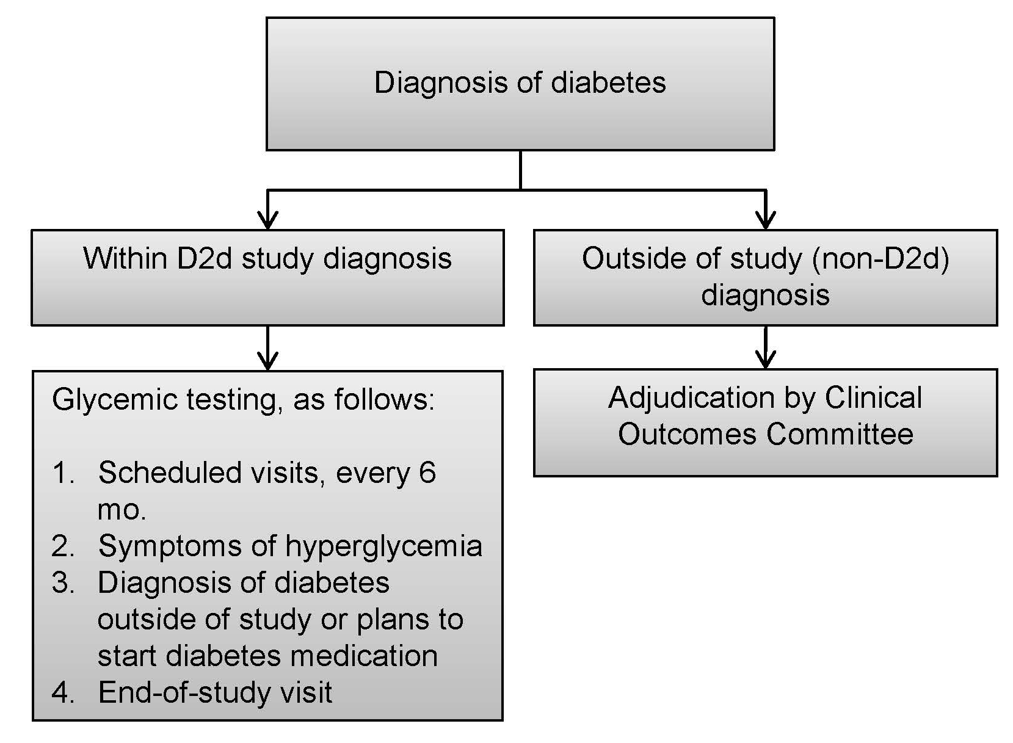
Primary outcome: incident diabetes | Overview of diagnosis

Slide 46
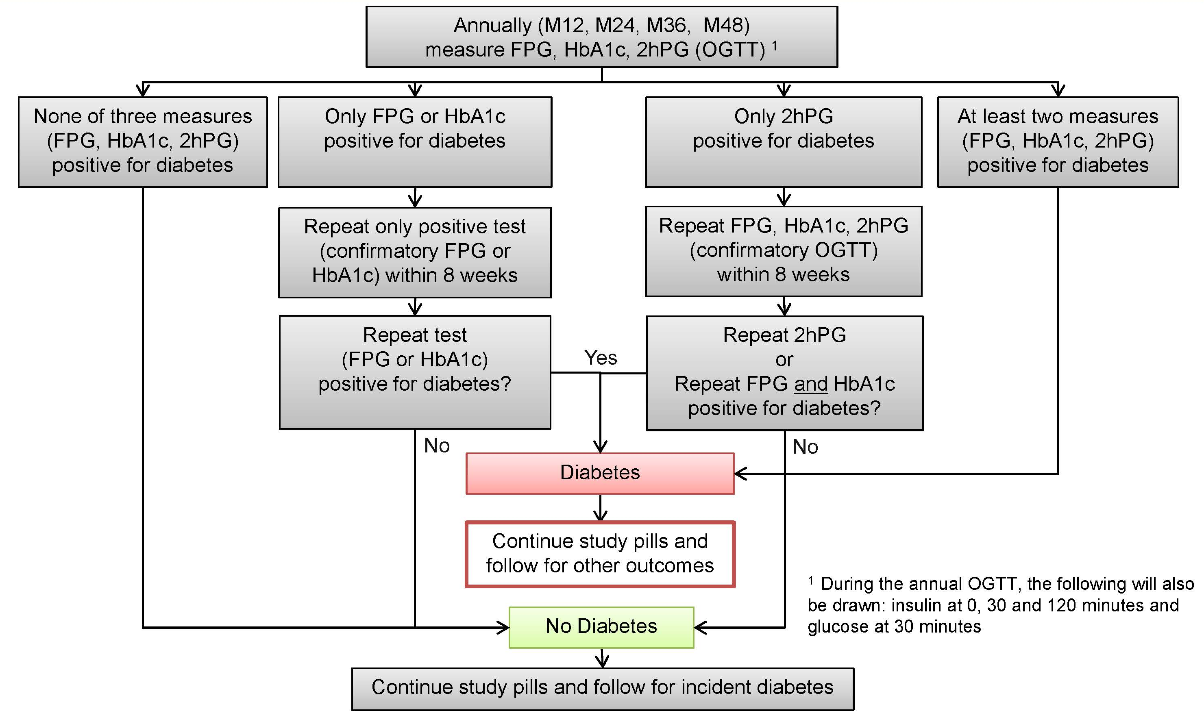
Diabetes diagnosis – annual visit

Slide 47
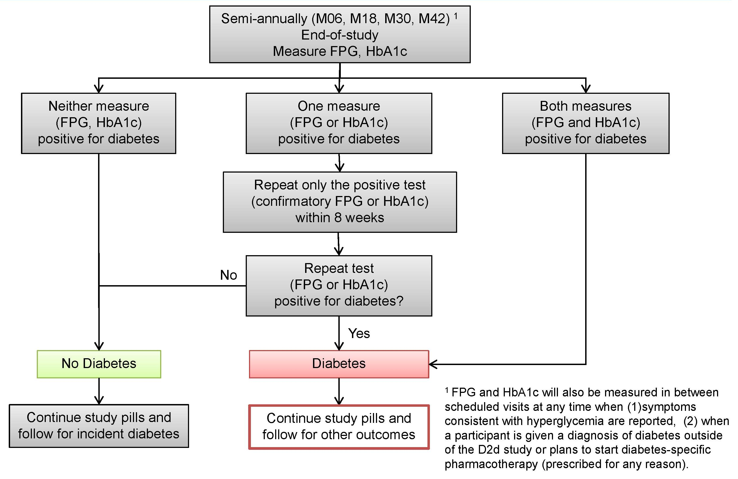
Diabetes diagnosis – semi-annual visit

Slide 48
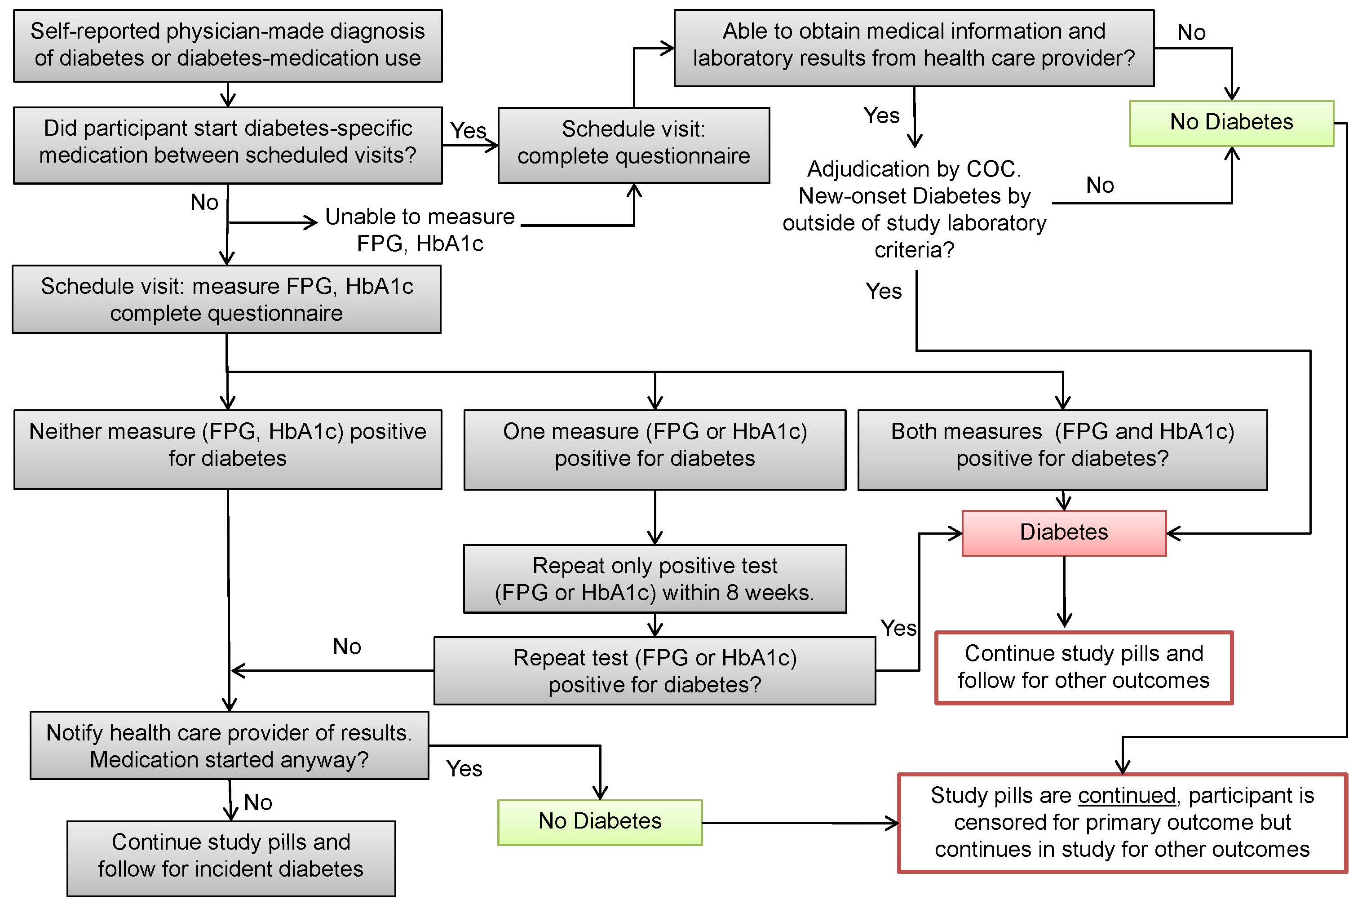

Slide 49
Management of participants after diabetes diagnosis
Study pills will be continued and participants will be referred to PCP for further care in relation to diabetes
Participants will continue in D2d and return for scheduled visits for assessment of other outcomes
Letter will be sent to the participant’s PCP
Provide results of the D2d glycemia measures
Reinforce that the participant will continue study pills and participation in D2d
Inform the health care provider that:
Glycemic results need to be repeated in the clinical setting before the diagnosis of diabetes is established clinically
The participant’s diabetes will not be managed in study by physician

Slide 50
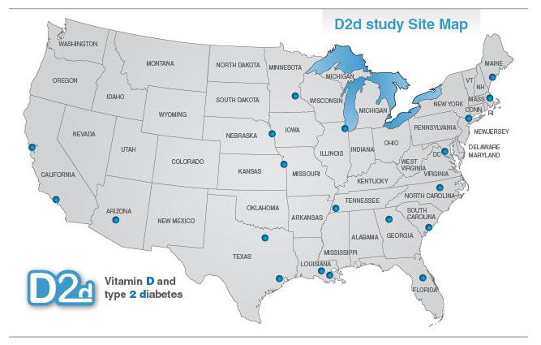
D2d collaborating clinical sites

