Slide 1
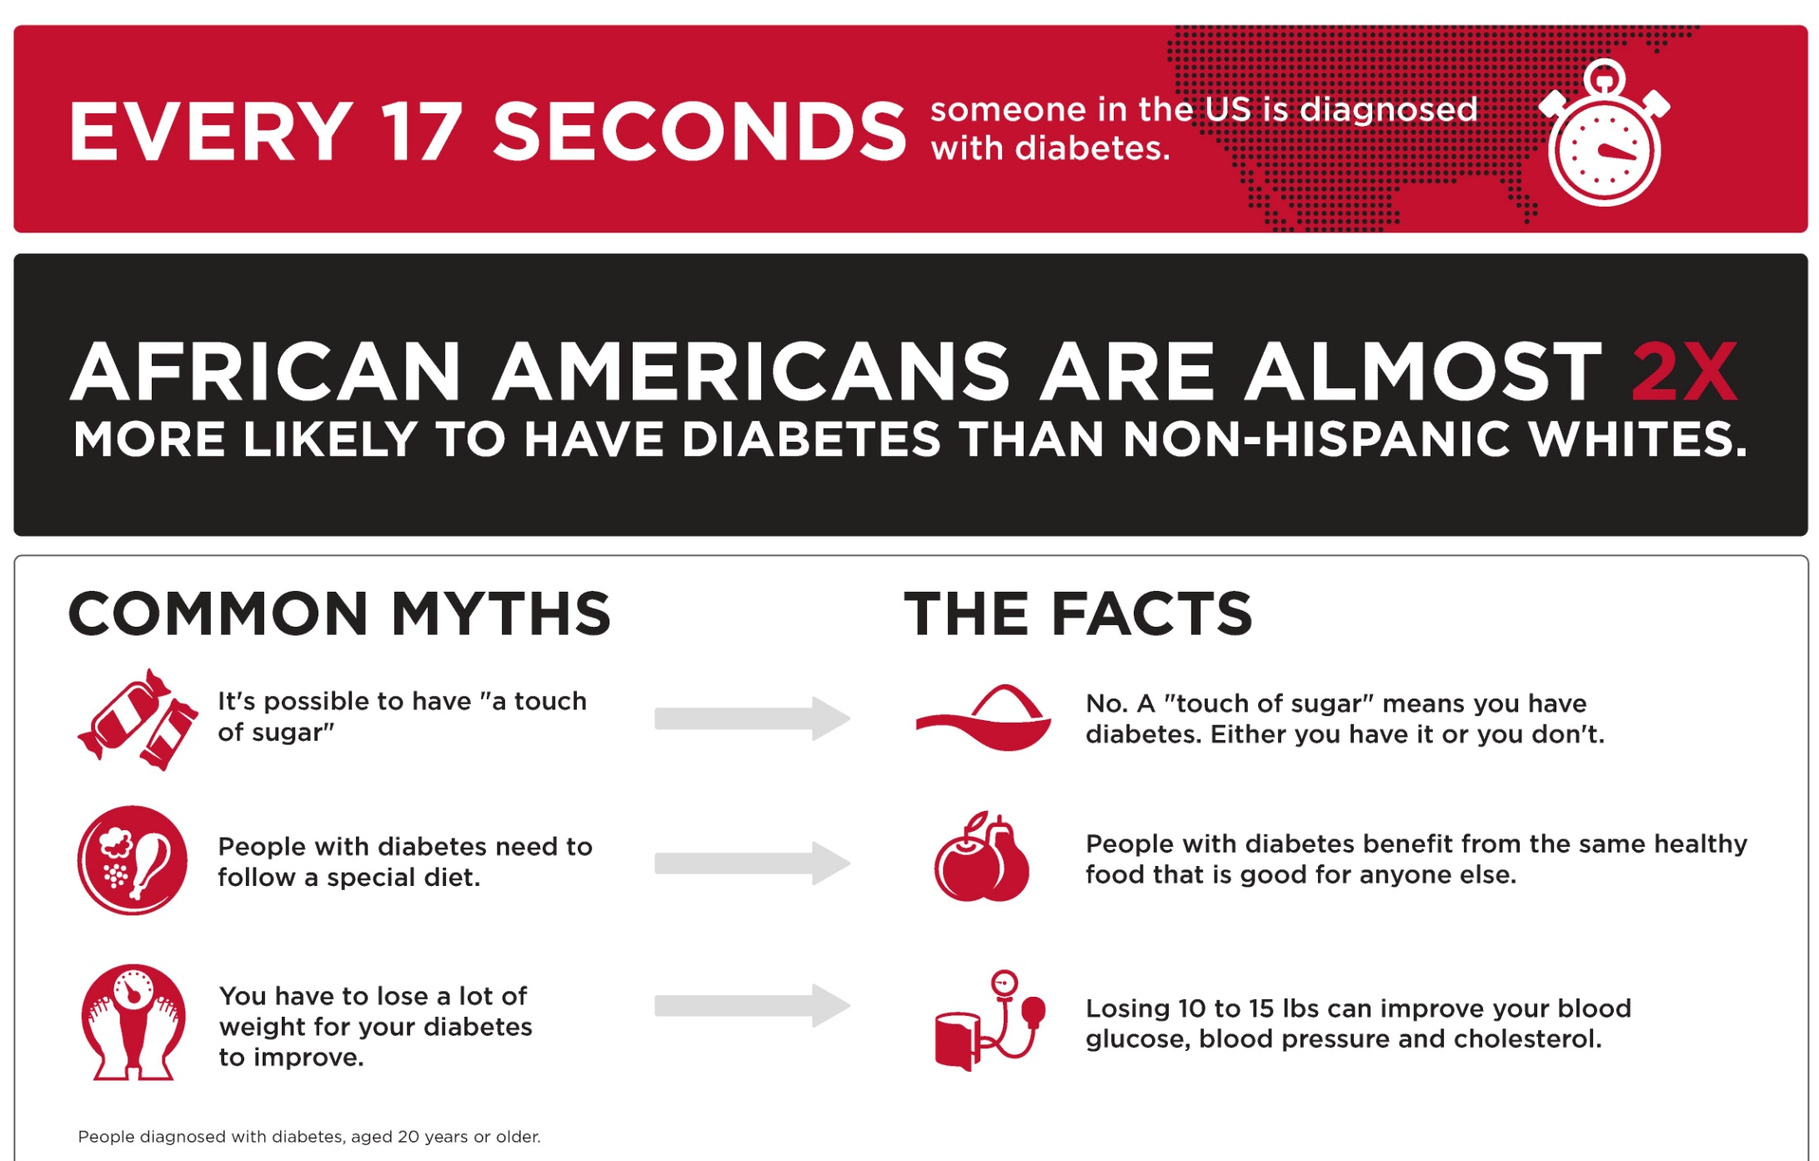

PARTICIPATE IN TYPE 2 DIABETES RESEARCH STUDIES
DDM2: 617-636-2834 D2d: 617-636-2842

Slide 2
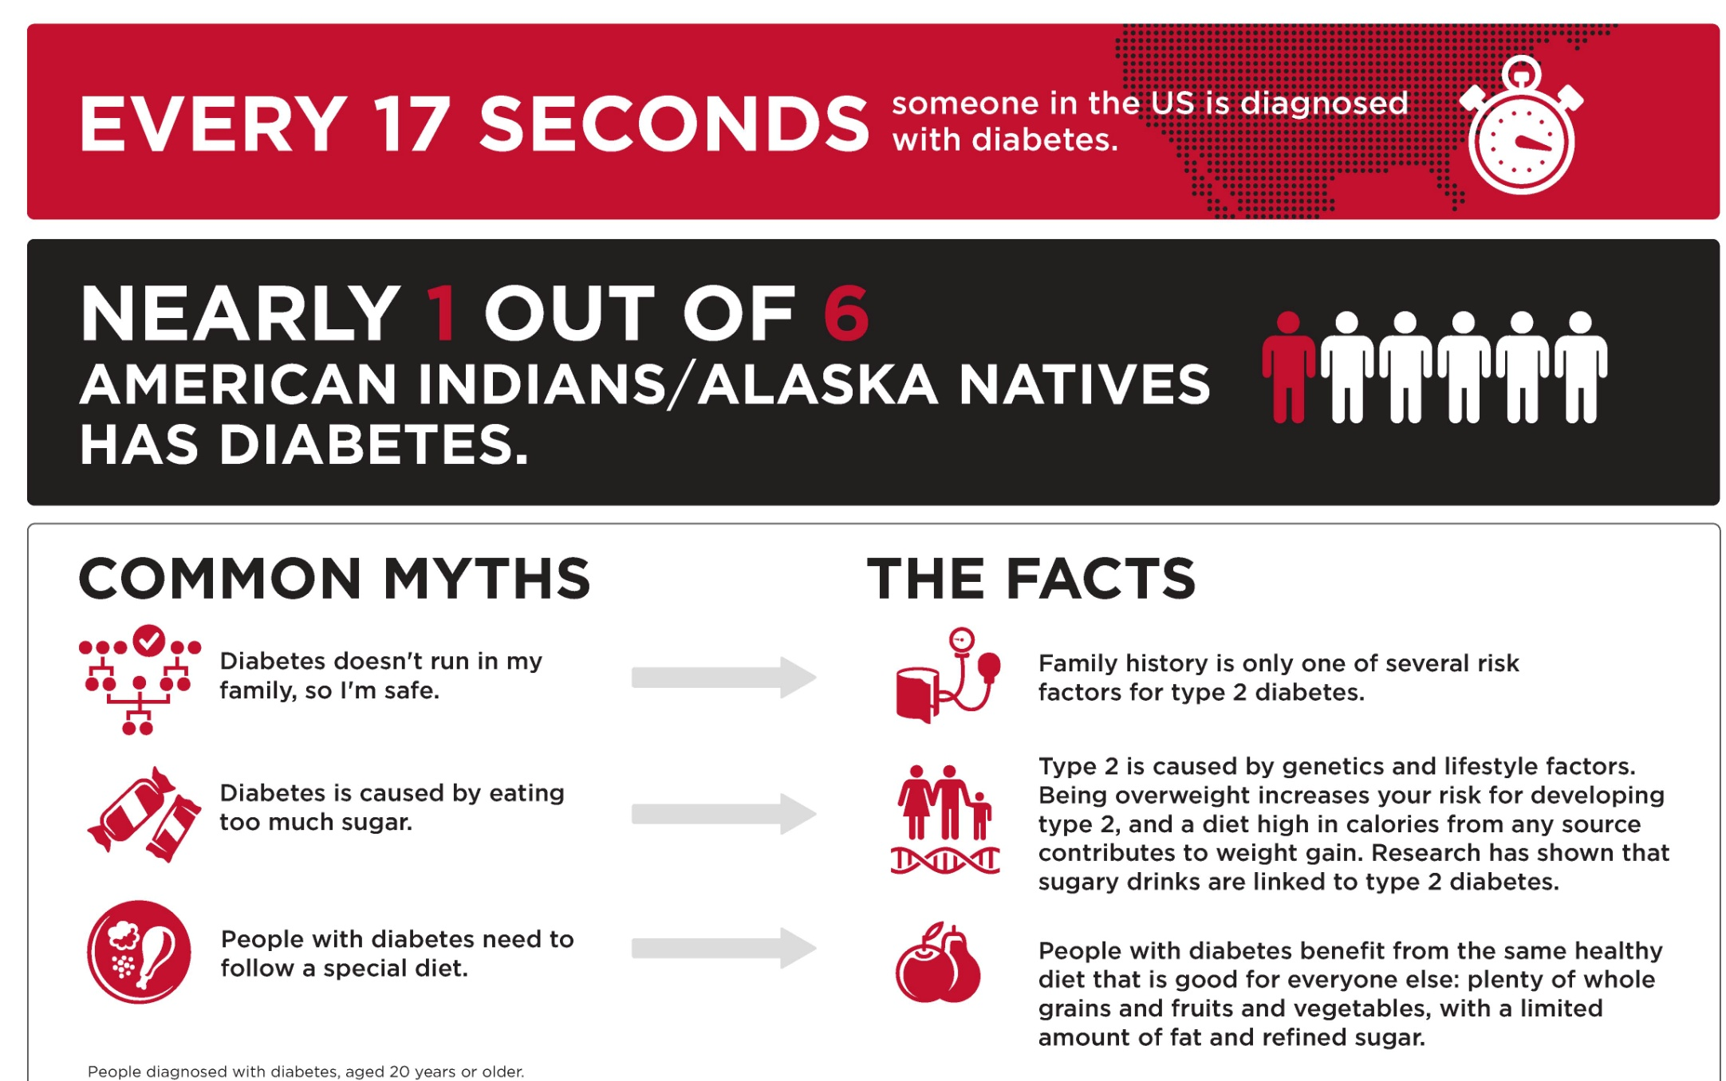
PARTICIPATE IN TYPE 2 DIABETES RESEARCH STUDIES
DDM2: 617-636-2834 D2d: 617-636-2842

Slide 3
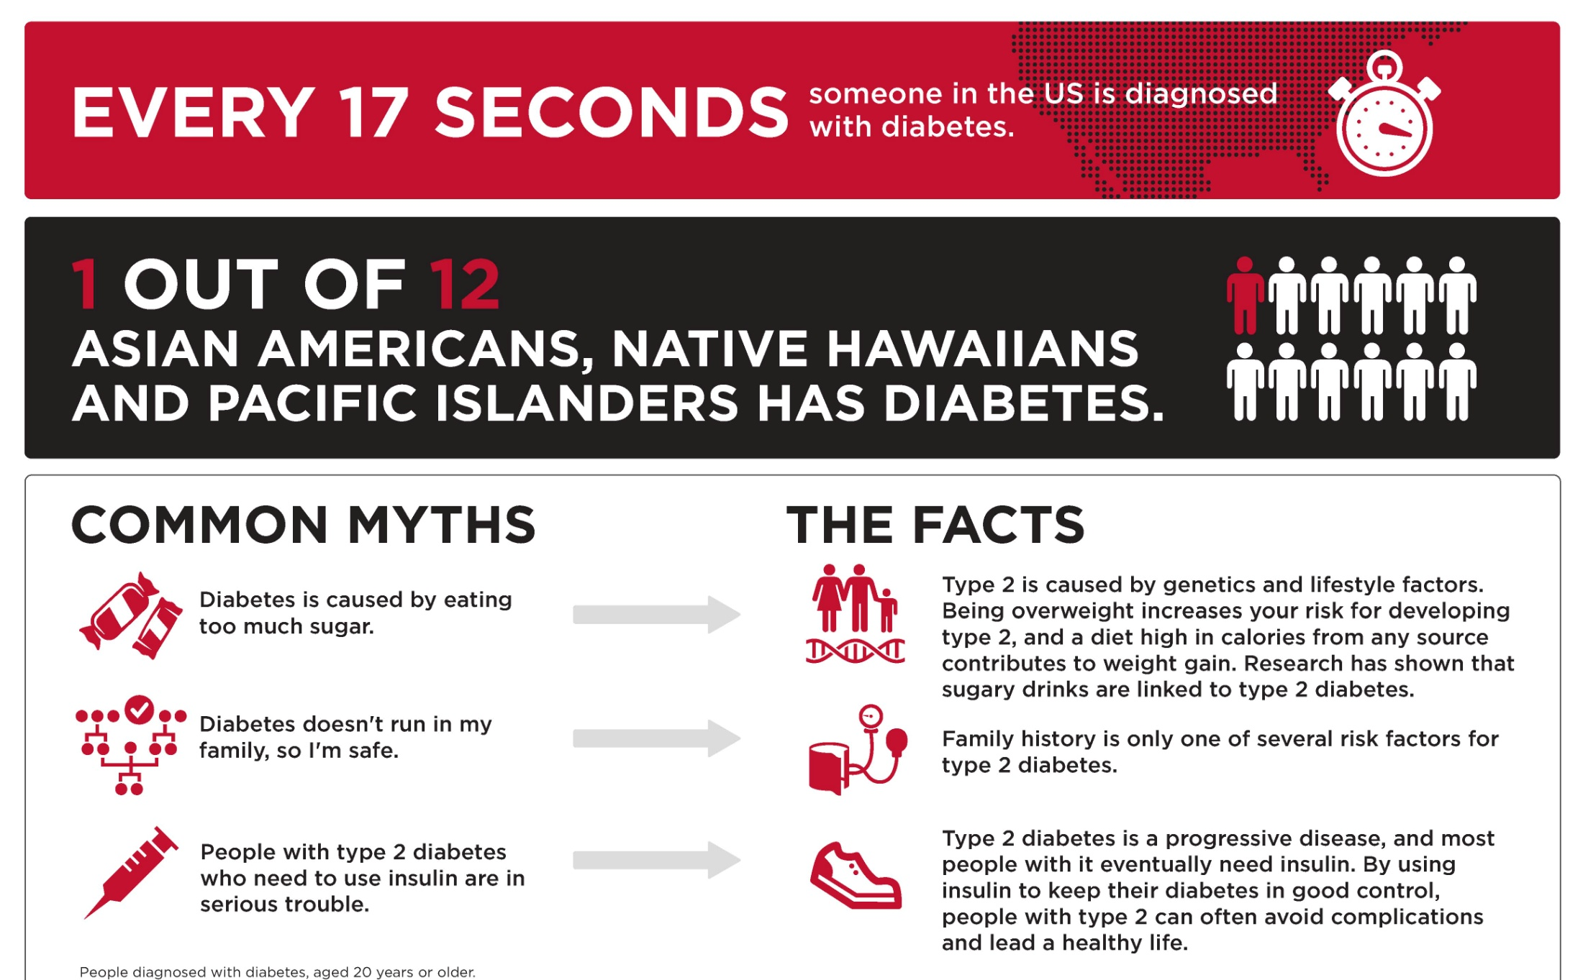
PARTICIPATE IN TYPE 2 DIABETES RESEARCH STUDIES
DDM2: 617-636-2834 D2d: 617-636-2842

Slide 4
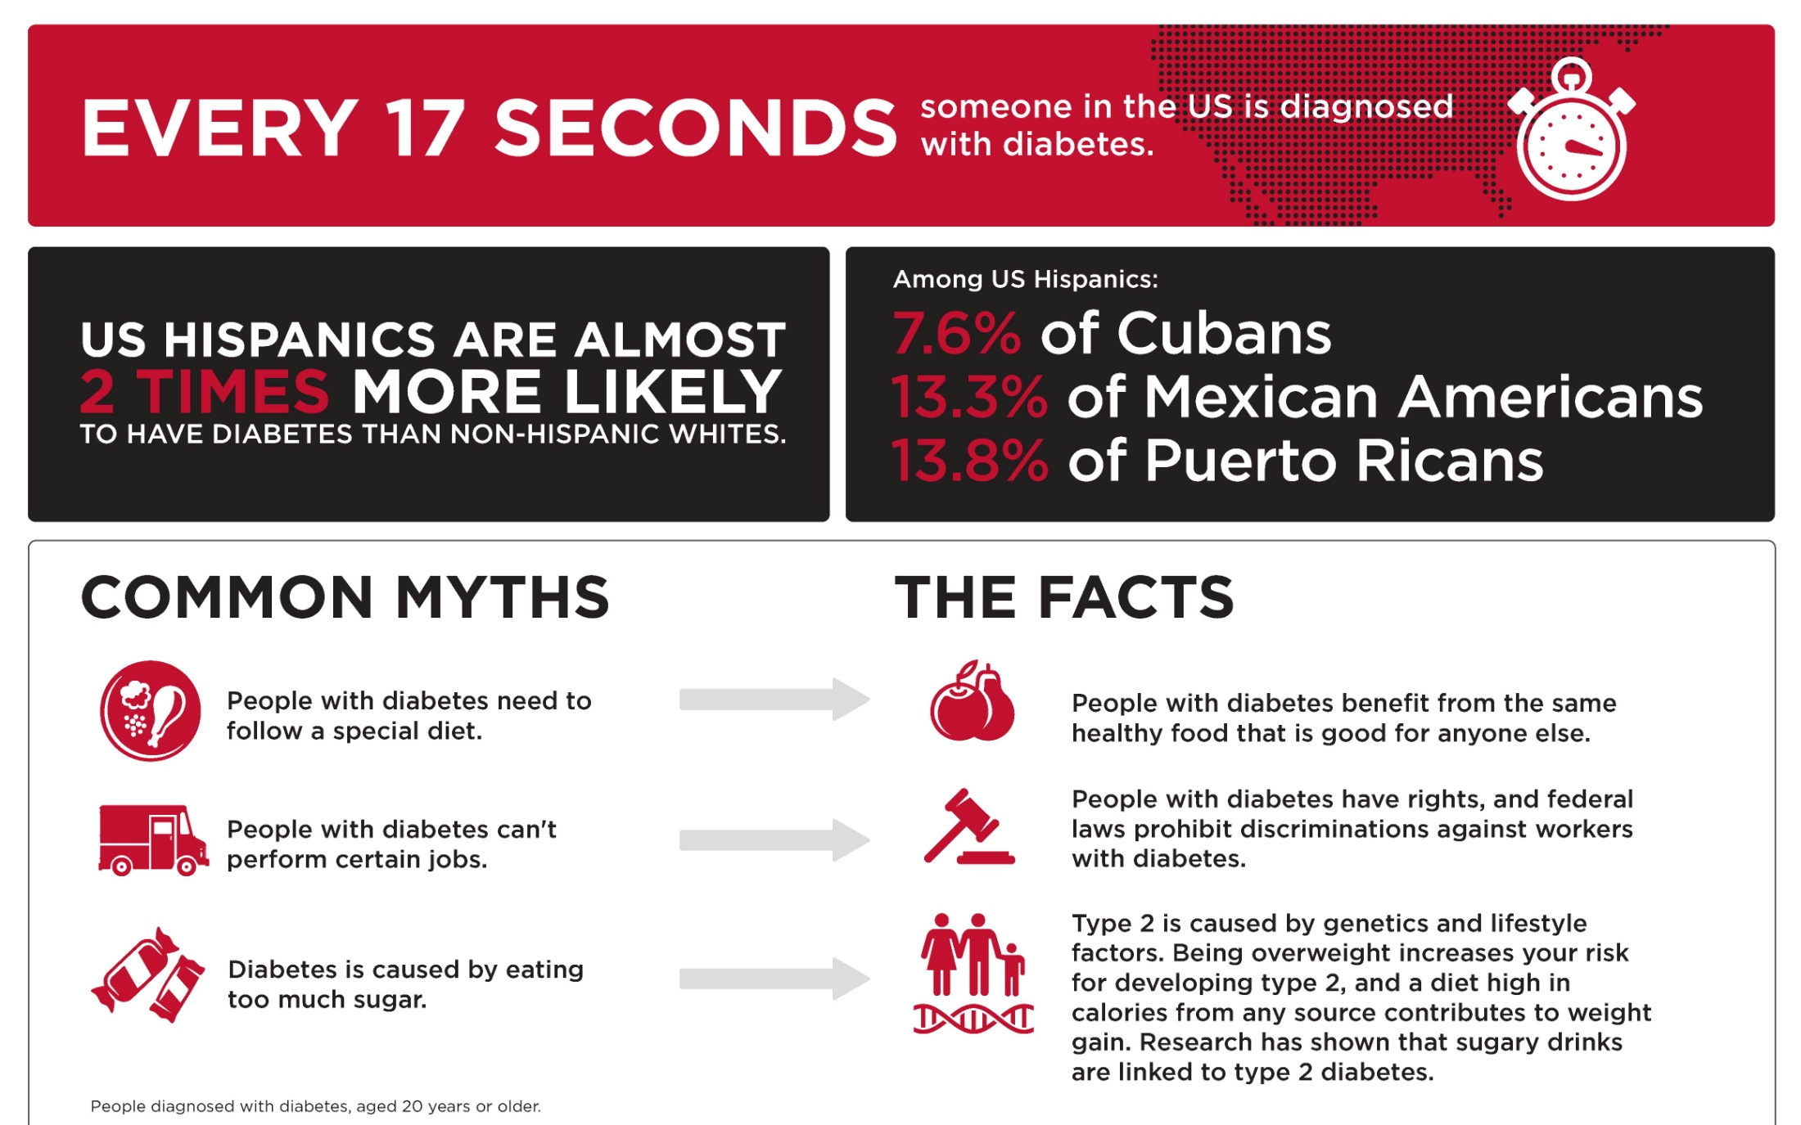
PARTICIPATE IN TYPE 2 DIABETES RESEARCH STUDIES
DDM2: 617-636-2834 D2d: 617-636-2842

Slide 5
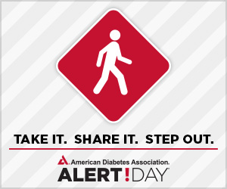
Nearly 26 million Americans have diabetes.
79 million more Americans have prediabetes.
1 in 3 adults will have type 2 diabetes by 2050.
DO SOMETHING. PARTICIPATE IN RESEARCH.

